Slide 1
Closetline® Packaged Heat Pumps

Slide 2
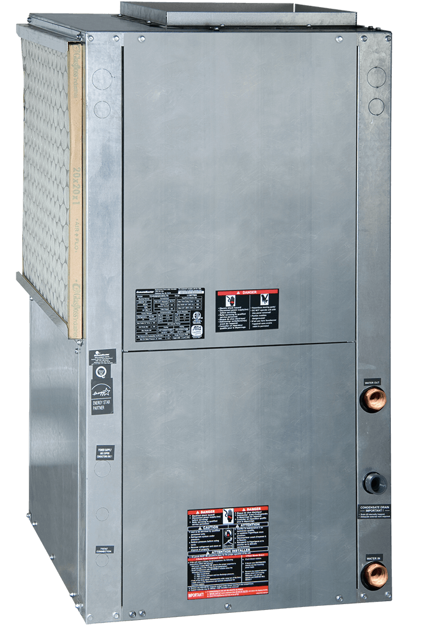
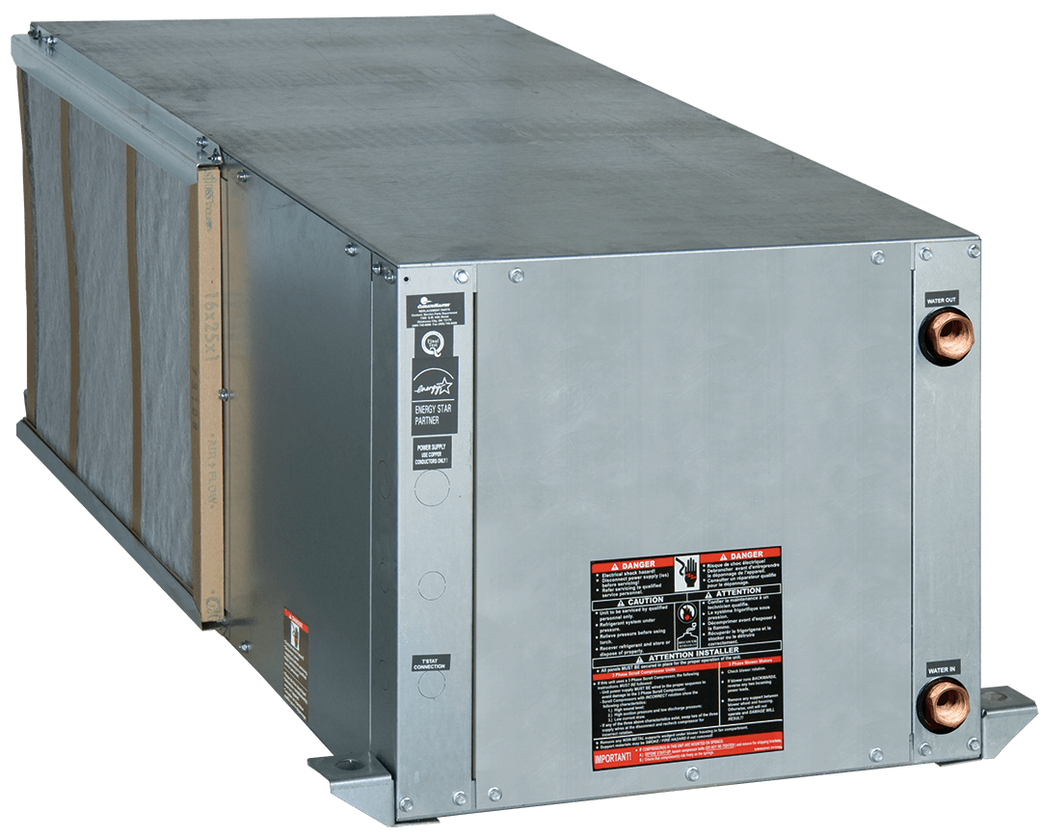
Closetline® Heat Pumps

Slide 3

Product line overview

Slide 4
Closetline® WC Compact Series
Capacity - 11 sizes: 0.5 to 5-ton
5 Voltages Available –
208-230/60/1
265/60/1
208-230/60/3
460/60/3
575/60/3
Compact Footprint
Single-stage operation

Slide 5
Closetline® WC Compact – EC Motor ratings

Slide 6
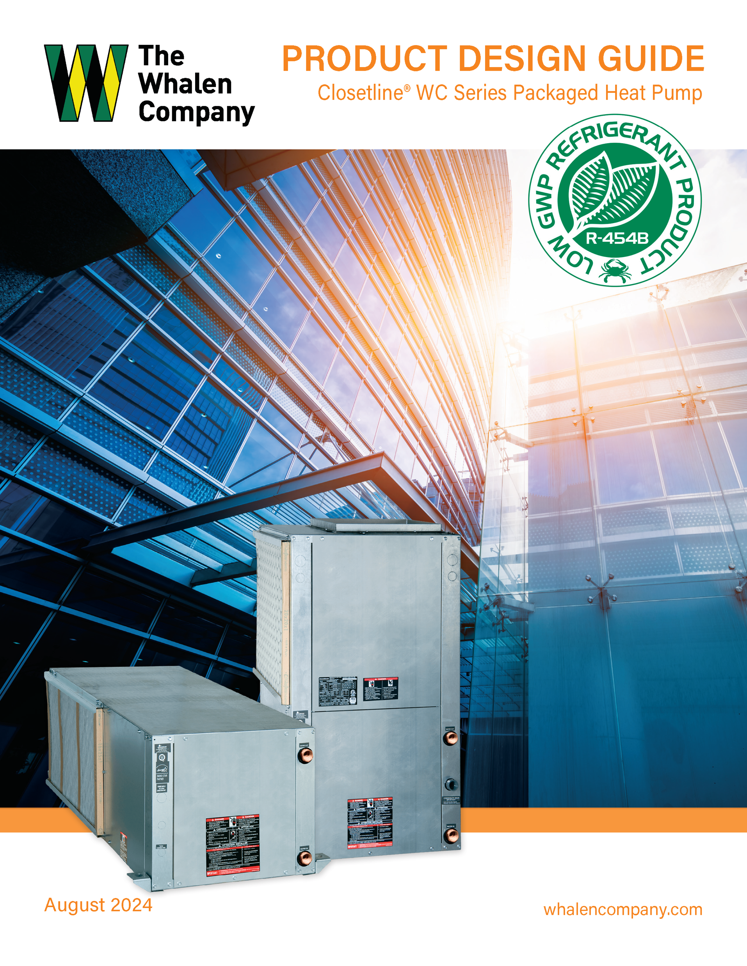
Closetline® WC Compact Series
Standard or Deluxe solid state control board
PSC or EC fan motors (high-static PSC motors are being phased-out)
Refrigerant Detection System (RDS)
Optional sizes 4 ton & below
Required sizes 5 ton & above
All valves are field installed in the hose kit.

Slide 7
Closetline® WC Compact Series Options
High efficiency ECM CV & CT motors blower motors
Deluxe solid-state controls
DDC Control board (BACnet, Modbus, and JCI N2)
Cupro-nickel water heat exchanger
Enhanced low sound package
Tin-plated air coils for added protection from formicary corrosion
Stainless-steel drain pans
Extended-range for geothermal applications
Electrical service disconnect

Slide 8
Closetline® WR Mid-Size Series
Capacity - 11 sizes: 0.5 to 5-ton
6 Voltages Available –
115-1-60
208-230/60/1
265/60/1
208-230/60/3
460/60/3
575/60/3
Mid-Size Cabinet Footprint
Single-stage operation

Slide 9
Closetline® WR Mid-Size – EC Motor ratings

Slide 10
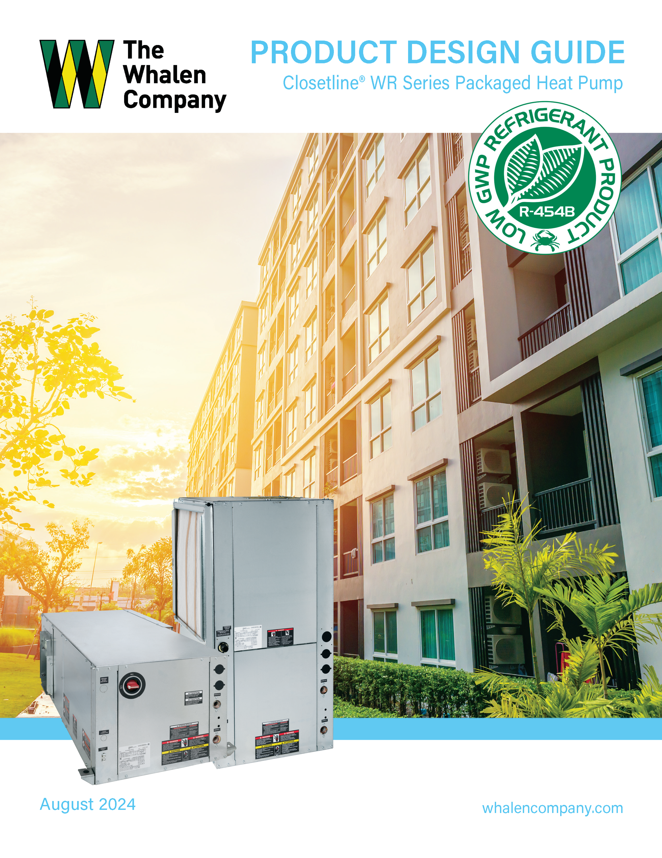
Closetline® WR Mid-Size Series
Standard or Deluxe solid state control board
PSC or EC fan motors (high-static PSC motors are being phased-out)
Refrigerant Detection System (RDS)
Optional sizes 4 ton & below
Required sizes 5 ton & above
Factory installed water options are available.

Slide 11
Closetline® WR Mid-Size Series Options
High efficiency ECM CV & CT motors blower motors
Deluxe solid-state controls
DDC Control board (BACnet, Modbus, and JCI N2)
Hybrid hydronic heating
Cupro-nickel water heat exchanger
Enhanced low sound package
Tin-plated air coils for added protection from formicary corrosion
Hot water generator
Internal circulators
Autoflow regulators
Motorized water valves
Stainless-steel drain pans
Internal electrical disconnect
Extended-range for geothermal applications
Electrical service disconnect
Waterside economizers

Slide 12
Closetline® WZ 2-Stage Mid-Size Series
Capacity - 6 sizes: 2 to 5-ton
3 Voltages Available –
208-230/60/1
208-230/60/3
460/60/3
Mid-Size Cabinet Footprint
Two-stage operation

Slide 13
Closetline® WZ 2-Stage – EC Motor ratings

Slide 14
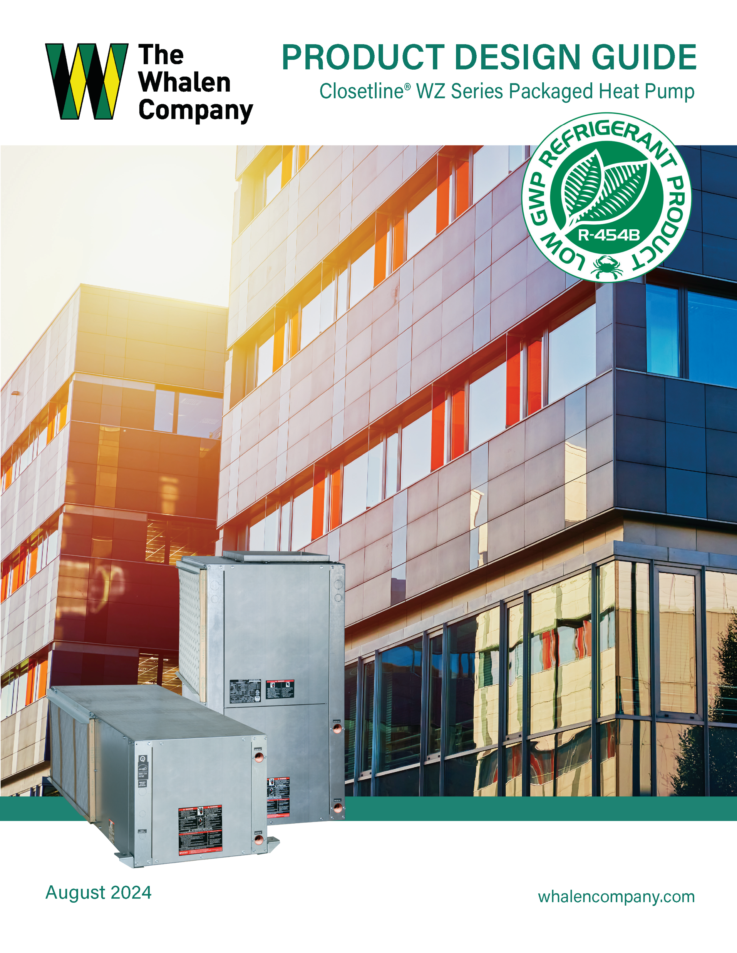
Closetline® WZ 2-Stage Mid-Size Series
Deluxe solid state control board
EC-CV fan motors
Refrigerant Detection System (RDS)
Optional sizes 4 ton & below
Required sizes 5 ton & above
Factory installed water options are available.

Slide 15

Closetline® WZ 2-Stage Mid-Size Series Options
DDC Control board (BACnet, Modbus, and JCI N2)
Hybrid hydronic heating
Cupro-nickel water heat exchanger
Enhanced low sound package
Tin-plated air coils for added protection from formicary corrosion
Hot water generator
On/off internal circulators
Variable speed Internal pumps
Modulating water valves
Internal electrical disconnect
Extended-range for geothermal applications
Electrical service disconnect

Slide 16
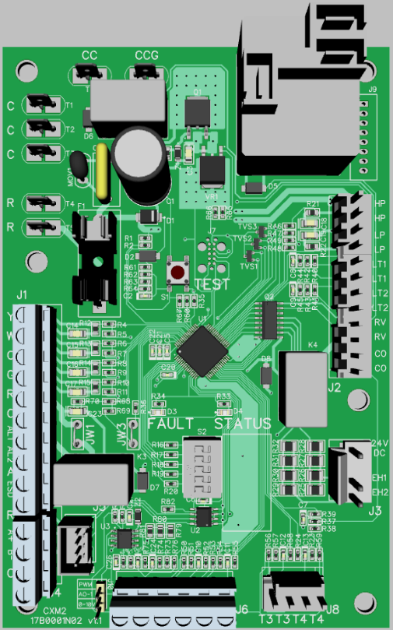
Standard Solid-State Control
Compressor
ECM Constant Torque
PSC (Single Stage)
Standard Control
Inputs:
Digital – 10
Analog – 7
Outputs:
Digital – 6
Analog – 1
Communications: 2
RS-485 (Modbus)
Serial
Add On Port:
Analog Outputs
uArt, SPI
Comms (LIN Bus)
Test Mode Button
On-board Fuse - CE
Safeties:
HP, LP, FP1, FP2
CO
24VAC Thermostat
Fault / Status LEDs
Aux Elec Heat
Alarm Relay
Modbus Comms
DIP Switch Bank
Loop Pump Options
Variable speed pump (PWM)
Modulating valve (0-10V)
Diagnostics Sensors
(EWT, LWT, LAT, CDT)

Slide 17
Control Safeties
Anti-short cycle time delay on compressor operation.
Low voltage protection.
High voltage protection.
Condensate overflow electronic protection.
Water coil low temperature sensing (selectable for water or anti-freeze).
Air coil low temperature sensing.
Entering and leaving water temperature sensing.
Compressor discharge temperature sensing.

Slide 18
Control Safeties
Emergency shutdown contacts.
Random start on power up mode.
Option to reset unit at thermostat or disconnect.
Automatic intelligent reset. Unit automatically resets 5 minutes after trip if the fault has cleared. If a fault occurs three times sequentially without thermostat meeting temperature, then lockout requiring manual reset will occur.
Ability to defeat time delays for servicing.
The low-pressure switch is not be monitored for the first 120 seconds after a compressor start command to prevent nuisance safety trips.
24V output to cycle a motorized water valve or other device with compressor contactor.

Slide 19
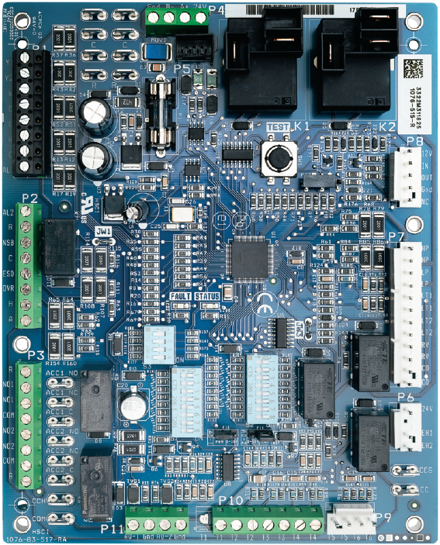
Deluxe Solid-State Control
Modbus Comms
HWG
ECM Constant Torque
PSC (Single Spd; 2-Spd)
On-board Fuse - CE
Deluxe Control
Inputs:
Digital – 13
Analog – 8
Outputs:
Digital – 10
Analog – 2
Communications: 2
RS-485 (Modbus)
ClimateTalk (Emerson)
24VAC Thermostat
Test Mode Button
Alarm Relay
Constant Volume ECM
Fault / Status LEDs
Safeties:
HP, LP, LT1, LT2
CO
Accessory Relays:
*Cycle with Fan
OA Damper
Water Valve
WSE
Digital NSB
Dehumidification
*Cycle with Compressor
Humidifier
Aux Elec Heat
DIP Switch Banks
2nd Stage Compressor
1st Stg Compressor
Loop Flow Options
Variable speed pump (PWM)
Modulating valve (0-10V)
Dehumidification pump
Diagnostics Sensors
(EWT, LWT, LAT, CDT)
VFD Blower

Slide 20
Deluxe control features
Same safeties as the standard control plus….
Boilerless system heat control at low loop water temperature.
Ability to allow up to three units to be controlled by one thermostat.
Relay to operate an external damper.
Relay to start system pump.
75VA control transformer. Control transformer shall have load side short circuit and overload protection via a built-in circuit breaker.

Slide 21
Solid-State Control Comparison

Slide 22
Minimum Installation Area – WC/WR/WZ 060
Minimum area where a blower-equipped unit must be installed, and mechanical / natural ventilation is not required

Slide 23
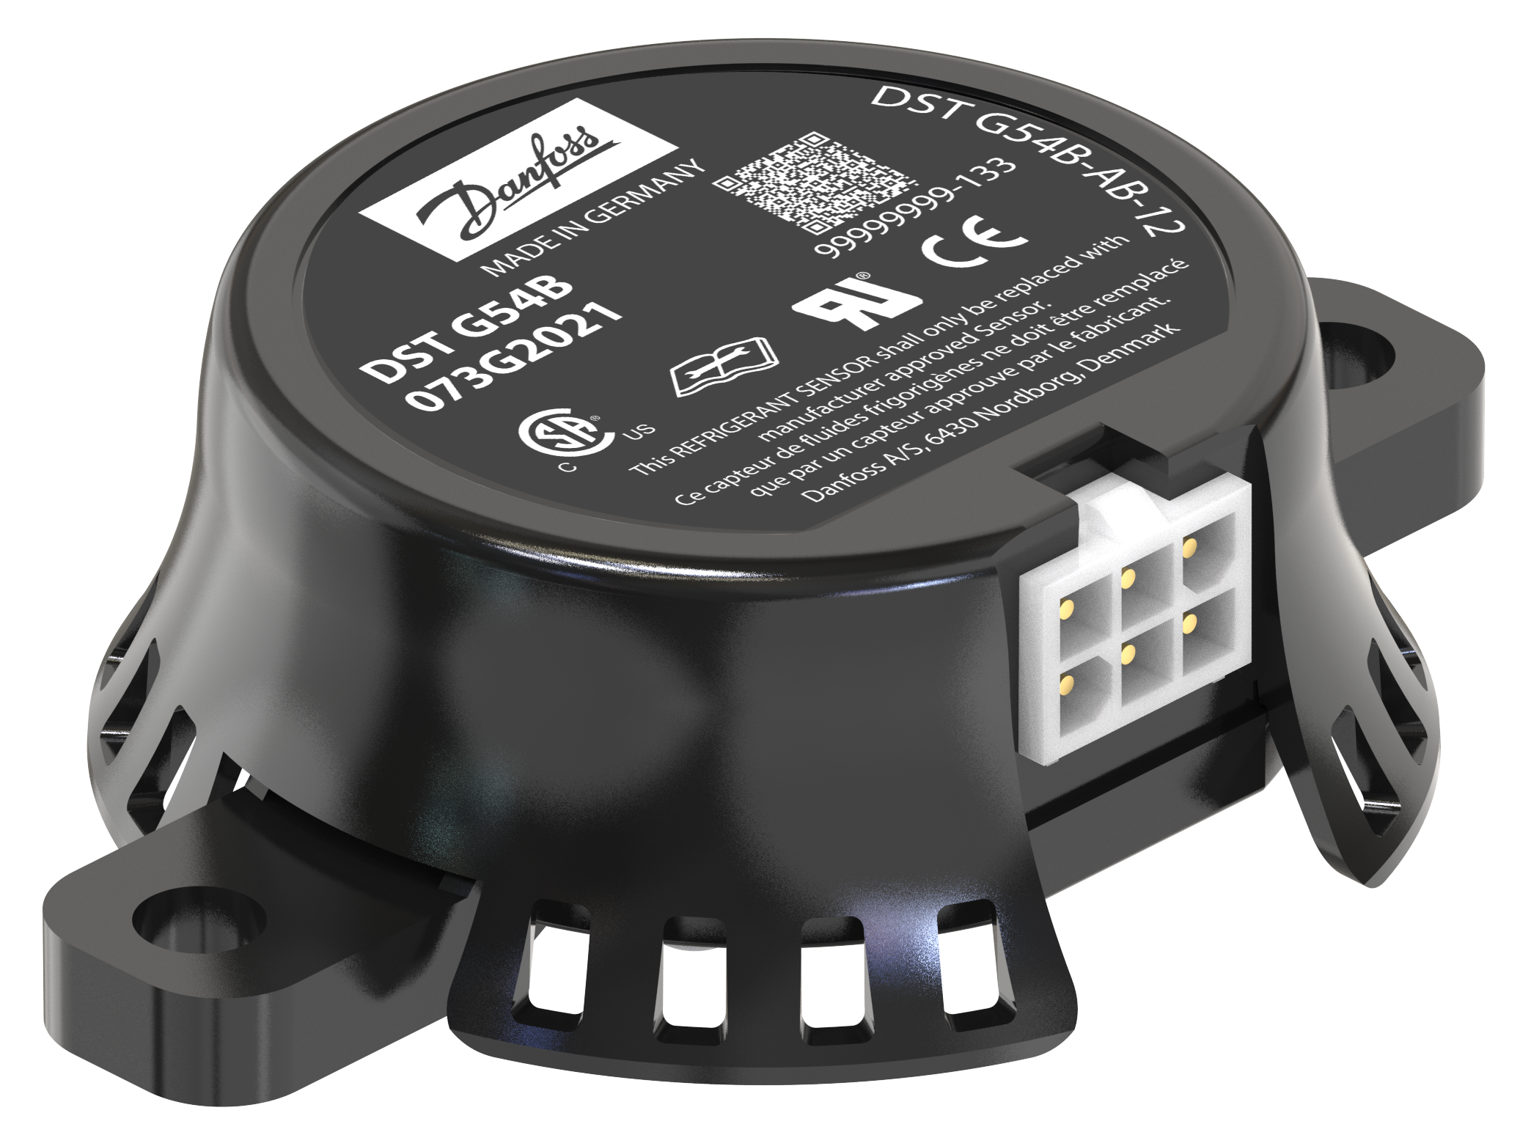
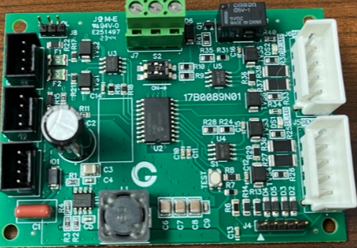
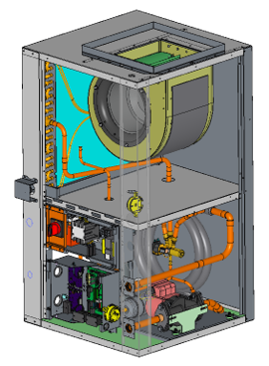
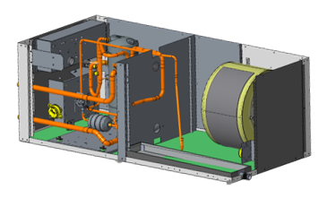
Refrigerant Detection System
Upon leak detection the system shuts down compressor operation & runs the fan to disperse any concentration of leaked refrigerant
RDS Includes:
2 sensors per board​
Sensor connector is unique​
Multiple power supply for redundancy
No field adjustments or calibration during 15+ year life
Sensors

Slide 24
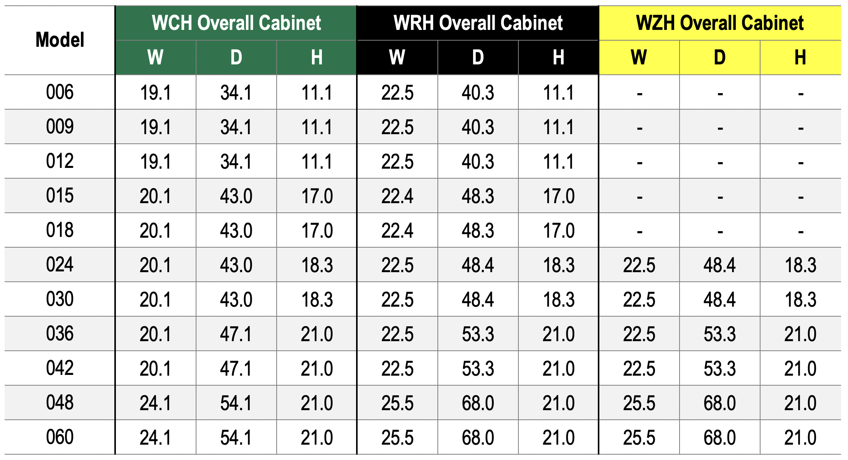
Horizontal Unit Dimension Comparison

Slide 25
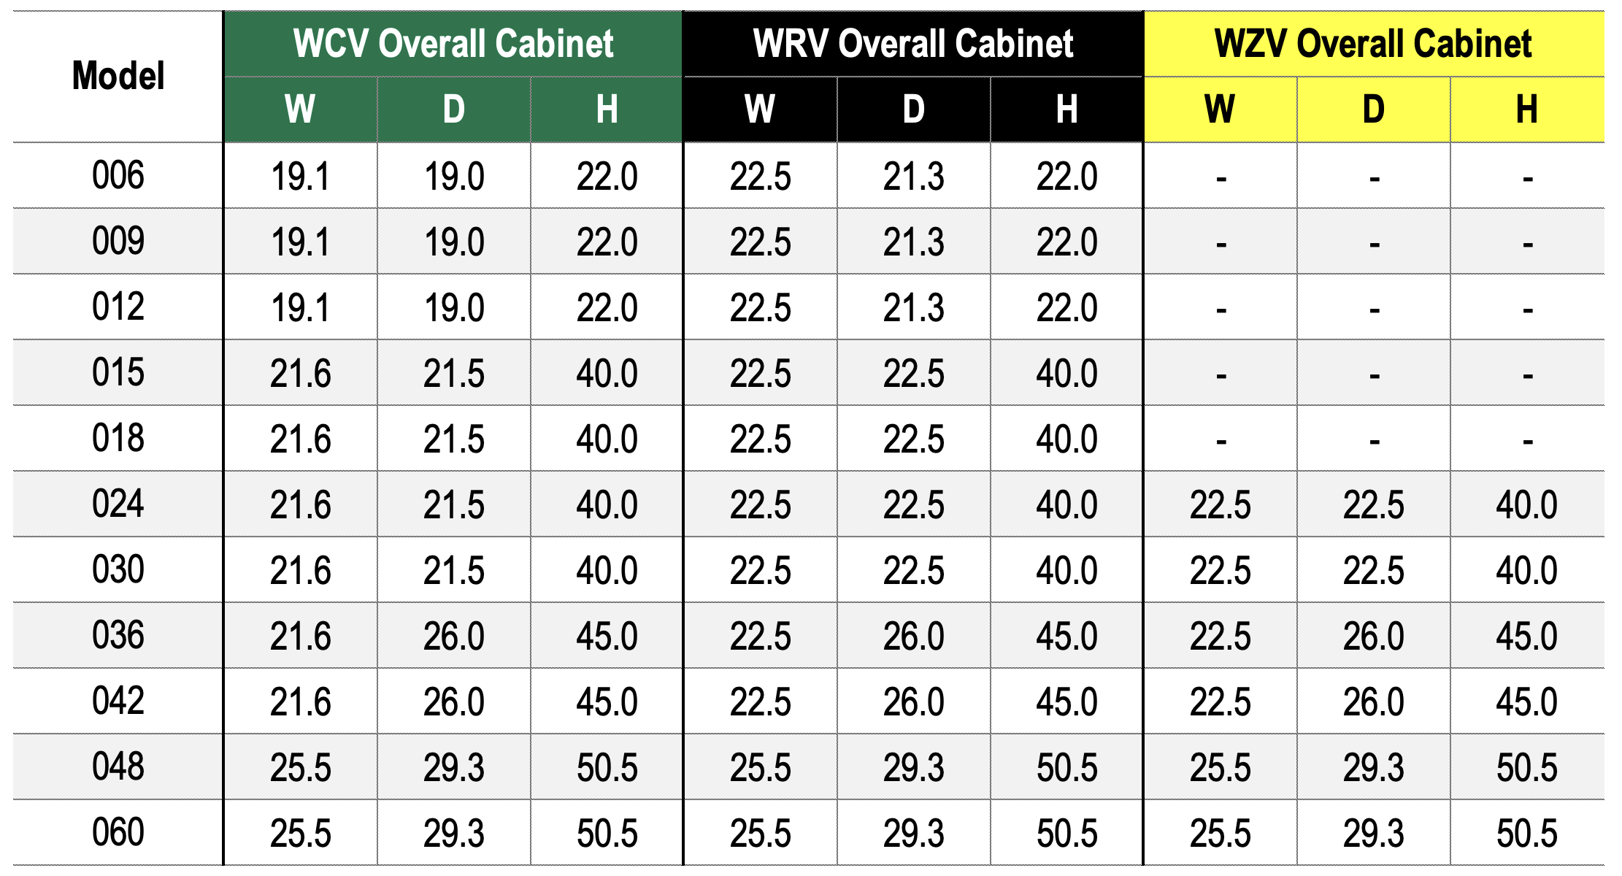
Vertical Unit Dimension Comparison

Slide 26
Questions?
Notes:
26

