Slide 1
Fan Coil Products

Slide 2
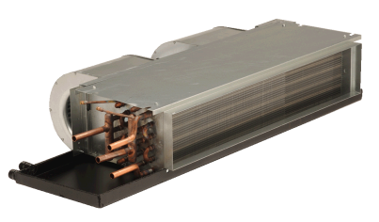
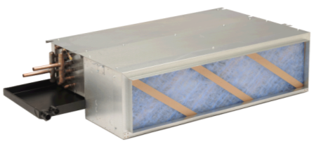
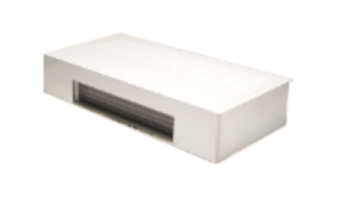

HC Series - Horizontal Fan Coils
Horizontal Ceiling
200 – 1,200 CFM
2 pipe or 4 pipe
Electric Heat - 0.5 to 7kW
PSC or EC motor options
  EC, Constant Torque, Constant Airflow, Modulating 2-10 VDC
Up to 0.25 ESP
1 to 6-row coil options
Coils can be DX, Hydronic, or Steam (heating)
Uncased, plenum, telescoping recessed, and painted exposed cabinet options
FR
PR
RF
EF

Slide 3
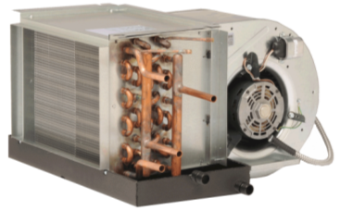
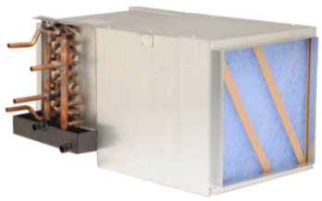
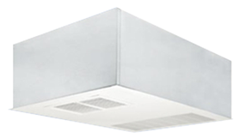
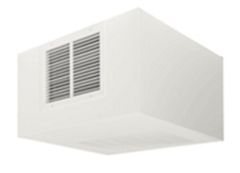
HP Series - Horizontal Fan Coils
High Performance
600 – 2,200 CFM
2 pipe or 4 pipe
Electric Heat - 0.5 to 9kW
PSC or EC motor options
  EC, Constant Airflow, Modulating 2-10 VDC
Up to 0.50 ESP
1 to 6-row coil options
Uncased, plenum, telescoping recessed, and painted exposed cabinet options
FR
PR
RF
EF

Slide 4
HC/HP Series – Feature & Benefits
Valve package selection will automatically extend the drain pan a minimum of 6 inches.
Standard cabinet is 18ga.
Standard Molex plug on motor for quick removal.
Optional fused or unfused disconnect.
Default is right hand configuration for piping and left hand for electrical (configured at time of order). Looking at SA, handing is determined with air hitting in face.
Can do custom color on exposed and painted panels with minimum of 10 units.

Slide 5
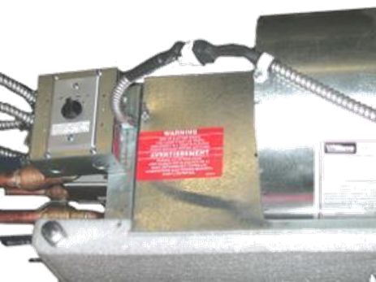
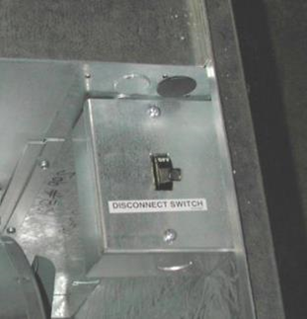
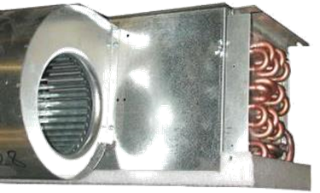
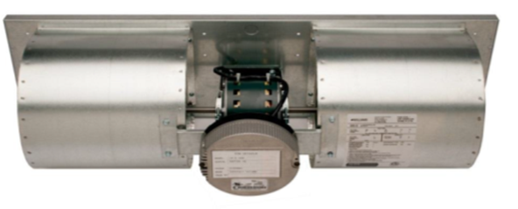
HC/HP Series – Feature & Benefits
Molex Connection
Disconnect switch
Unit mounted 3-speed switch w/ off
Model Identification Label
Wings Nuts for Easy Removal of Blower Assembly

Slide 6
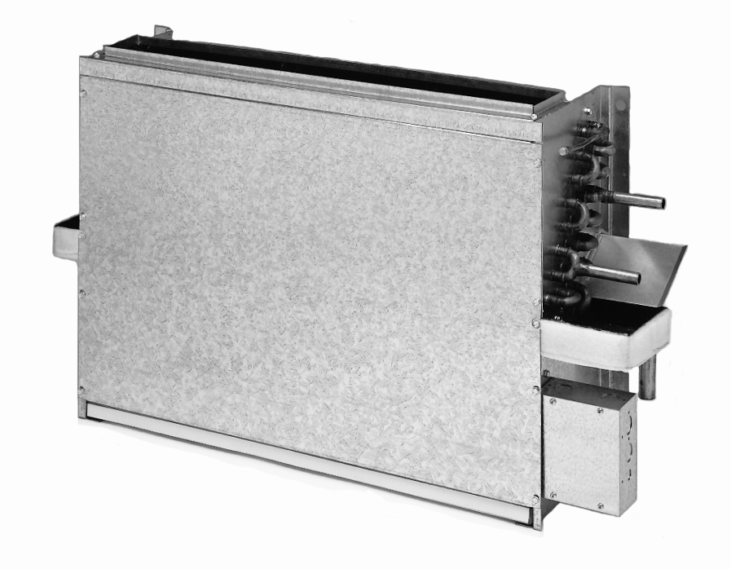
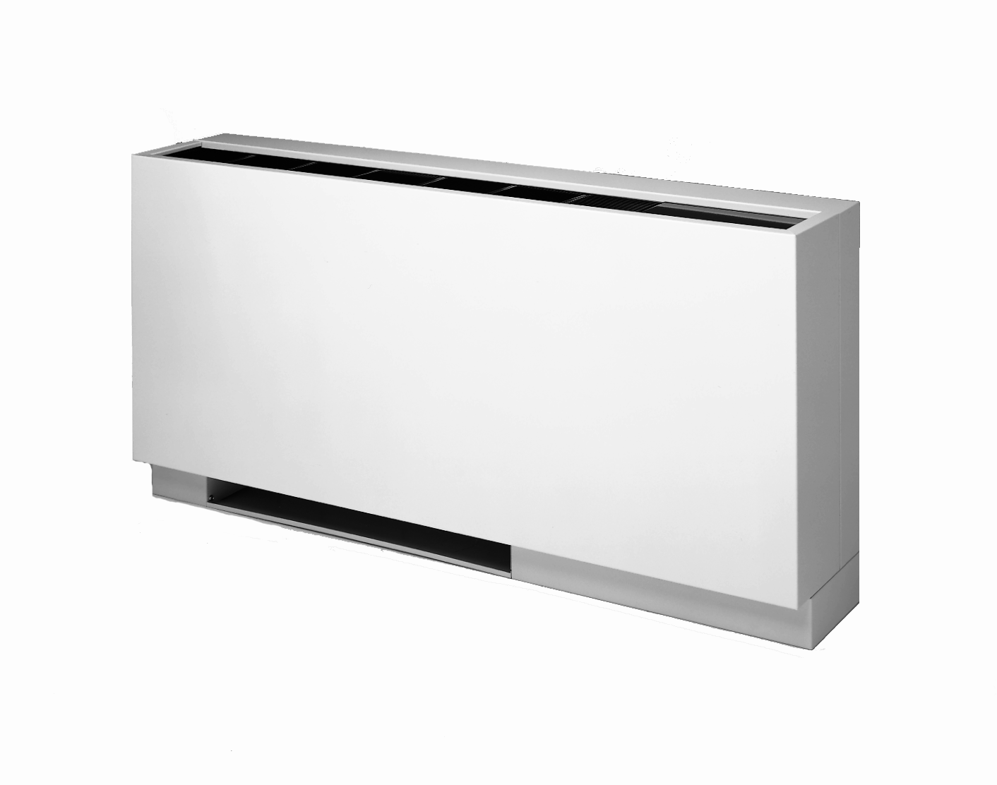
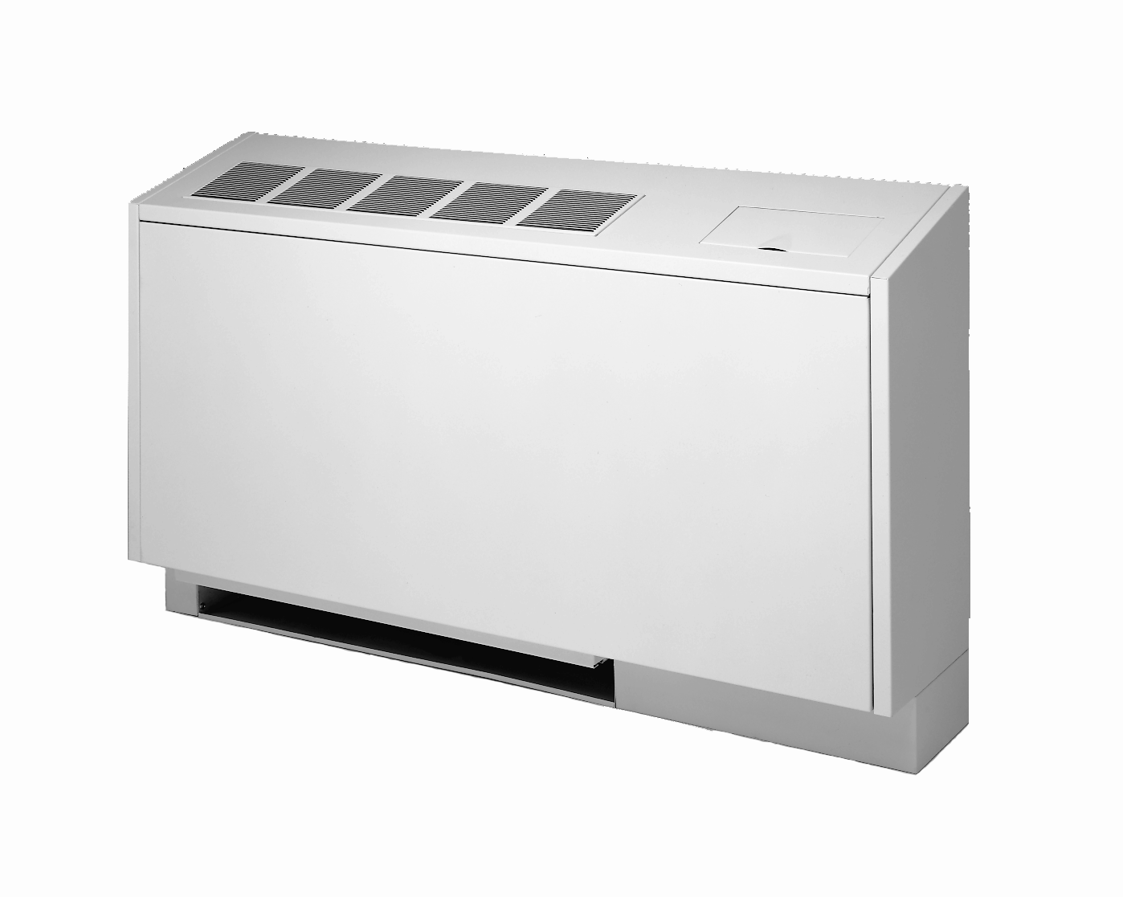
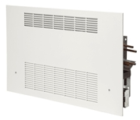
VW Series –Vertical Console Fan Coils
Vertical Wall Mount
200 to 1200 CFM
2 pipe or 4 pipe
Electric Heat – 1 to 6kW
PSC or EC motor options
  EC, Constant Torque, Constant Airflow, Modulating 2-10 VDC
Up to 0.15 ESP
1 to 5-row coil options
Concealed, wall recessed, flat top, and sloped top
CS
FT
ST
RG

Slide 7
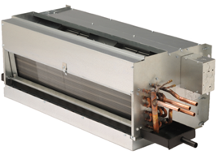
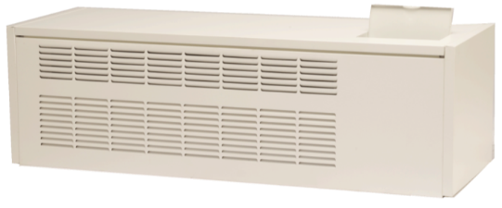
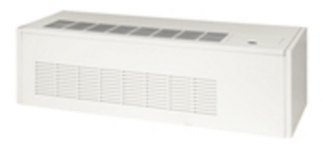
VW Series – Vertical Lowboy Fan Coils
Vertical Lowboy Wall Mount
400 to 600 CFM
2 pipe or 4 pipe
Electric Heat – 0.5 to 6kW
PSC Motors
Up to 0.15 ESP
1 to 4-row coil options
Exposed, wall recessed, front discharge, and top discharge
Can do custom cabinet extensions to accommodate retrofit applications.
LR
LF
LT

Slide 8
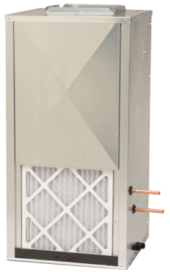
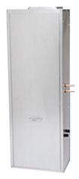
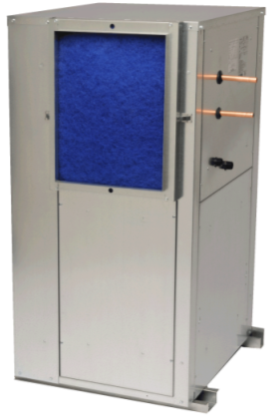
VC Series - Vertical Fan Coils
Vertical Closet
600 to 2,200 CFM
2 pipe or 4 pipe
Electric Heat - 0.5 to 9kW
Slide-out motor / blower assembly
PSC or EC motor options
  EC, Constant Airflow, Modulating 2-10 VDC
Up to 0.50 ESP
1 to 6-row coil options
Front, Bottom, or Rear return / Bottom supply
FS
BS
RS

Slide 9
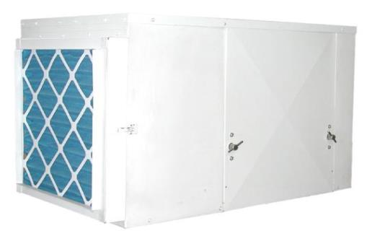
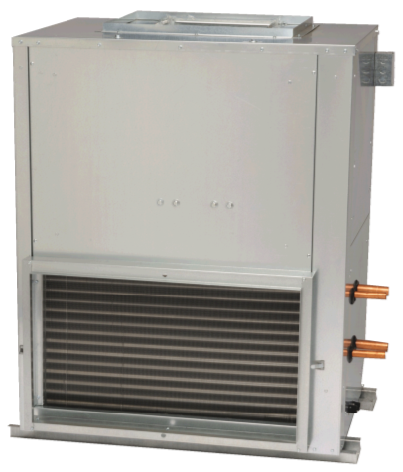
AH Series – Belt Drive Fan Coils
Air Handler
800 to 12,000 CFM
2 pipe or 4 pipe
Electric Duct Heat – up to 45kW (Shipped Loose)
EPAct Compliant, VFD ready motors
Up to 10HP motor options with adjustable pitch sheave (factory set)
Up to 3.75 ESP
1 to 10-row coil options
Single or optional double wall cabinet design
  Solid or perforated liner
HP
VS

Slide 10
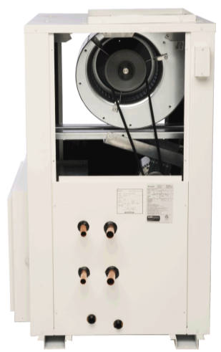
AH Series – Features & Benefits
Quarter-turn door latches
Mixing box
24V motorized controls
2-position or Modulating dampers
V-Bank filter rack
2” Filters and 4” filter brackets
Valve package enclosures
Water resistant cabinets
Rainhoods

Slide 11
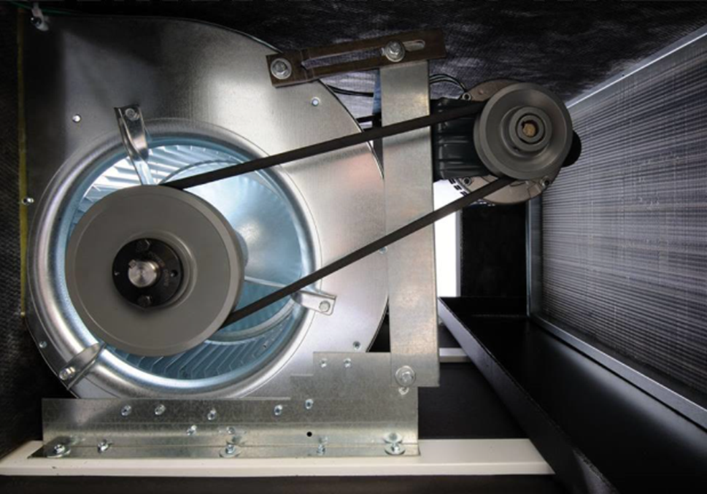
AH Series-Cast Iron Pulley w/ Sheave

Slide 12
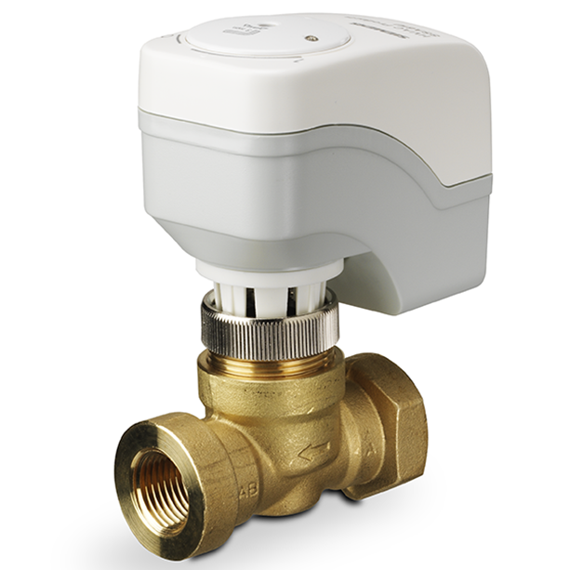
Valve Package - Options
Valve Package
  2-Way & 3-Way Valves (Brand: 599-01100 Siemens)
    Motorized (on/off)
    Modulating
      Proportional 0-10VDC, 2-10 mA
      Floating Point
    Standard Sweat Connections, Optional Threaded Connections
  Auto Flow Control
  Pressure Temperature / Test Ports / Pete’s Plugs

Slide 13
Valve Package - Options
Valve Package
  Ball Valves
    Optional Memory Stop
  Stainless Steel Hose Kits
    12”, 24” and 36”
  Unions
  Y-Strainer with Cleanout
  Factory installed valves and components on direct drive. Belt drive ship loose for field install.

Slide 14
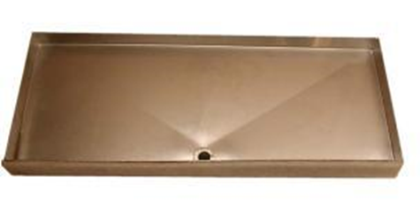
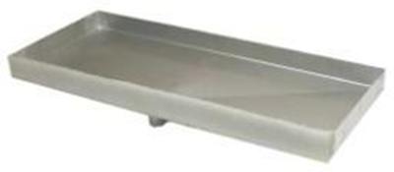
Drain Pan - Options
Drain Pans
  Galvanized (Standard)
  Optional Stainless Steel
  Extended
  Removable
  Insulation (3/8” thickness)
    Closed cell

Slide 15
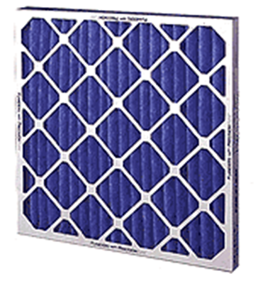
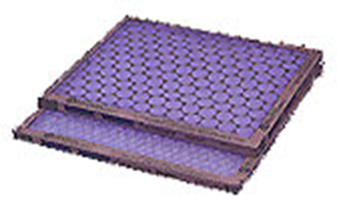

Air Filter - Options
Air Filters
  1” Standard throwaway MERV 4
  2” throwaway MERV 4
  1” and 2” Pleated MERV 8
  Washable
  1” and 2” Pleated MERV13 available for Belt Drive units only

Slide 16
Questions?
Notes:
16

