Slide 1

Integrated Sales Center (ISC) Overview

Slide 2
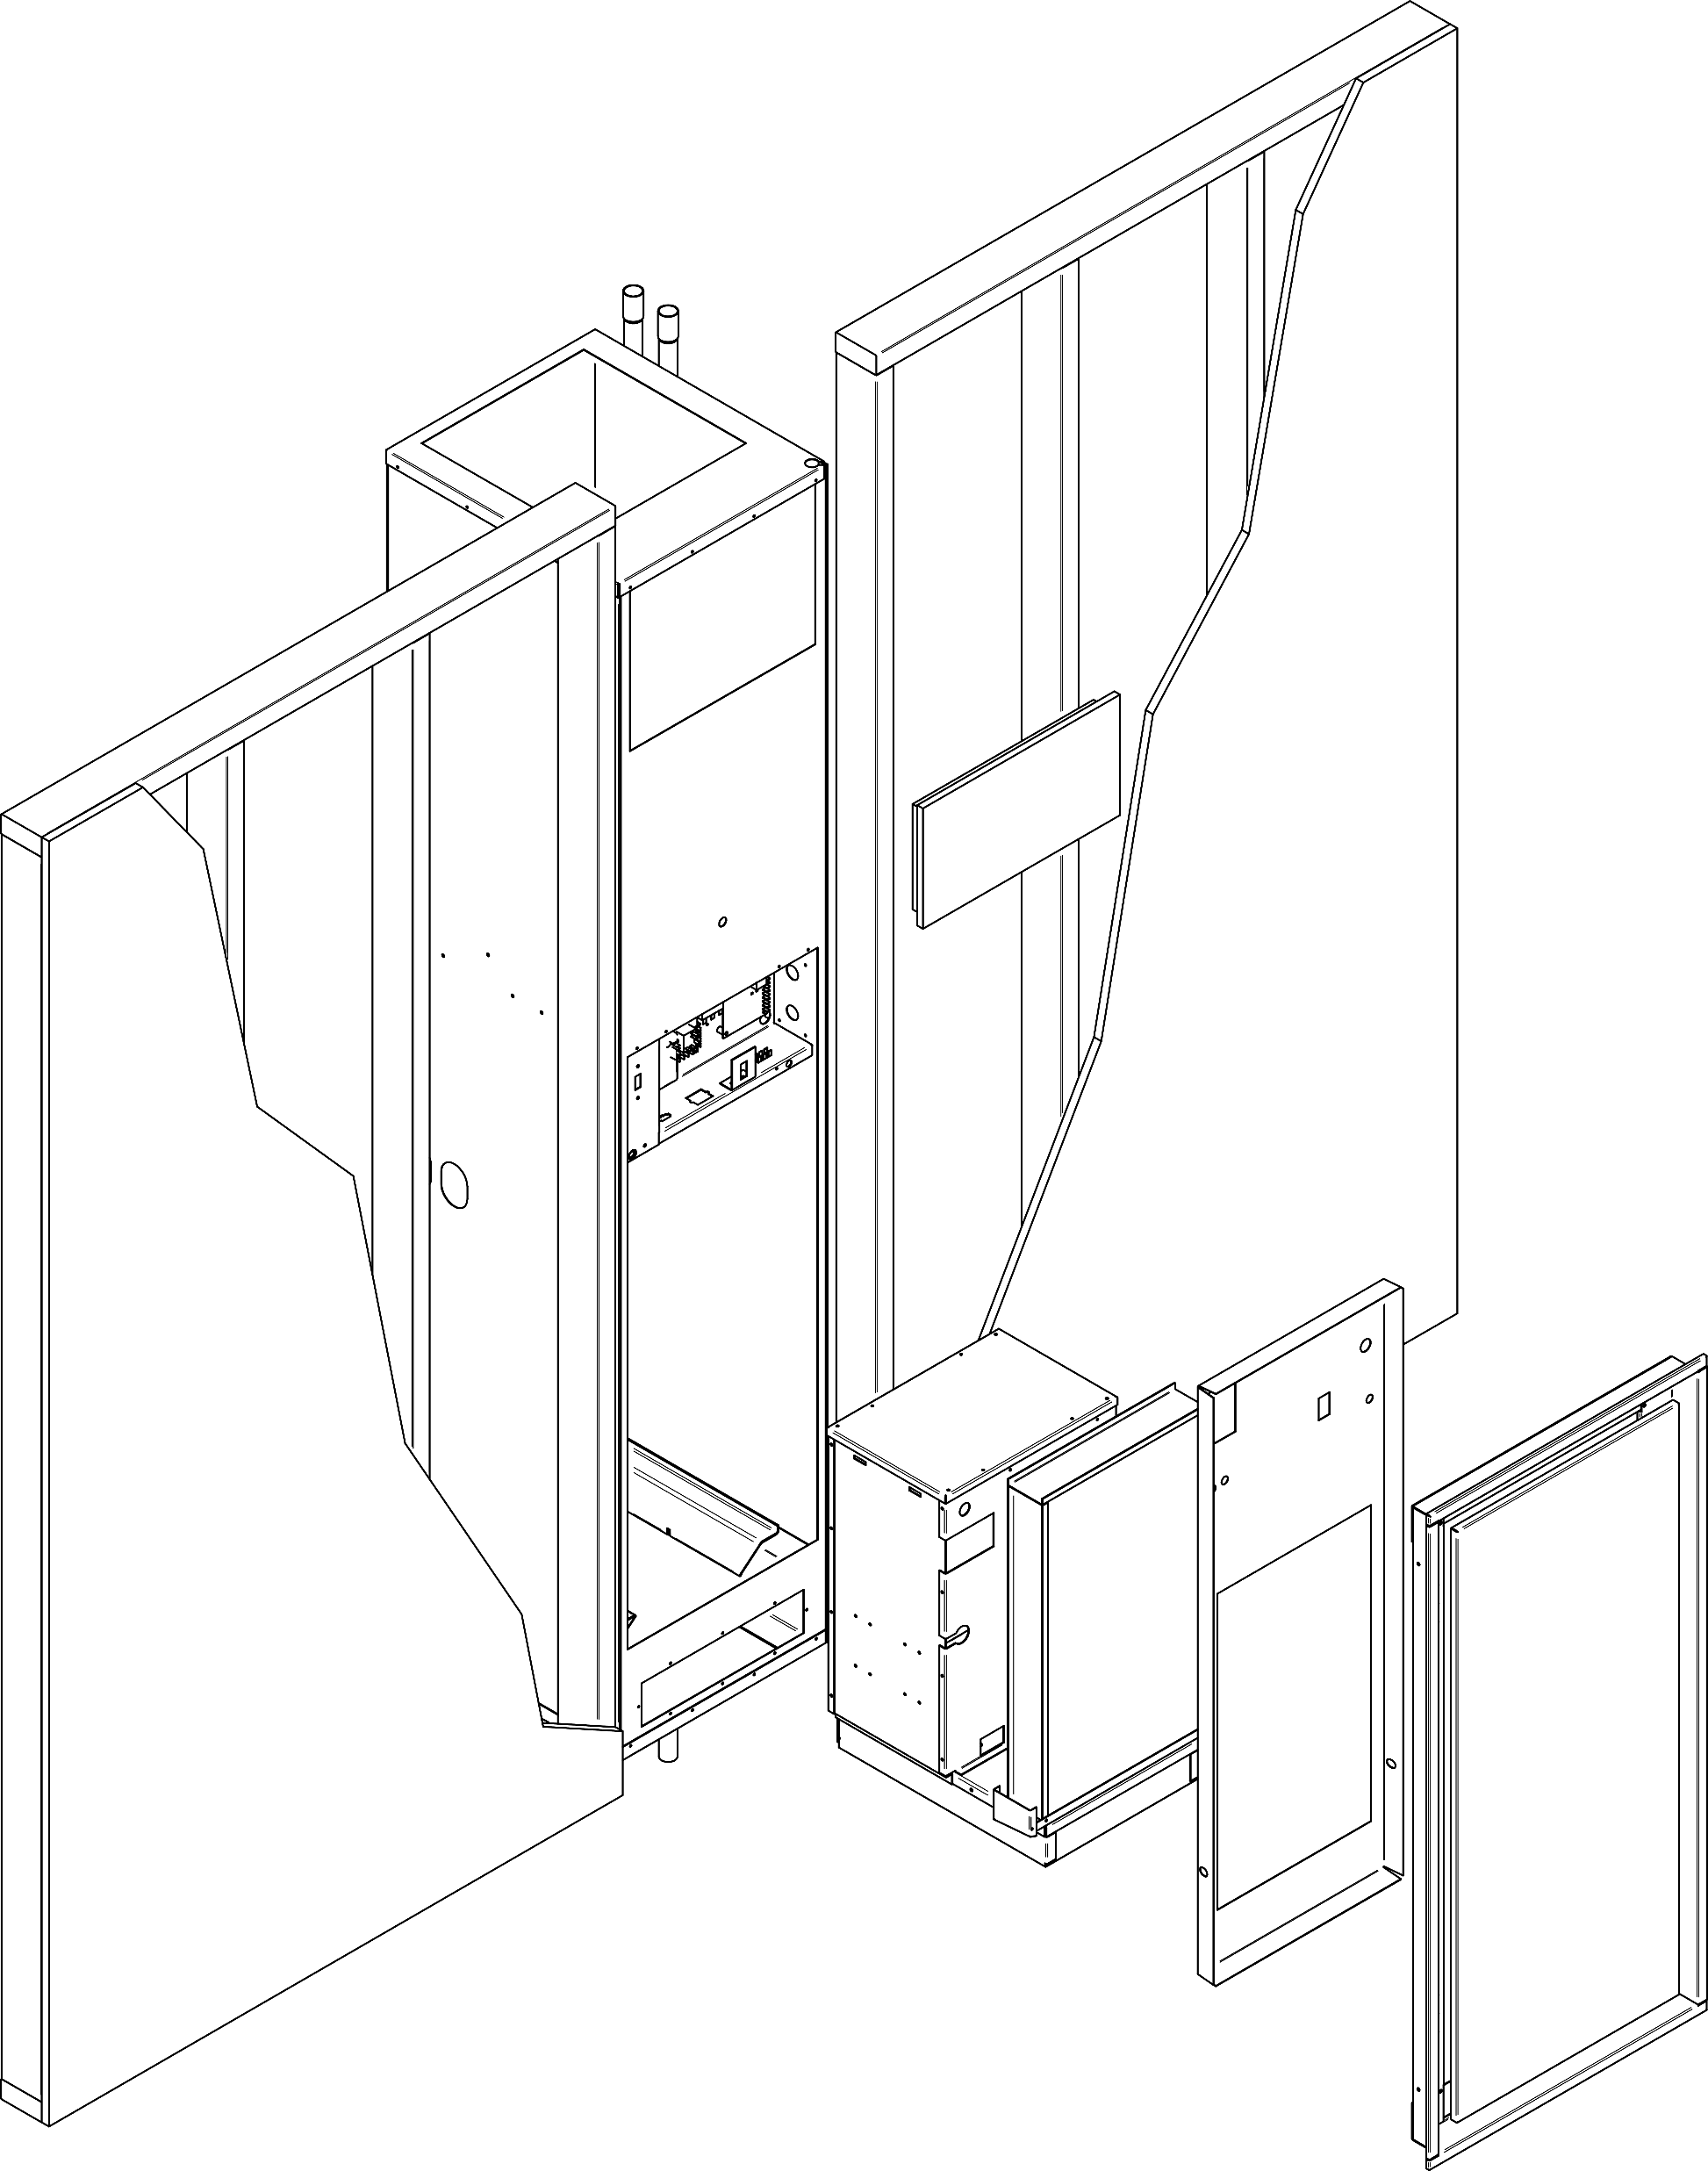
Vertical Stack Assembly
Supply / Return Risers
Room Wall Assembly
Vertical Stack Cabinet
Assembly process
Cabinet / Refrigeration chassis – Product Family
Risers – Specific to each Product Family
Return air sound panel - Accessory
Hose kit - Accessory
Thermostat - Accessory
Supply air grille – Accessory
Everything must be added!
Nothing is included with the unit. Even if required to operate.
Supply Grille
Refrigeration Chassis
Insulated Sound Reducing Panel
Cabinet Inner Panel

Slide 3
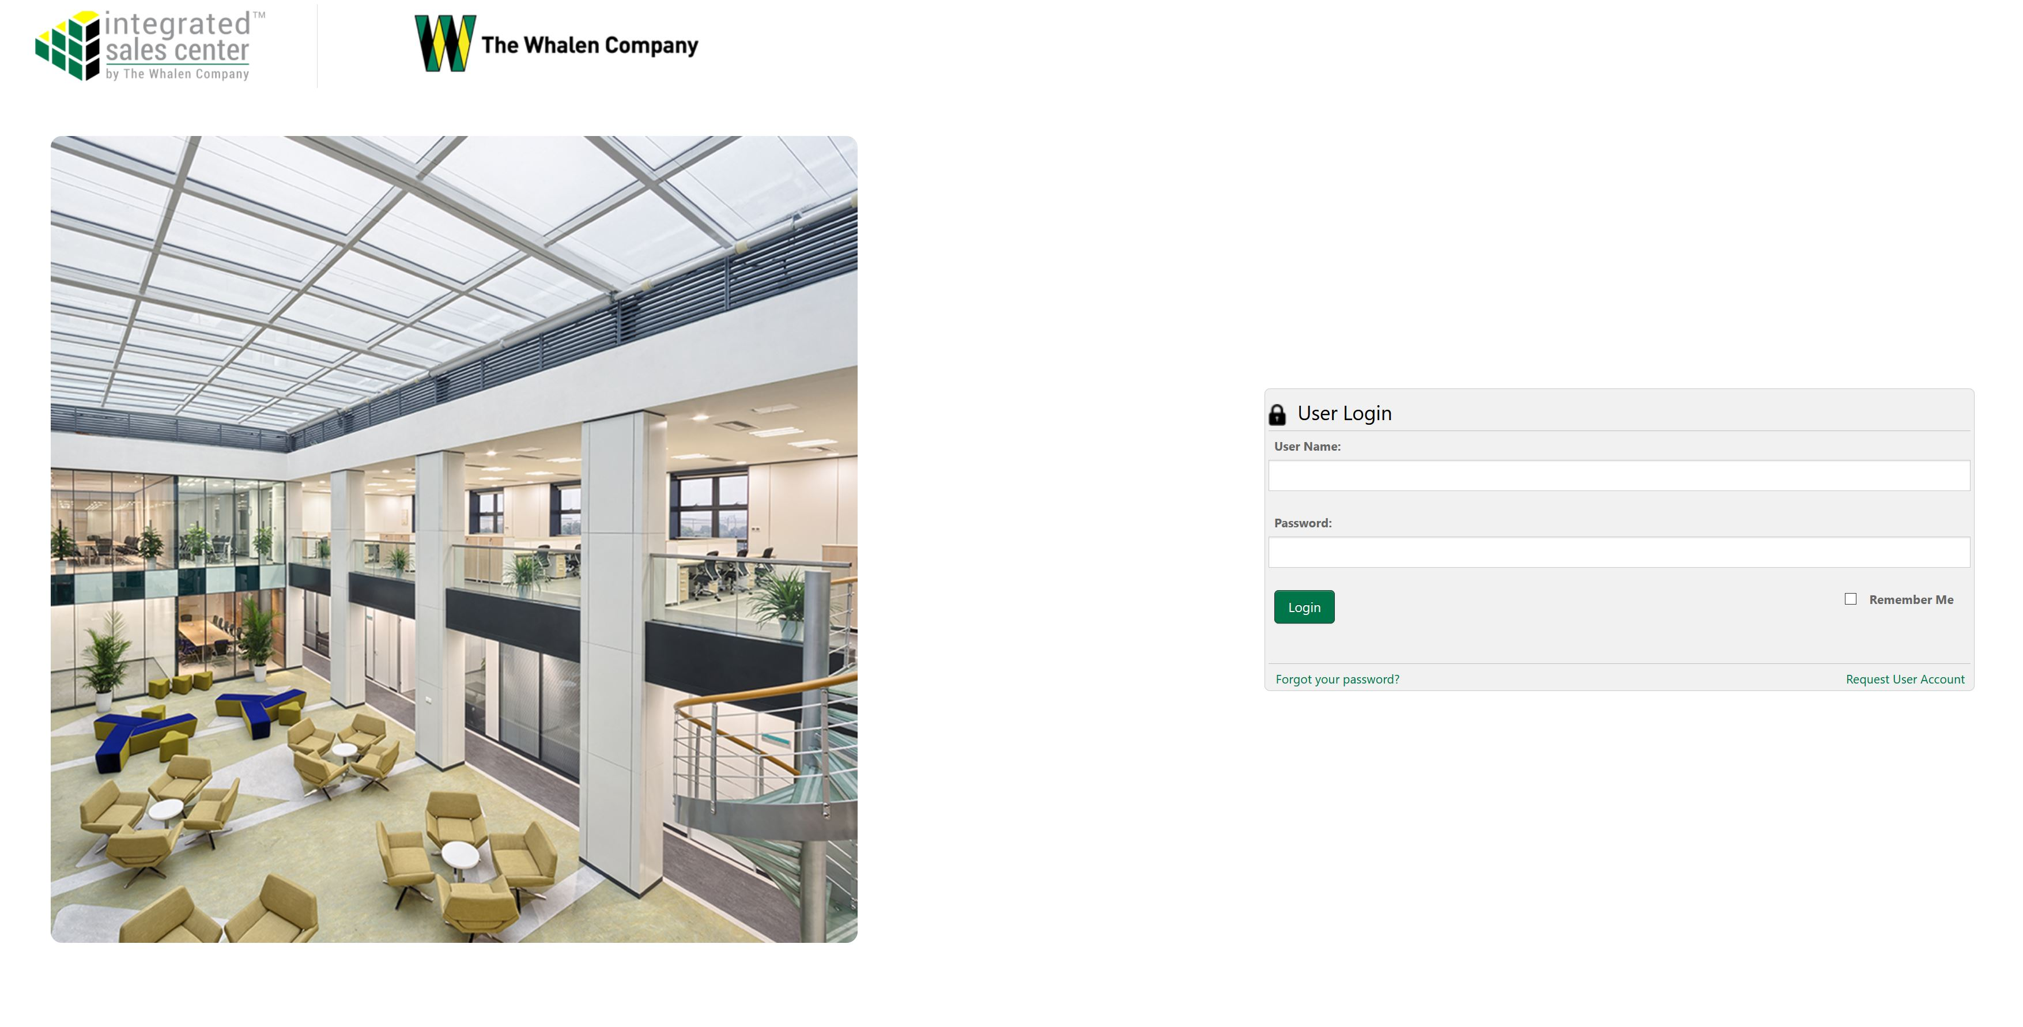
ISC Login

Slide 4
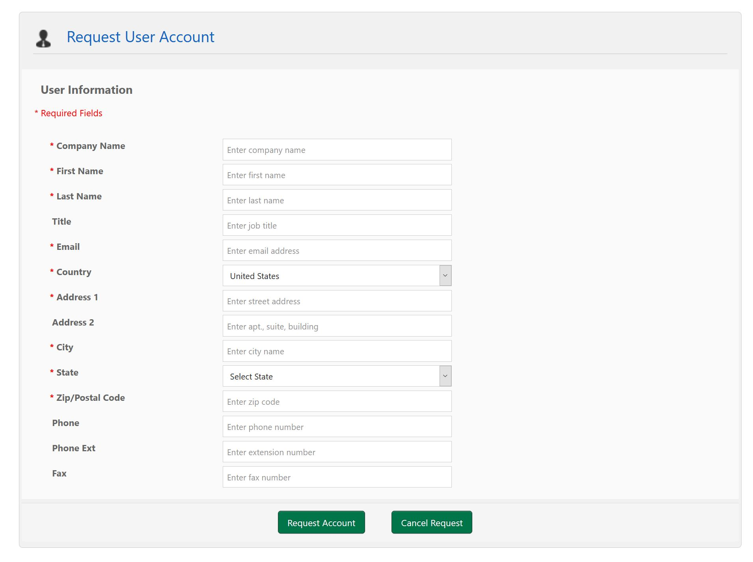
ISC Account Request
For access to the program, complete the “Request User Account” form.
Your Regional Manager will be notified and process the request.
Your username will be your business email address.

Slide 5
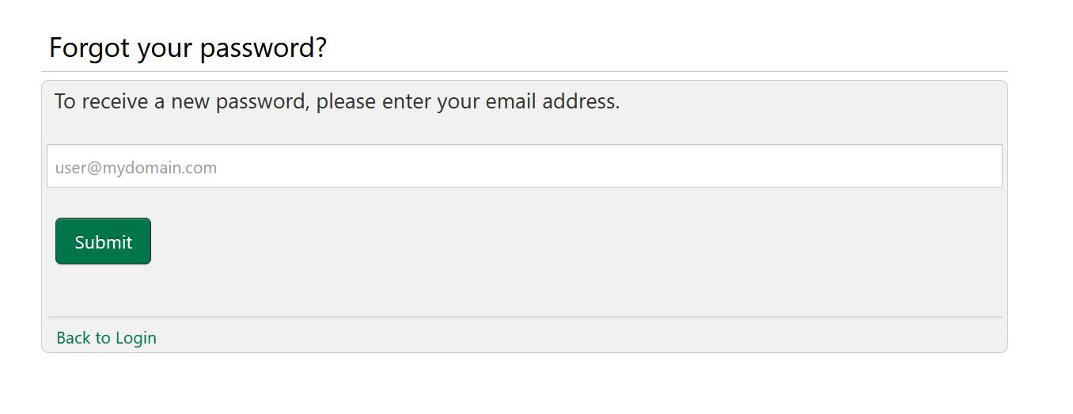

ISC Password Reset
To reset your password, use the “Forgot your password?” link on the login page.
You will receive an email from the address ISC-noreply@whalencompany.com with a temporary password.
Your new password must be a combination of letters and number only. Passwords cannot contain special characters.
Password must contain letters & numbers only!

Slide 6
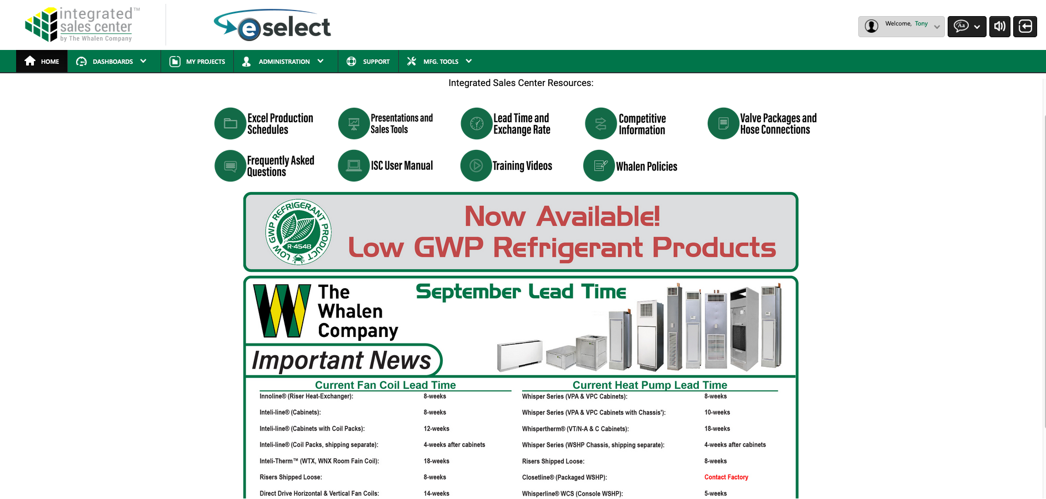
ISC Homepage
Current Lead Time

Slide 7
ISC Homepage

Slide 8
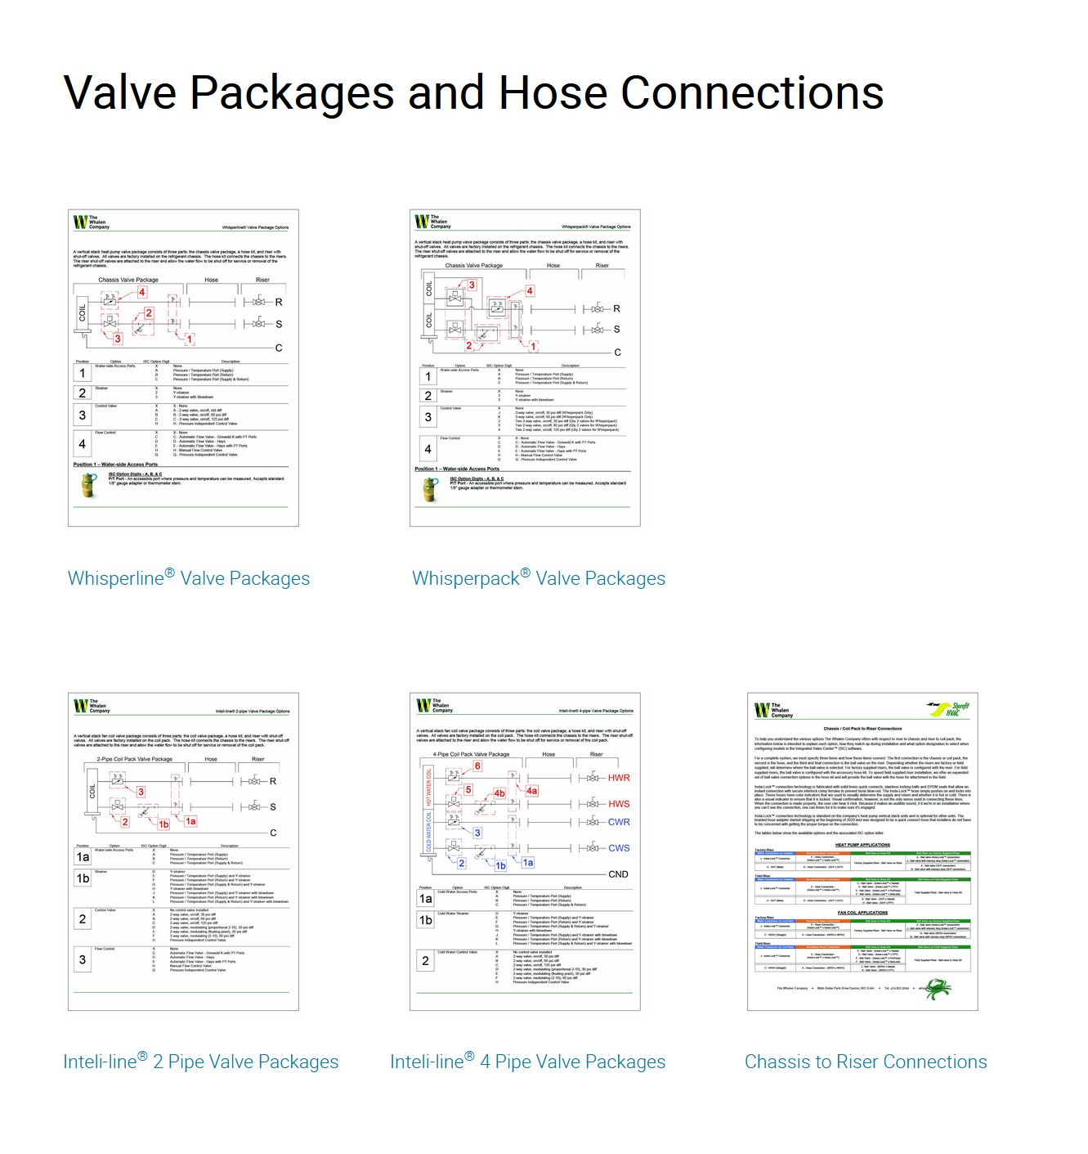
Valve Package & Hose Connections
We have added documents to help walk you through the valve package options for fan coils and heat pumps.
The hose connection sheet shows the options available to connect your chassis or coil pack to the risers.

Slide 9
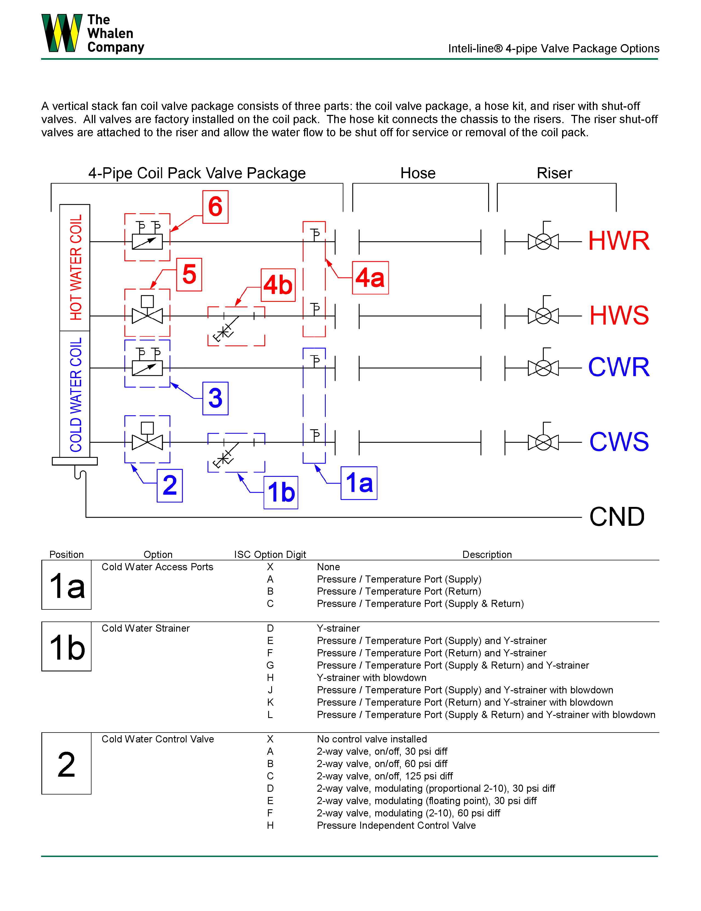
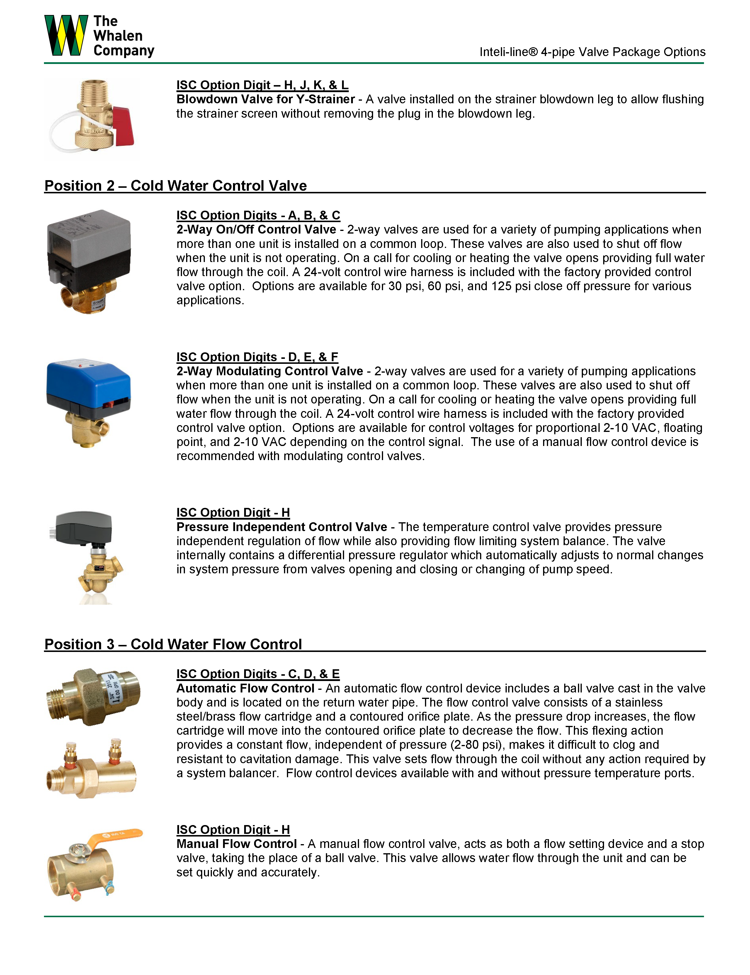
Valve Package & Hose Connections
Detail sheets to help make option selections in ISC
Shows position of component in the system
Gives explanation of the component operation

Slide 10
ISC Homepage

Slide 11
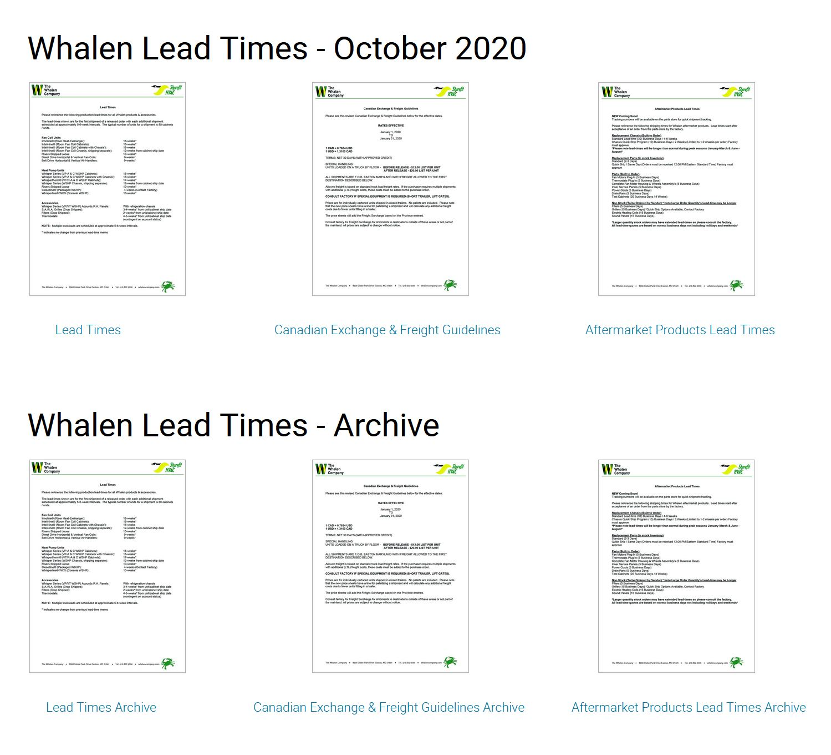
Lead Time & Exchange Rates
Monthly lead times are posted to the ISC Homepage for new construction and aftermarket products.
Exchange rate information is also posted.
Lead Time Archives are also available if you need to look back and review.
Updated every month or more frequently if necessary
No need to wait for a reply from your RM. This is always current information.

Slide 12
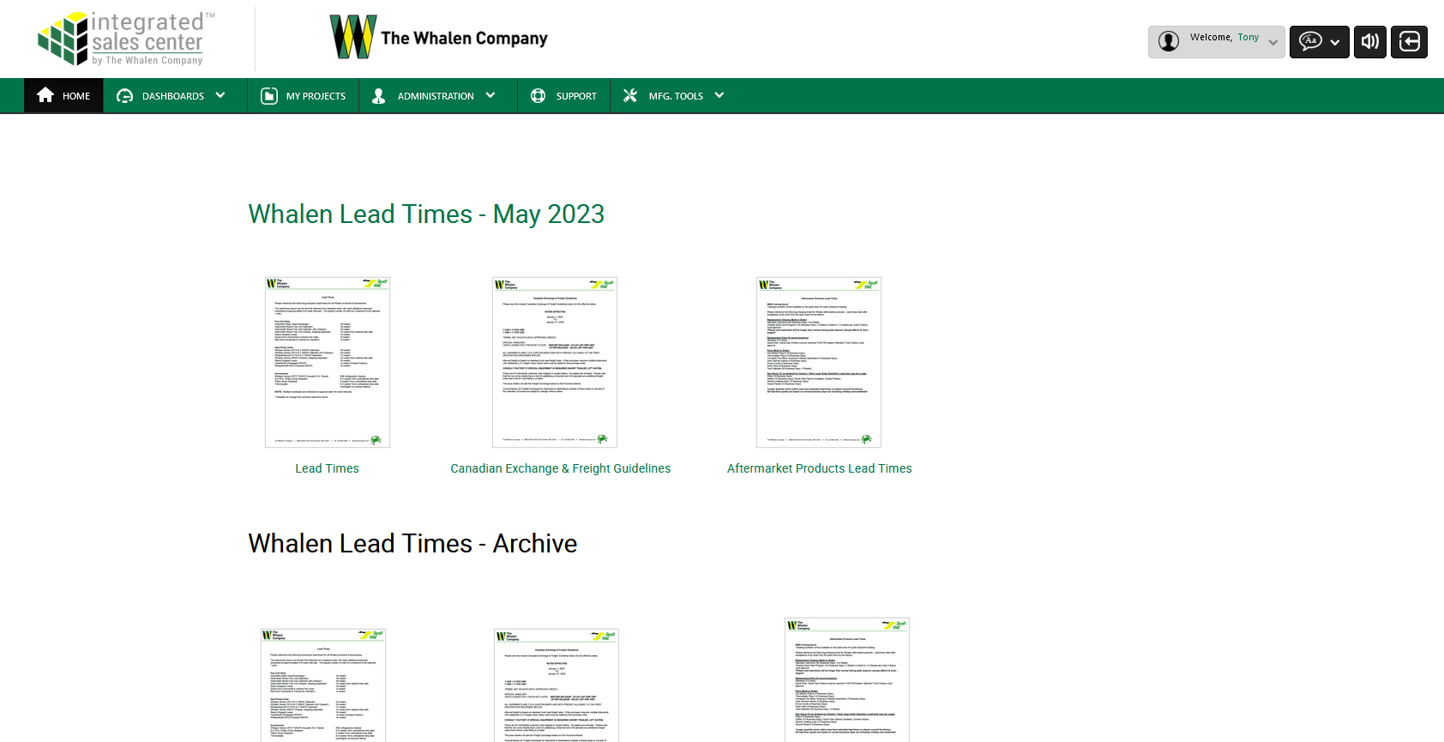
Current Lead Time – Online Access

Slide 13
ISC Homepage

Slide 14
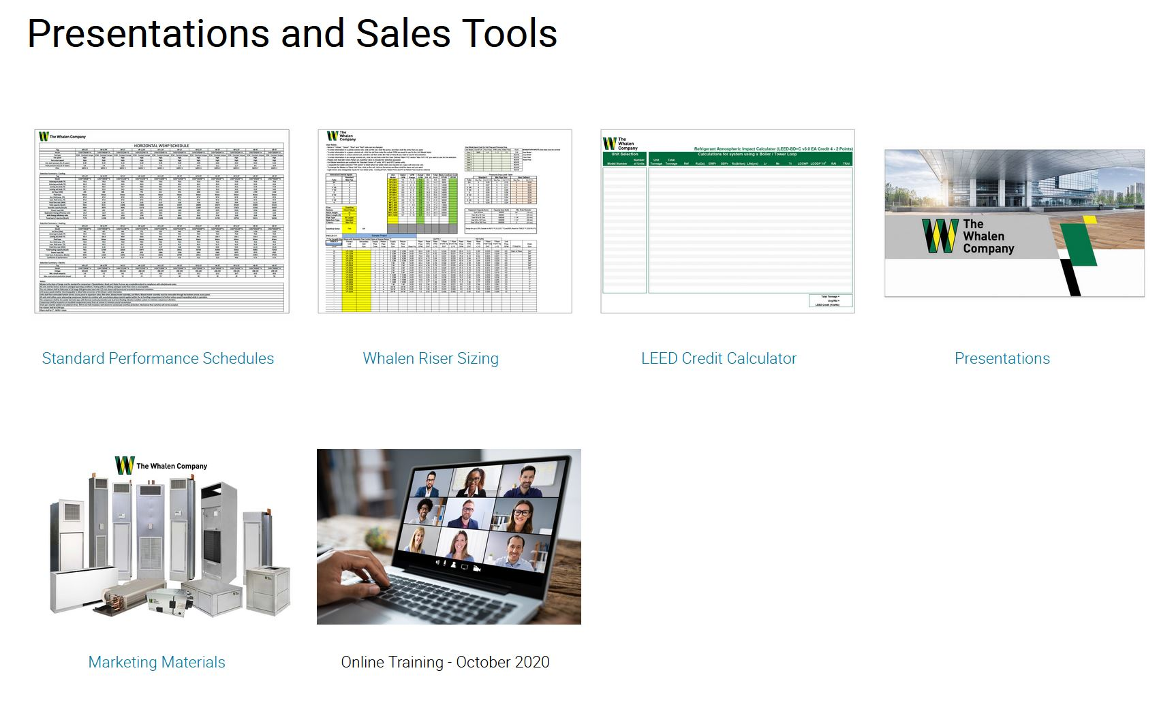
Presentations & Sales Tools
Standard performance schedules are available to allow copy & paster to an engineer's schedule
Riser sizing tools to help size risers
Product presentations to learn & familiarize yourself and engineers with Whalen products
Marketing material to help you sell
Material for Online training classes

Slide 15
ISC Homepage

Slide 16
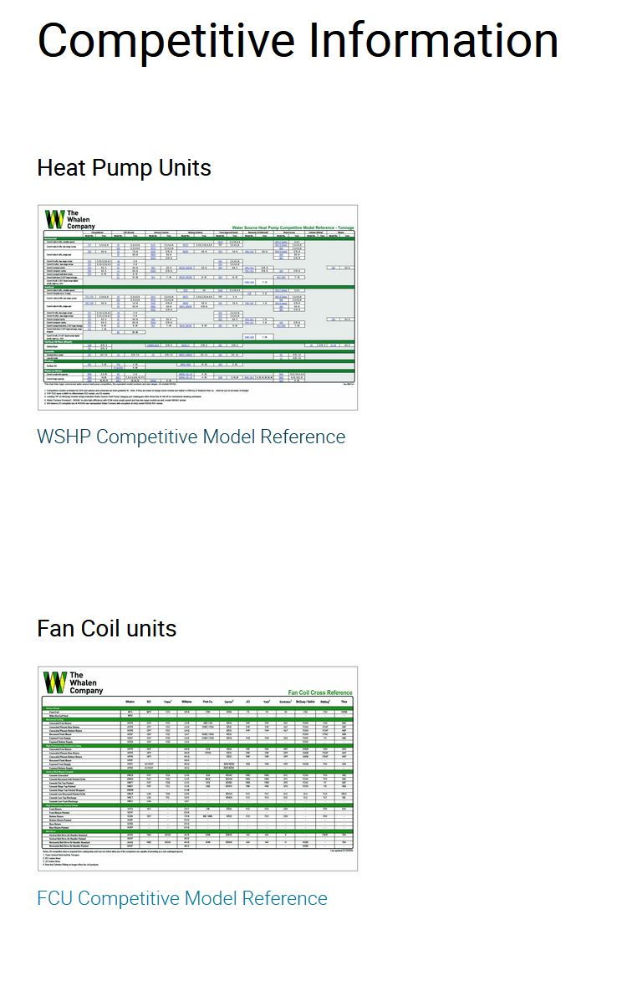
Competitive Information
Single page sheet with models and sizes.
Information to help you identify competitive units for heat pump and fan coil units.
Model numbers include links to competitive websites to ease product comparison.
Can easily see where product gaps exist.

Slide 17
ISC Homepage

Slide 18
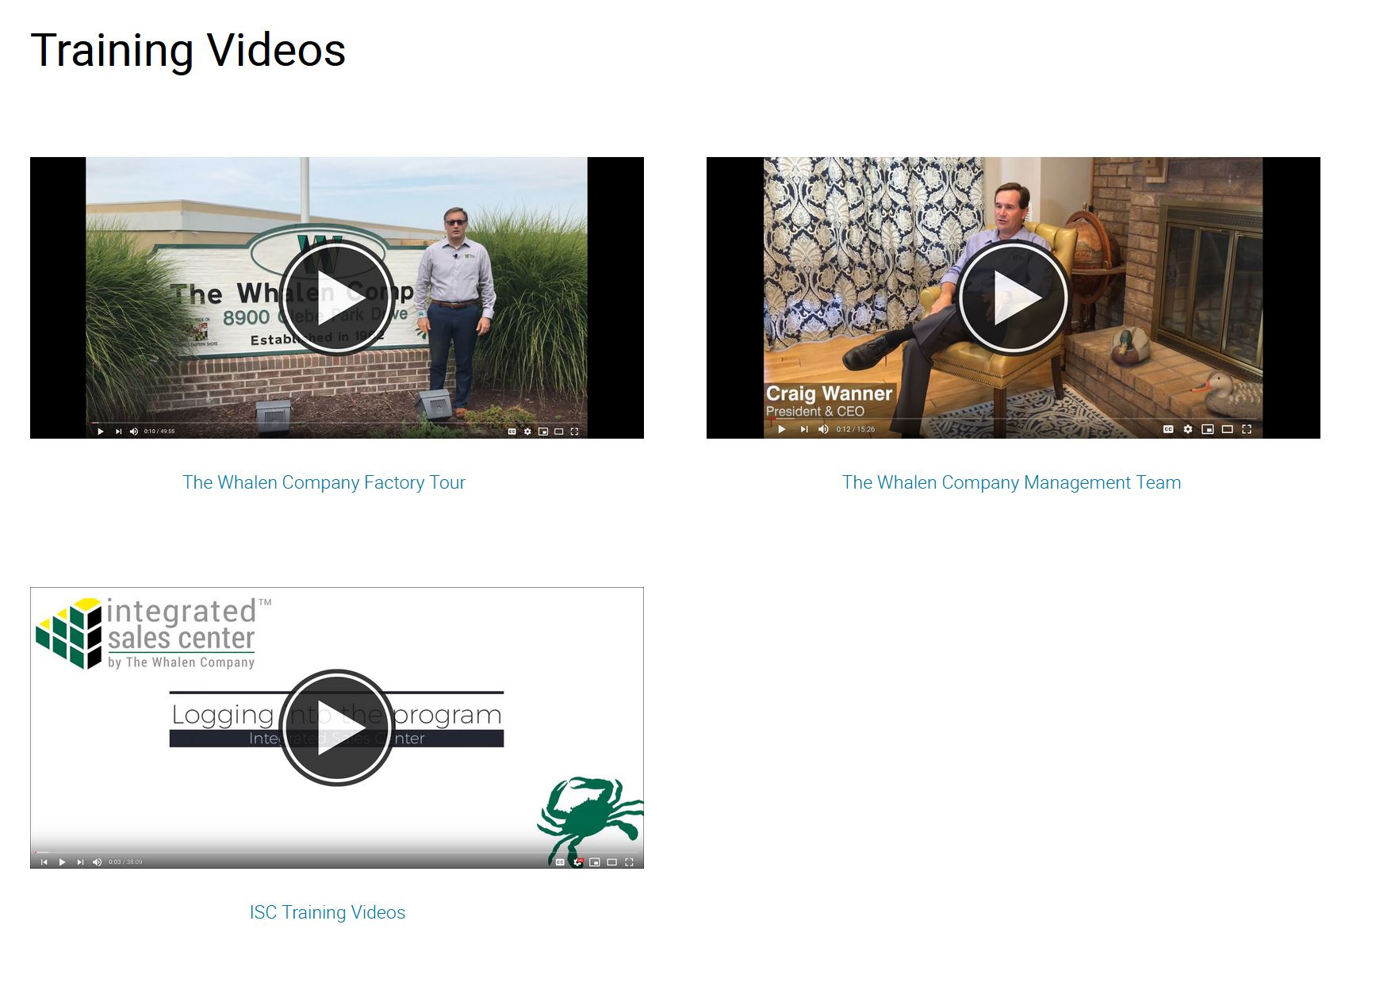
Training Videos
Factory tour video
Introduction to the Whalen management team
ISC training videos.
Full length or specific topics
Will continue to add additional training topics

Slide 19
ISC Homepage

Slide 20
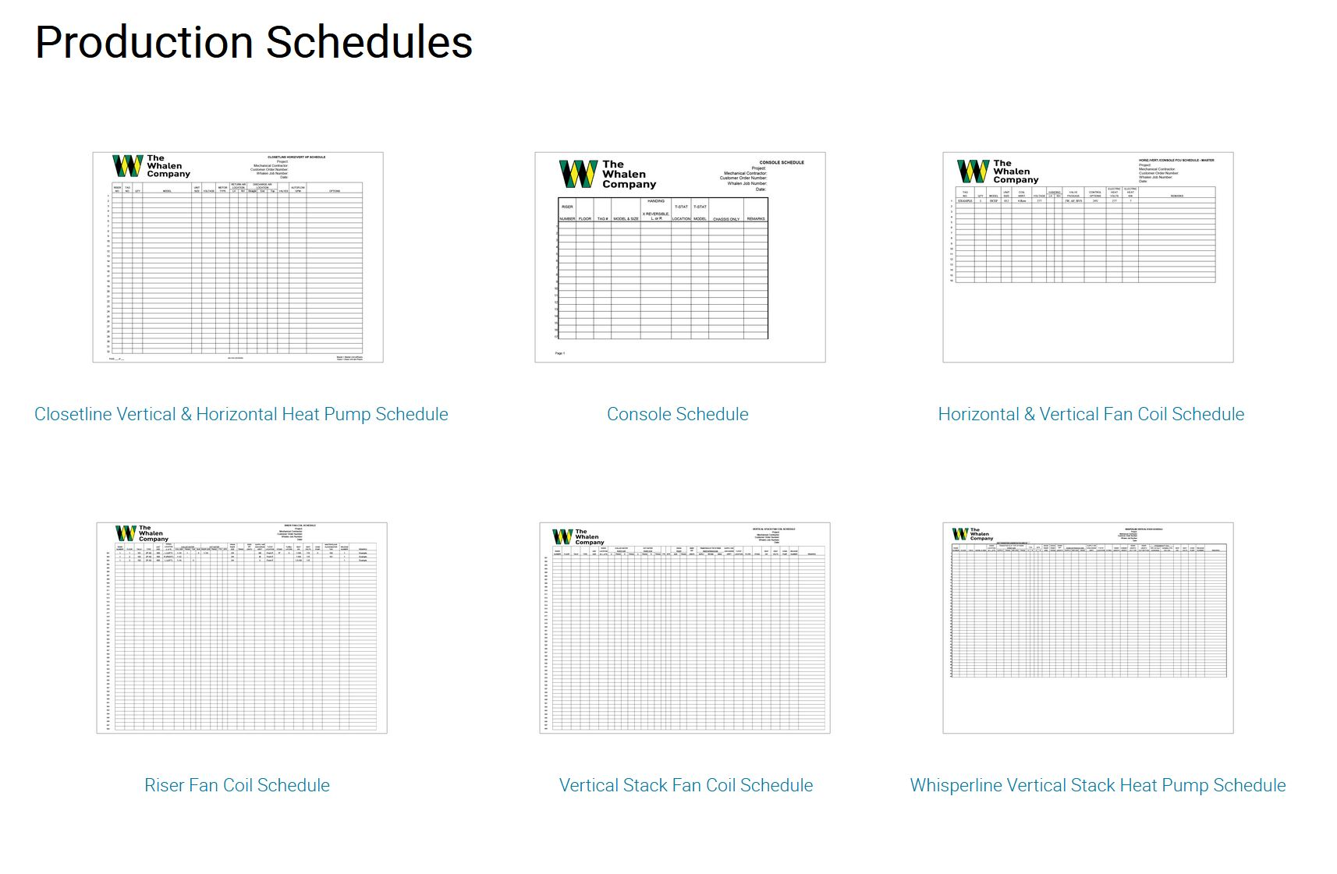
Production Schedules
Production schedules are Microsoft Excel documents used to identify airflow configuration, riser location.
Allows a final check to ensure what was configured in ISC matches what you intended to configure.
Ties unit tag to riser to cabinet to chassis / coil pack.
One line per unit
Required for every project regardless of size.

Slide 21
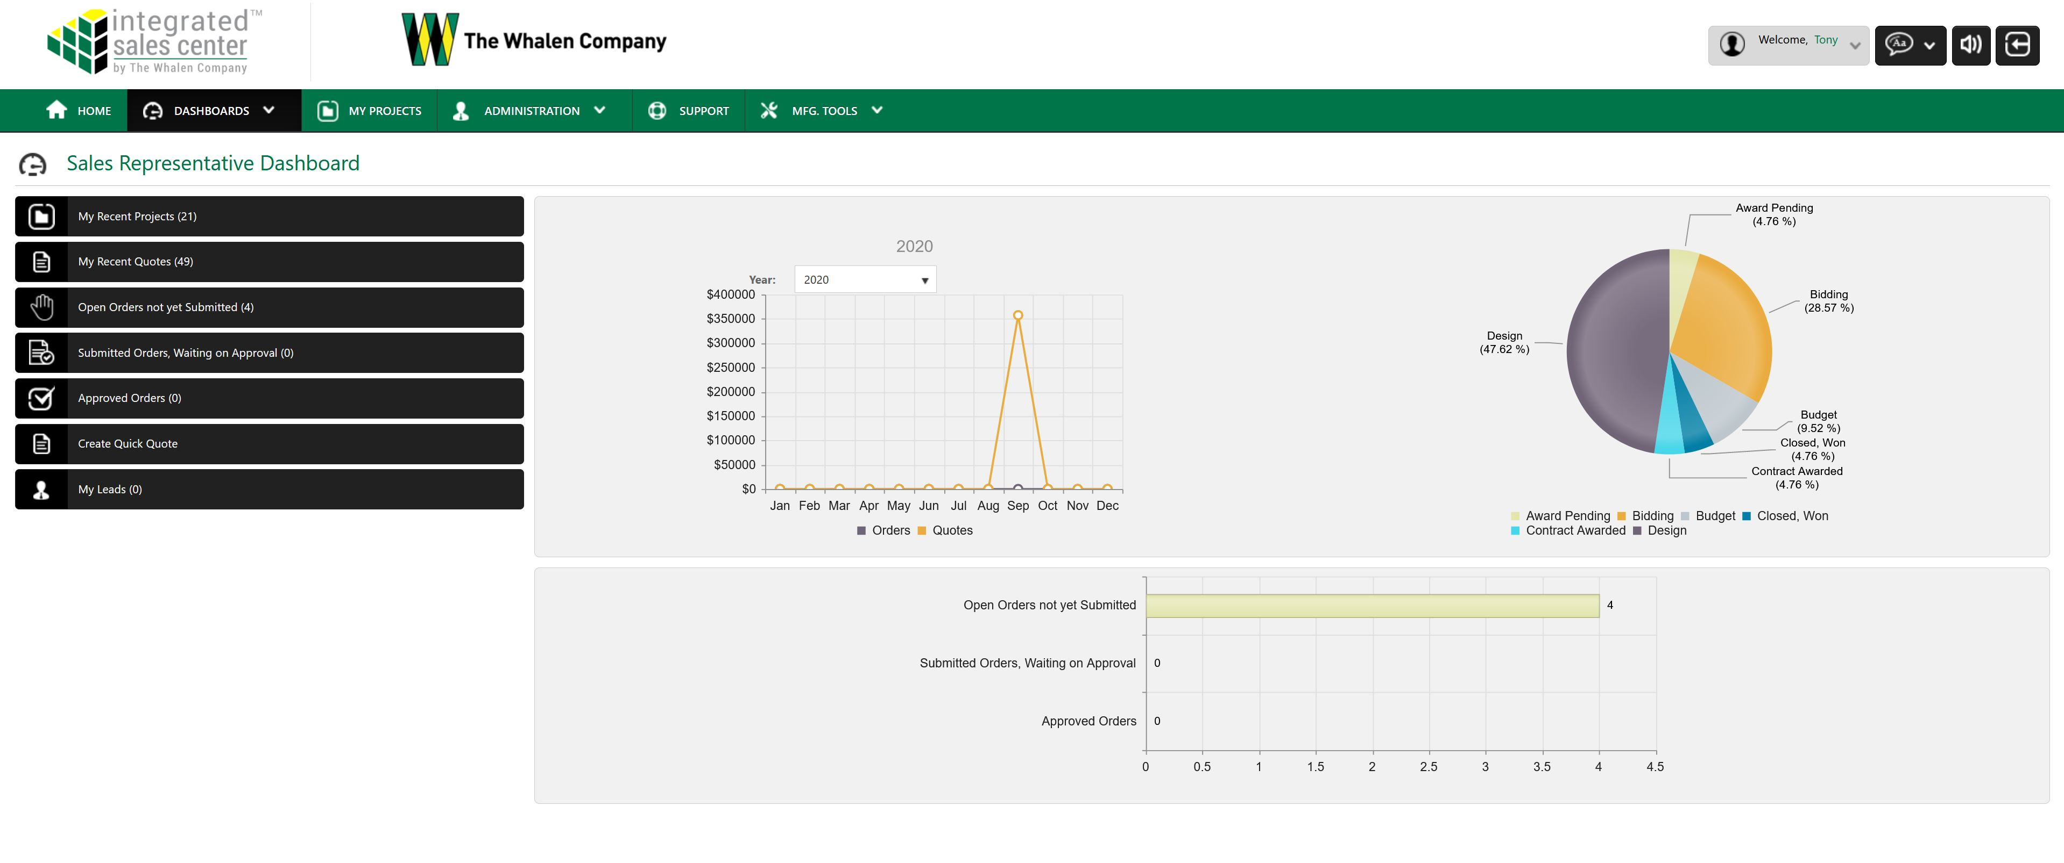
Performance Dashboard

Slide 22
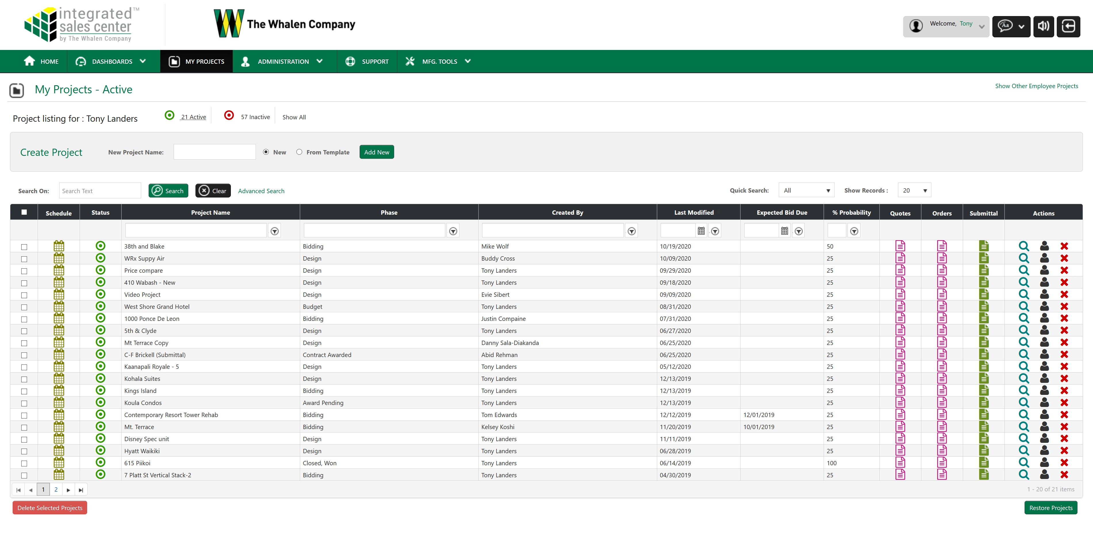
My Projects

Slide 23
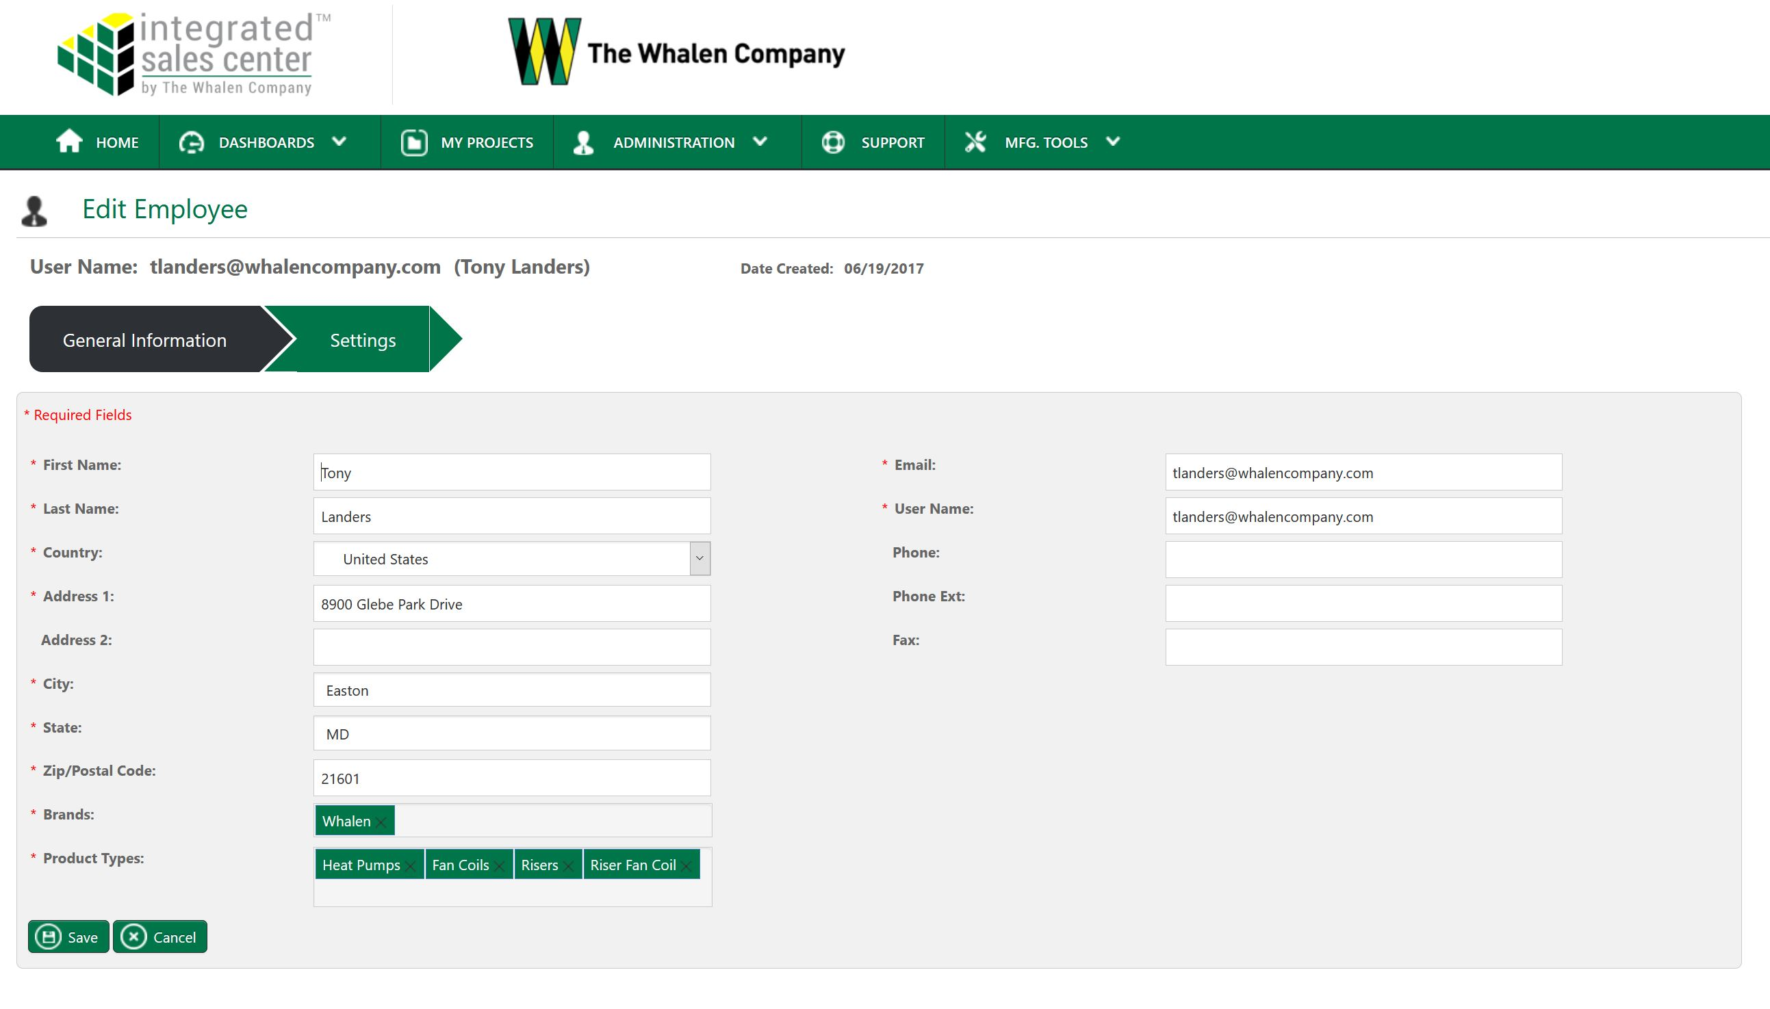
Managing Users

Slide 24
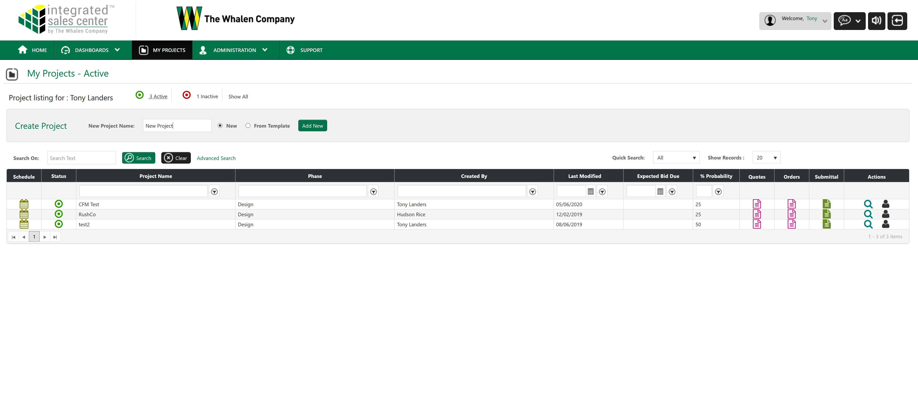
Creating a New Project

Slide 25
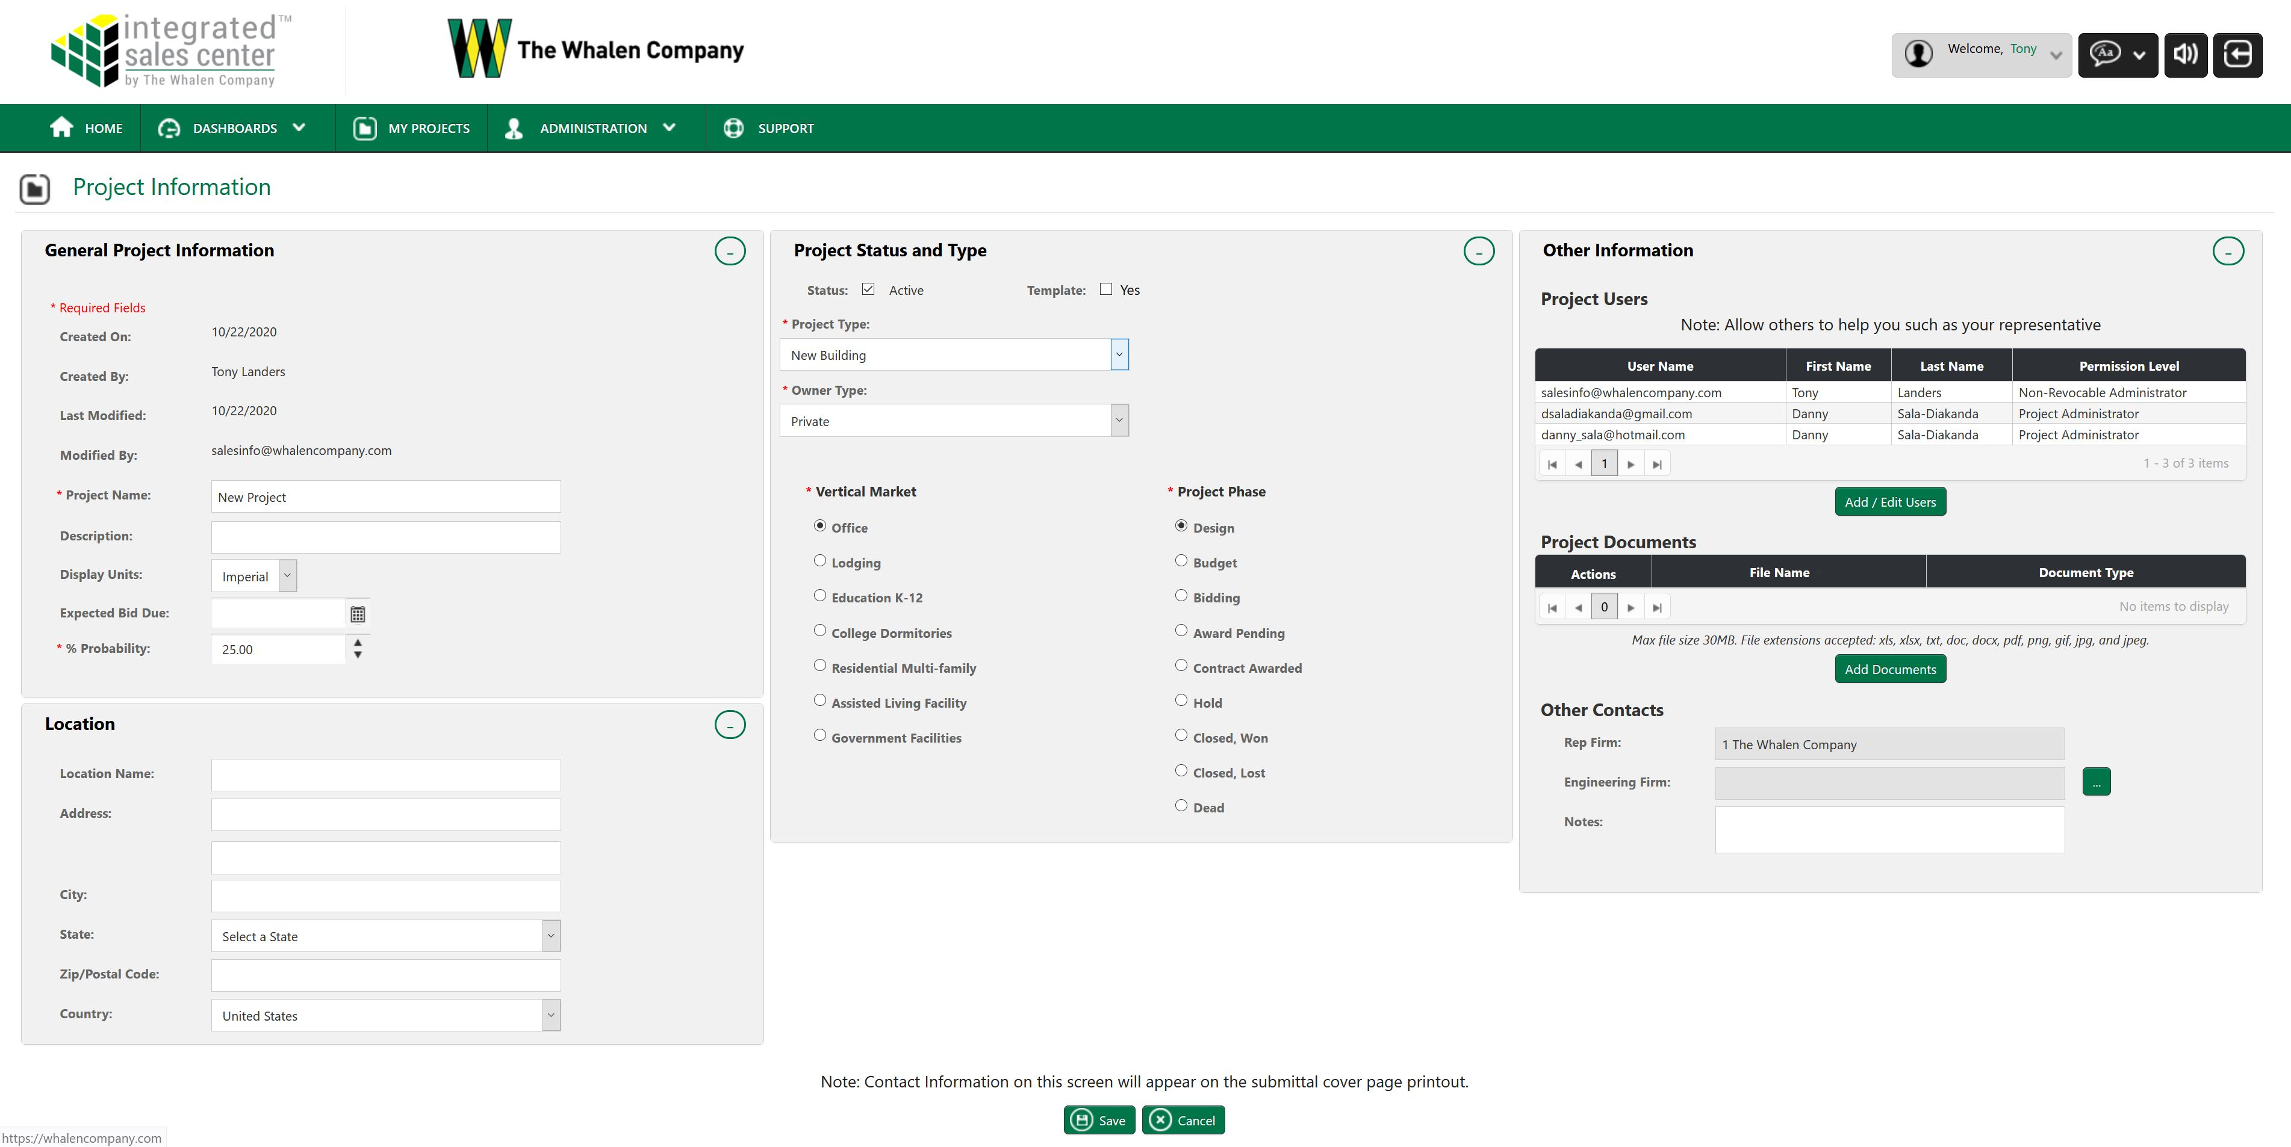
Adding Users to Project

Slide 26
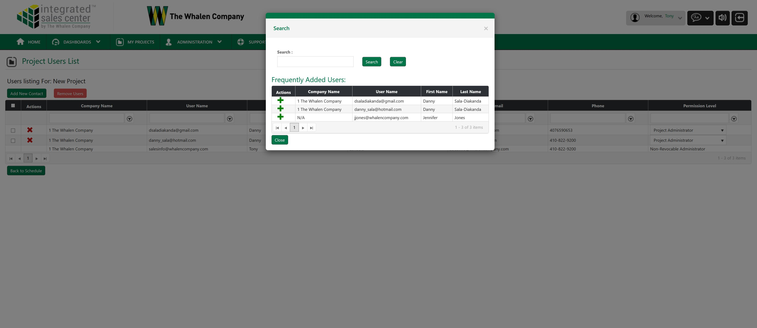
Adding Users to Project

Slide 27
Adding Documents to Project

Slide 28
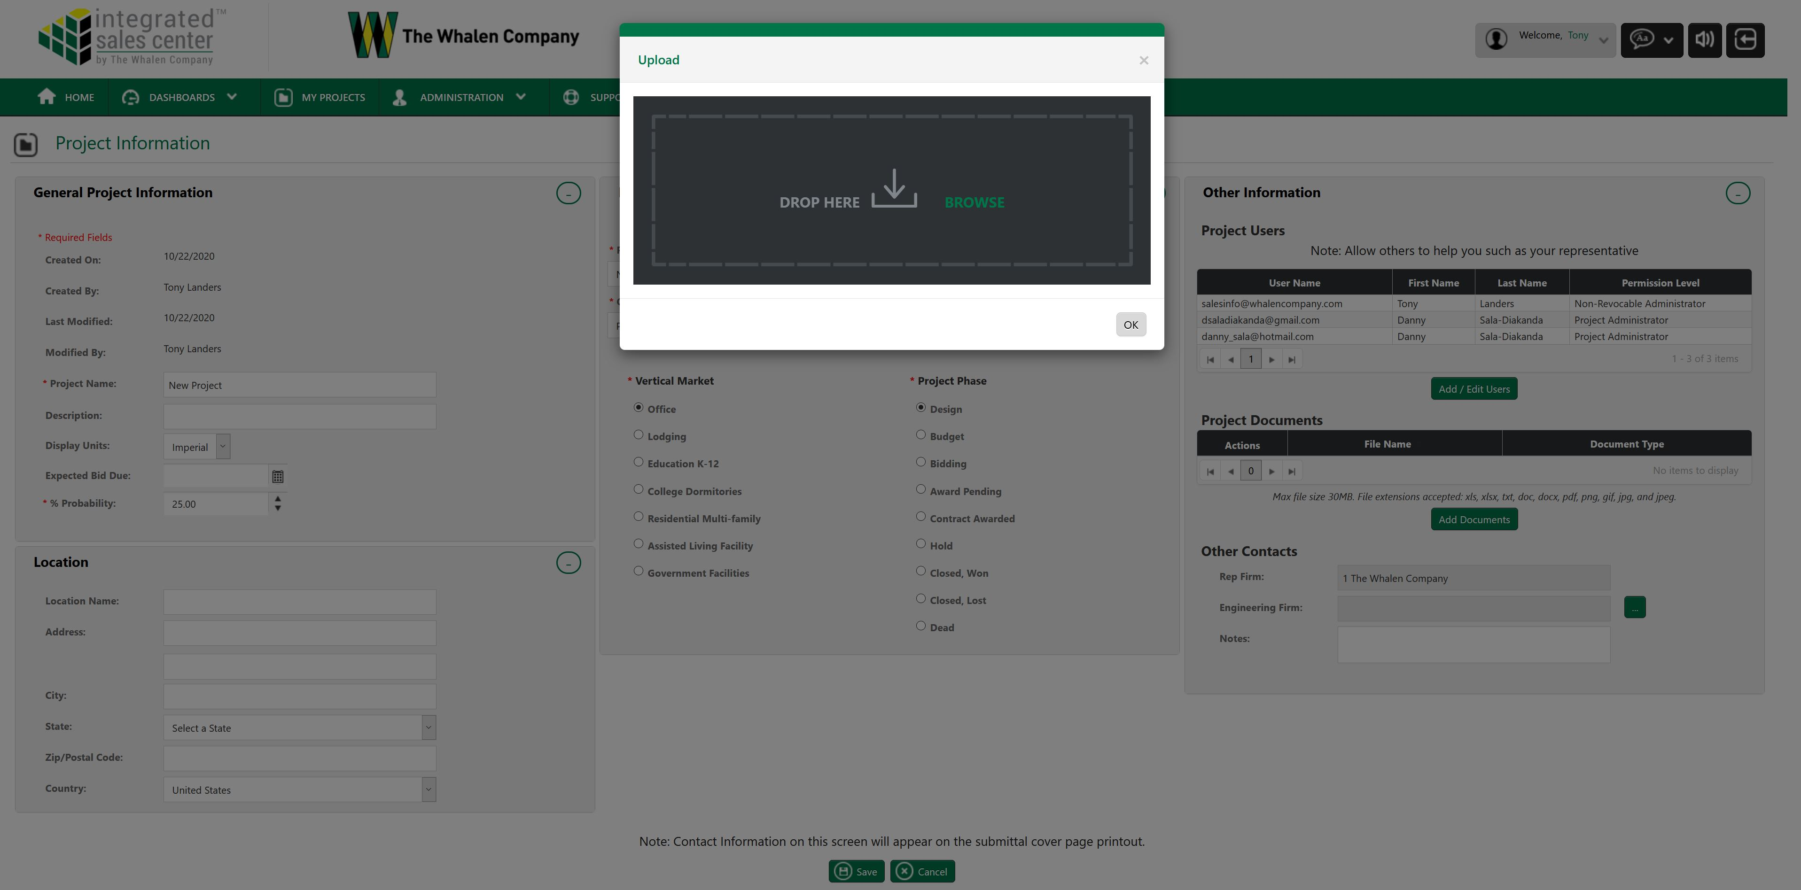
Adding Documents to Project

Slide 29
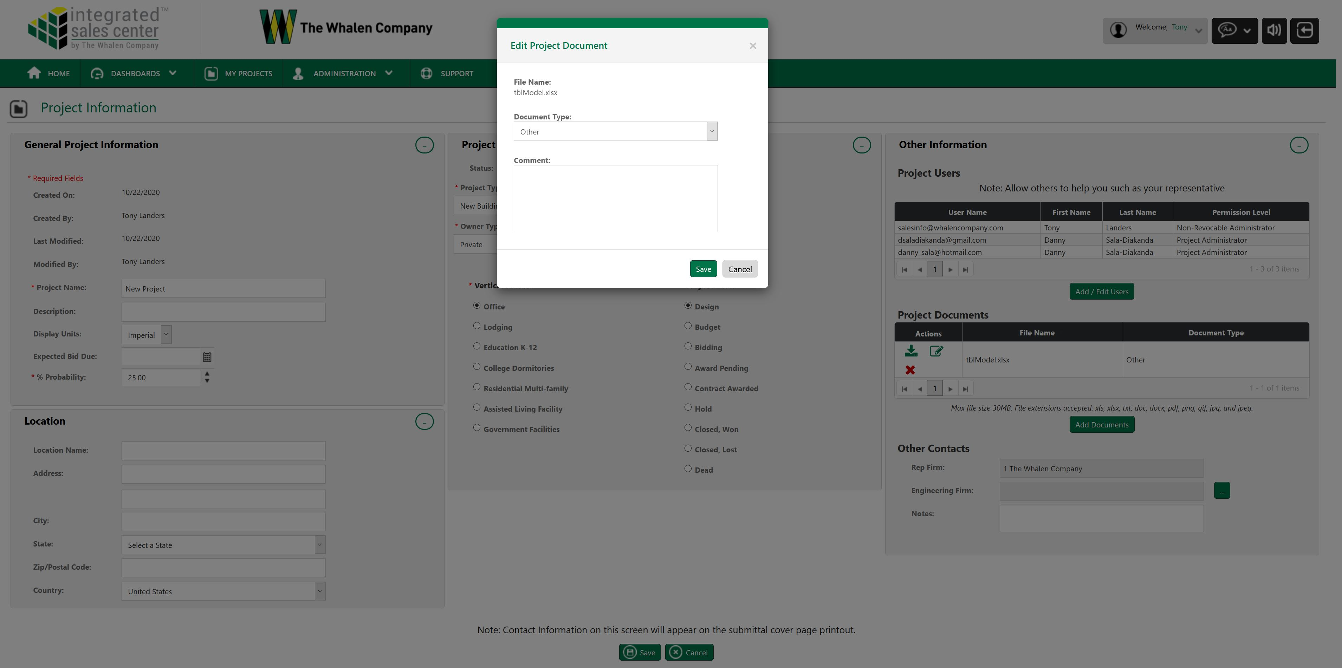
Adding Documents to Project

Slide 30
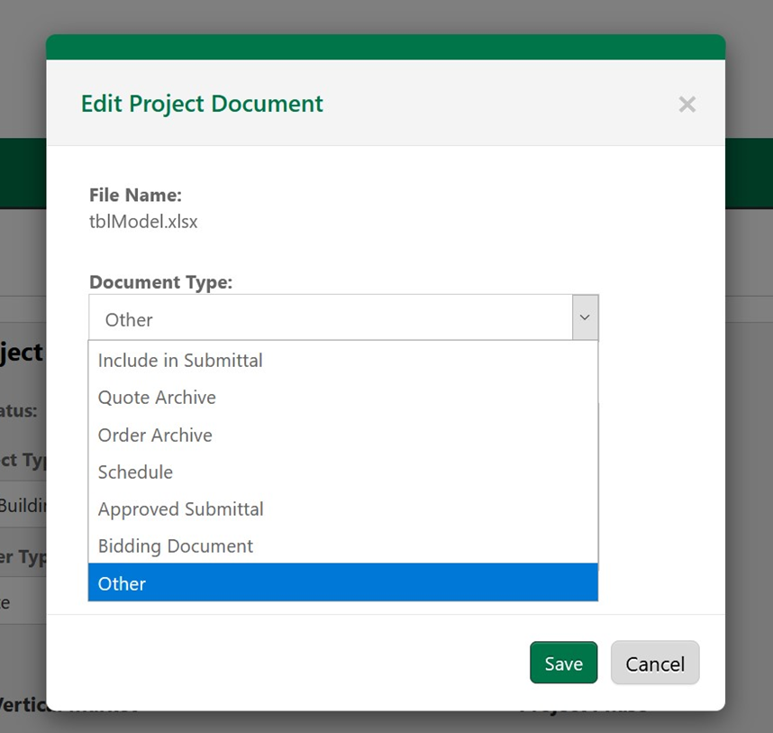
Adding Documents to Project
Assign the Document Type to your file and click save.
Documents you want included in the submittal will be added at the end of the document.
File type must be a .png to be added to the submittal

Slide 31
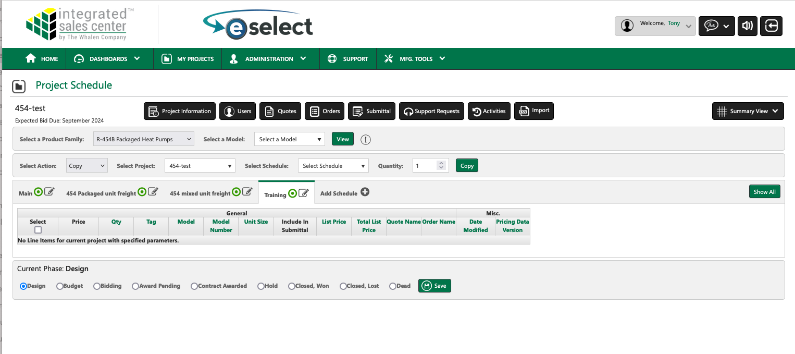
Adding / Configuring Units

Slide 32
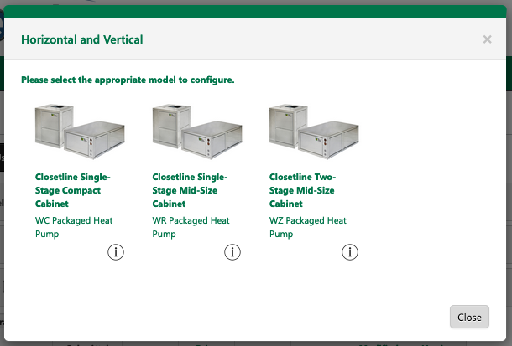
Unit Configuration

Slide 33
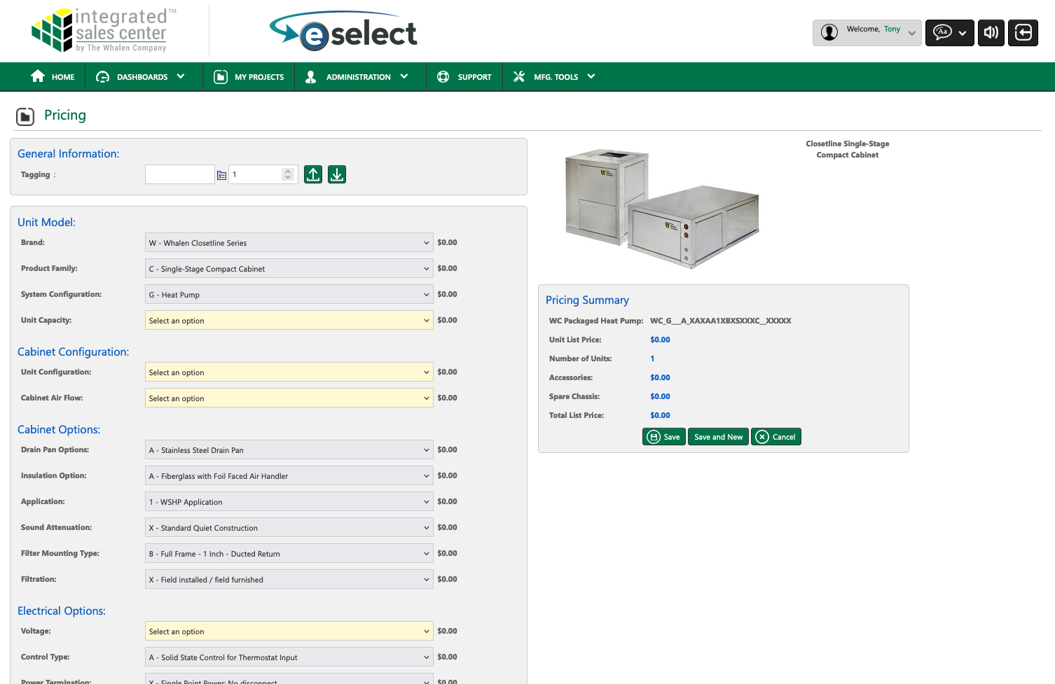
Unit Configuration

Slide 34
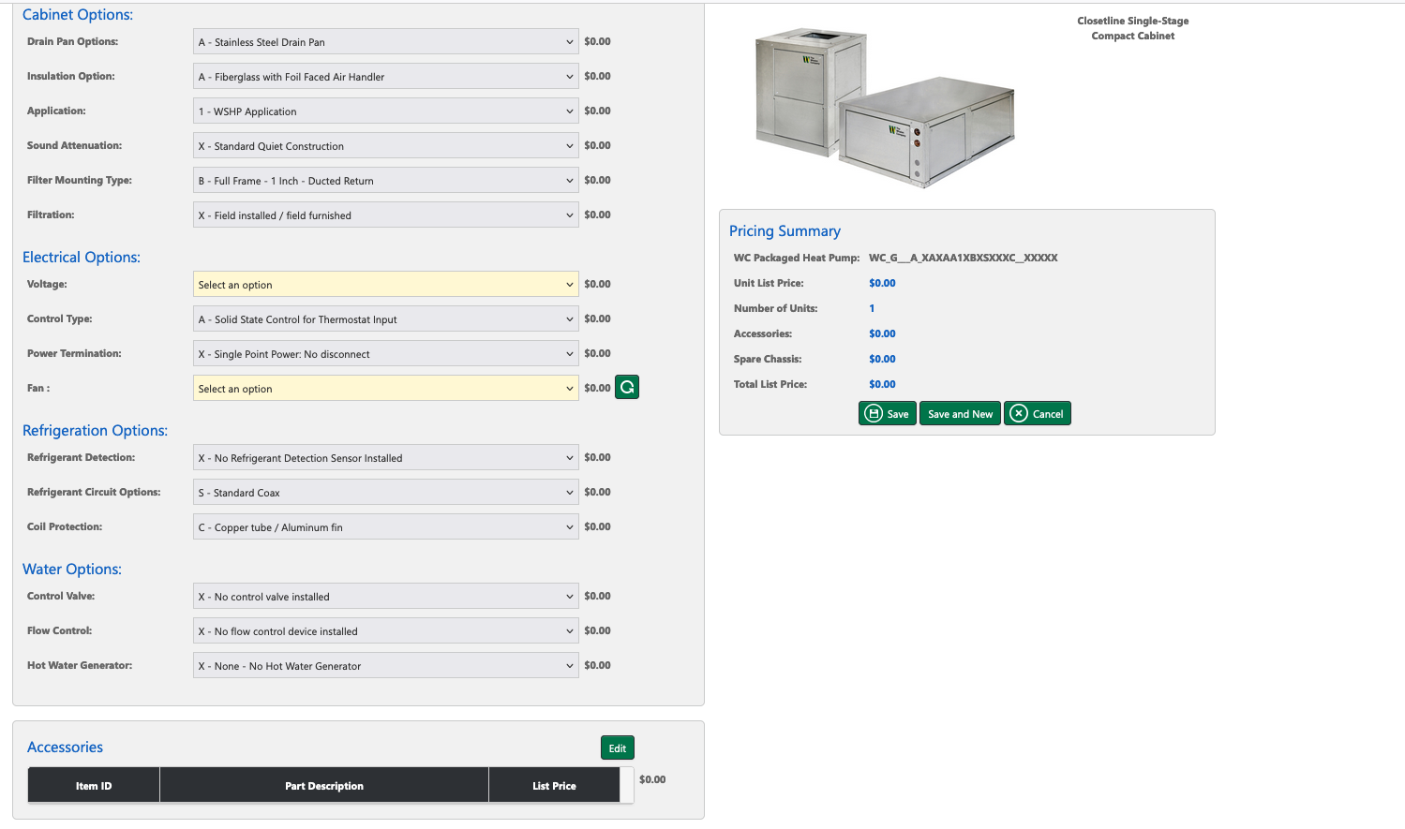
Unit Configuration

Slide 35
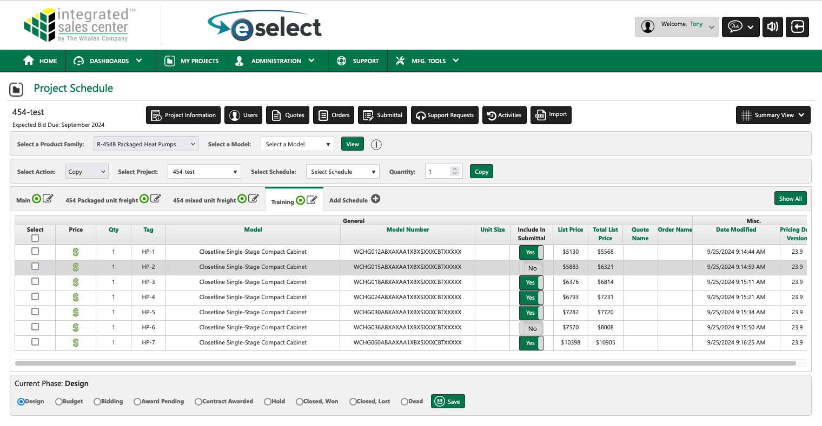
Project Schedule
Review models, unit tags, and quantities configured.

Slide 36
Creating a Submittal

Slide 37
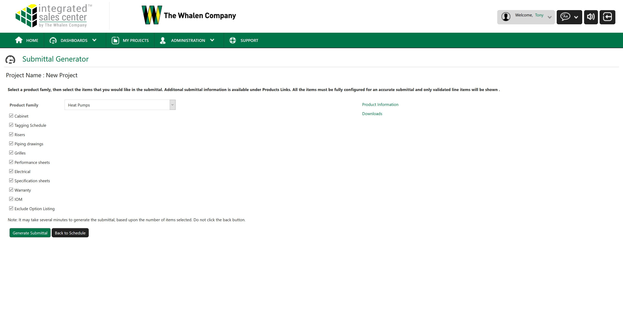
Creating a submittal
Submittal can be tailored to include only the type of information you want by checking / unchecking these items.

Slide 38
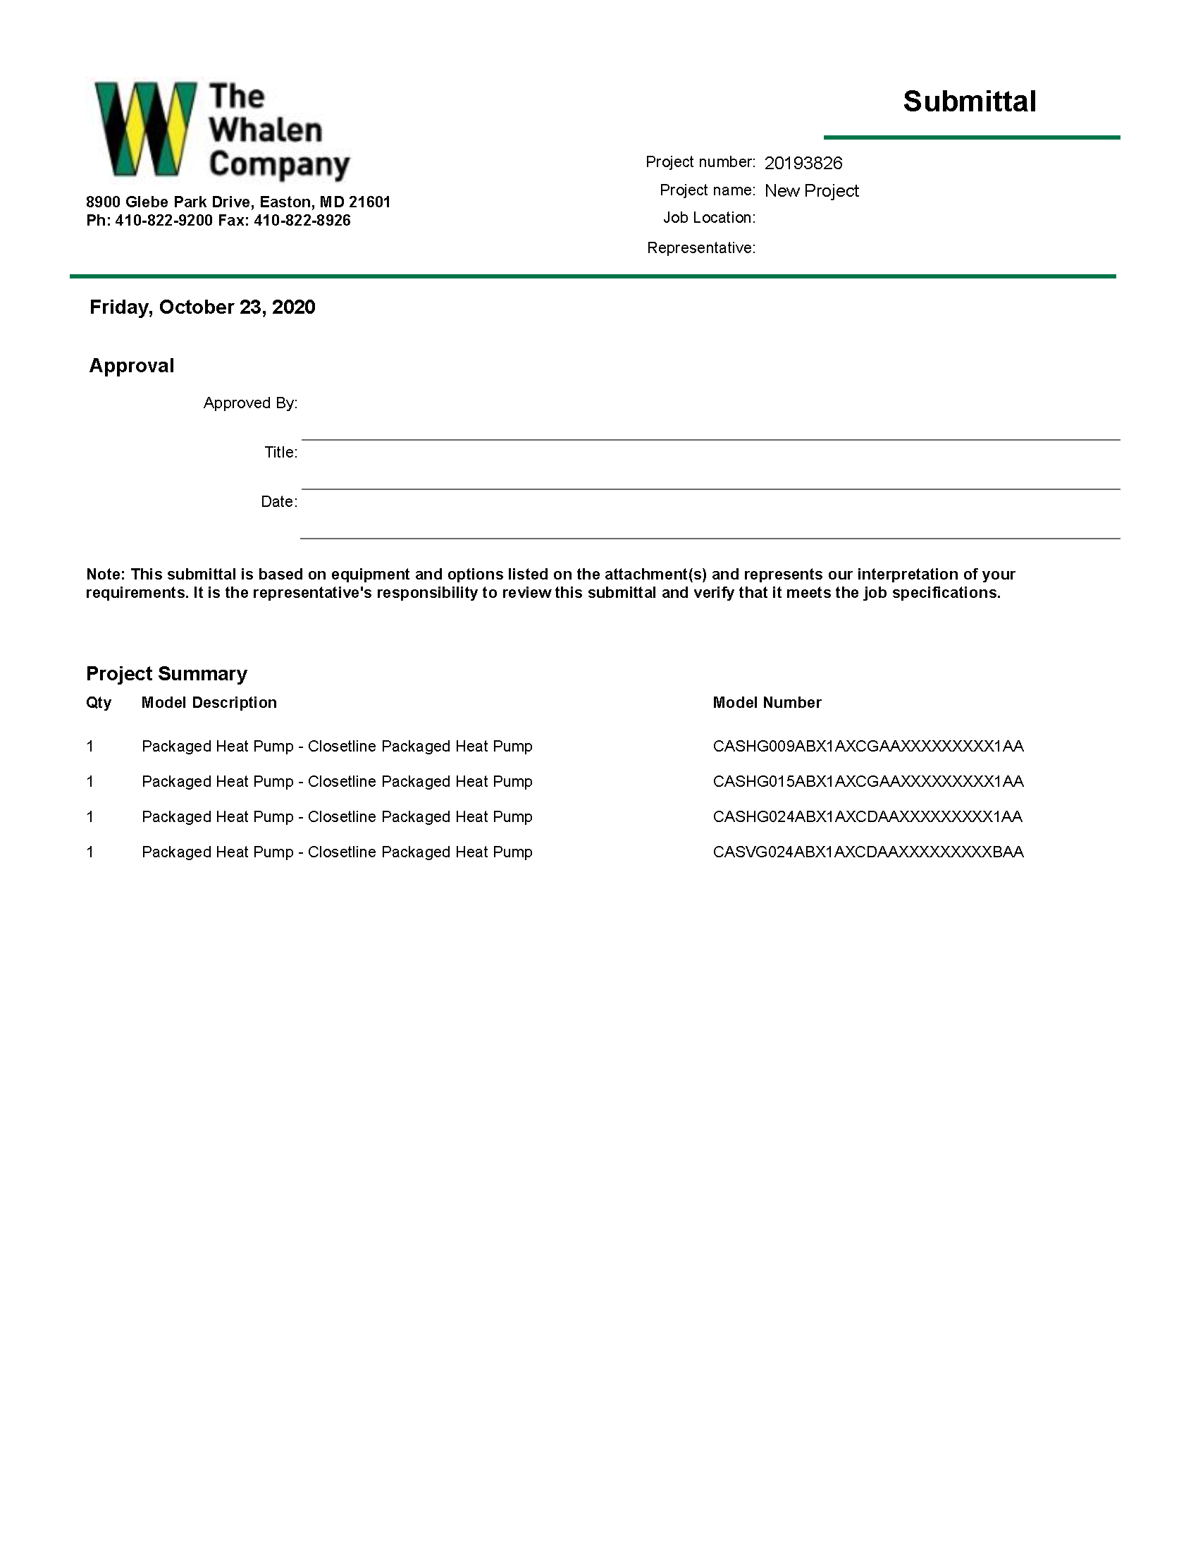
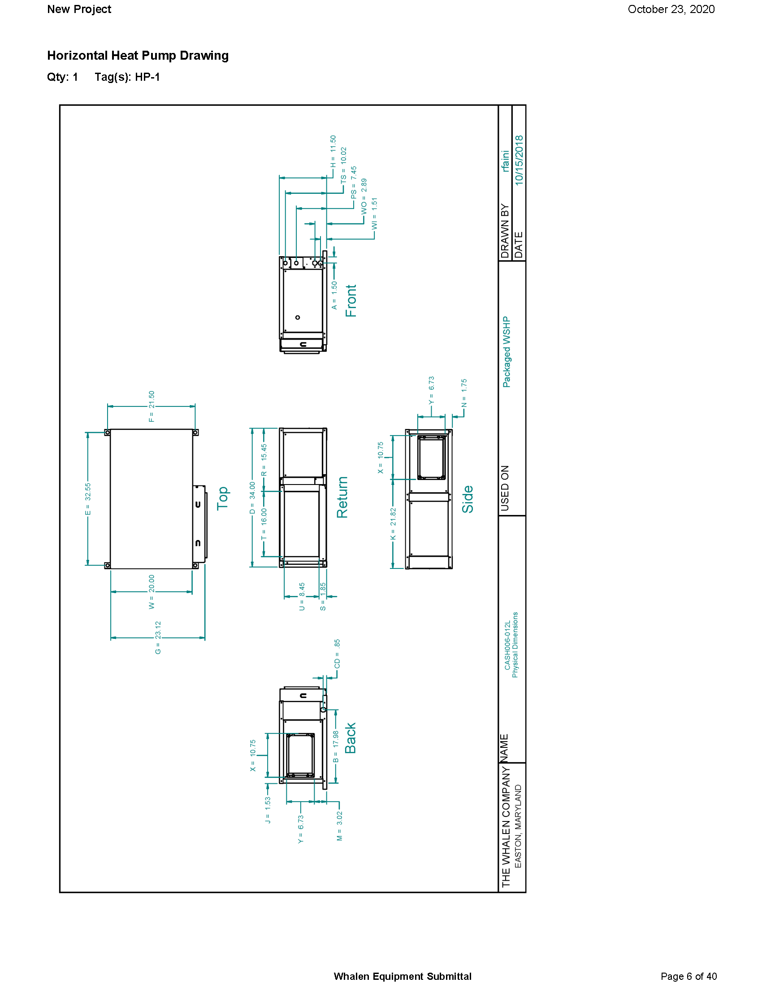
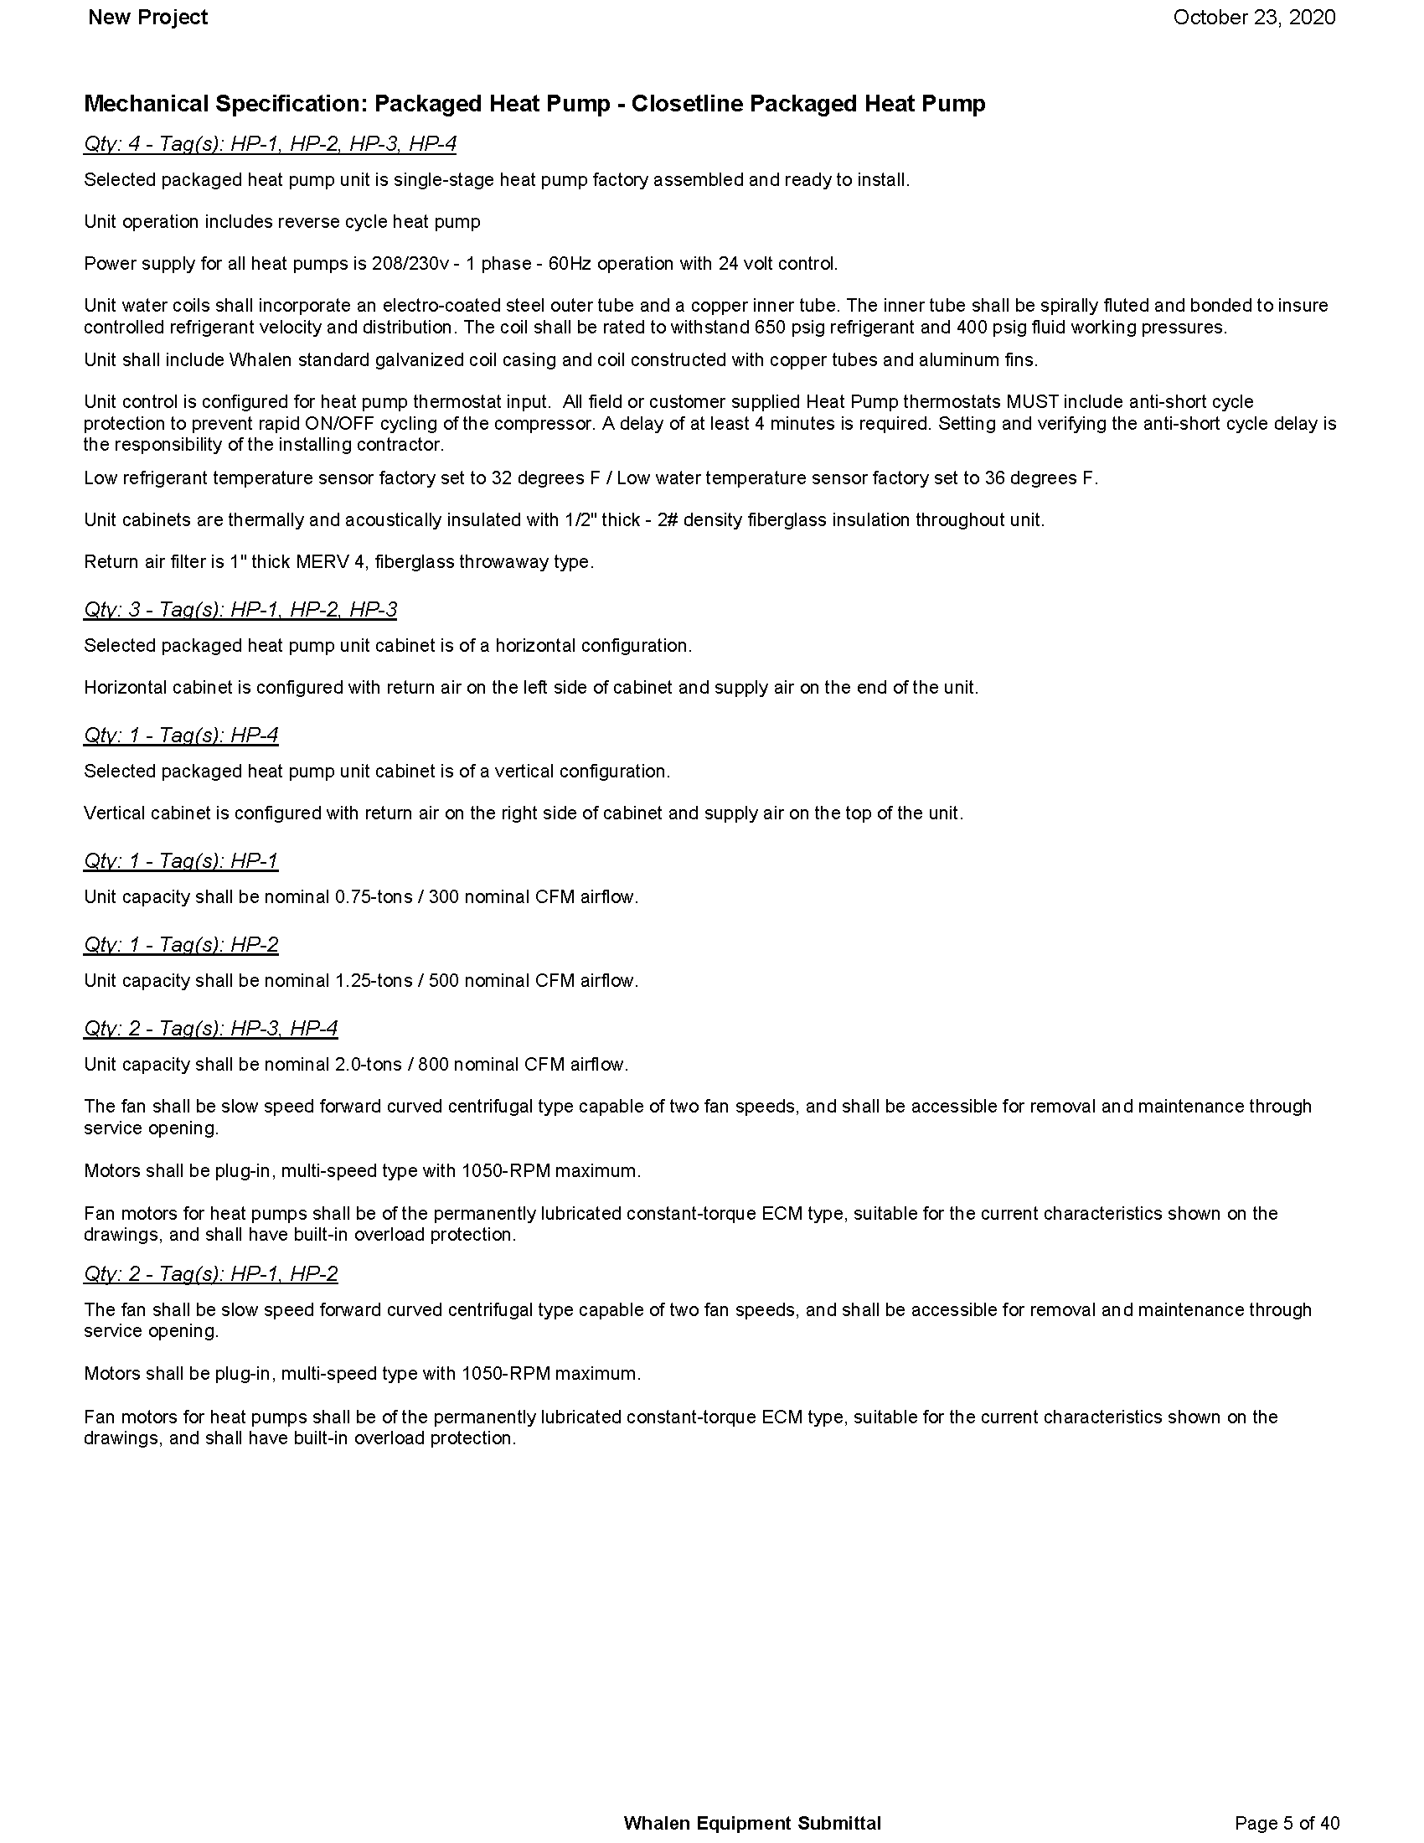
Submittal Document

Slide 39
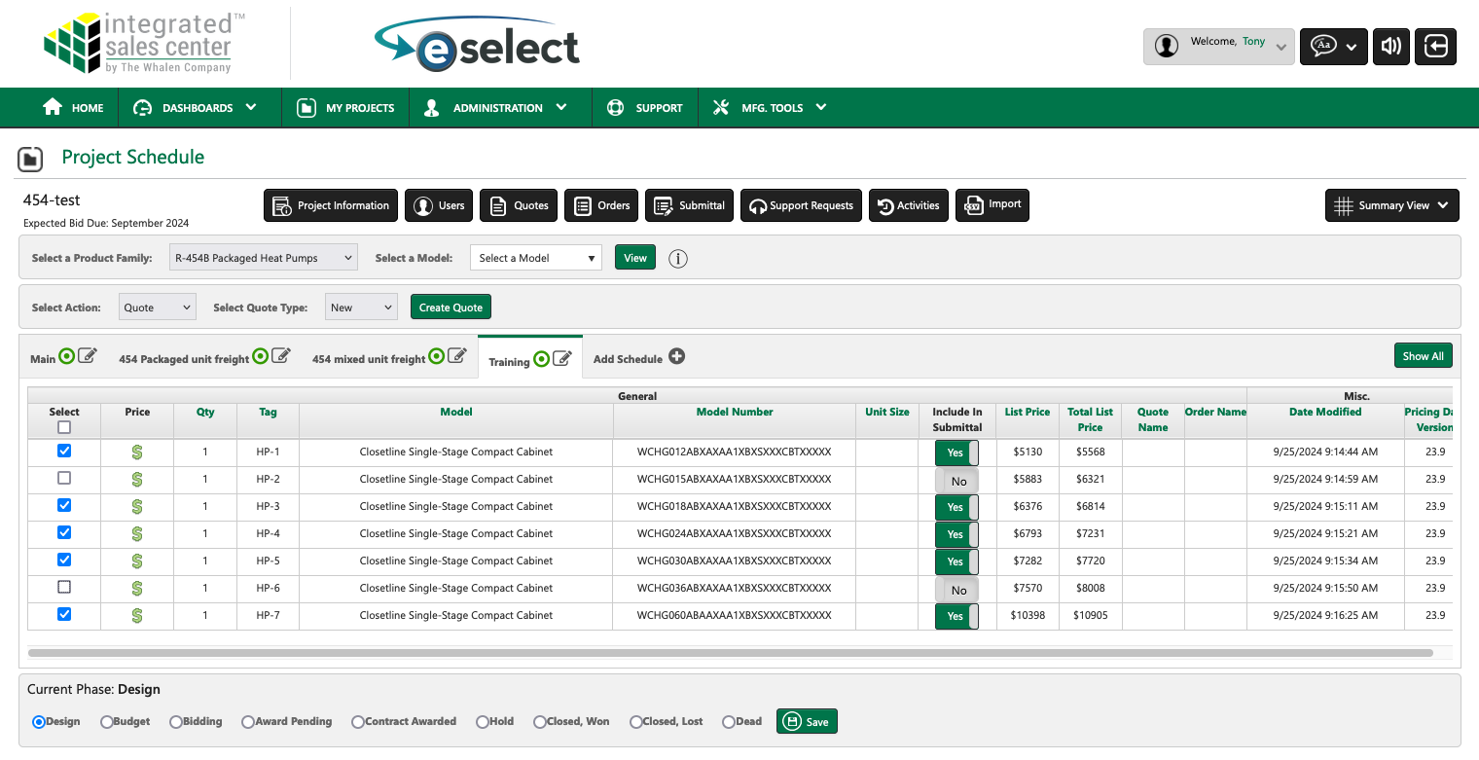
Creating a Quote

Slide 40
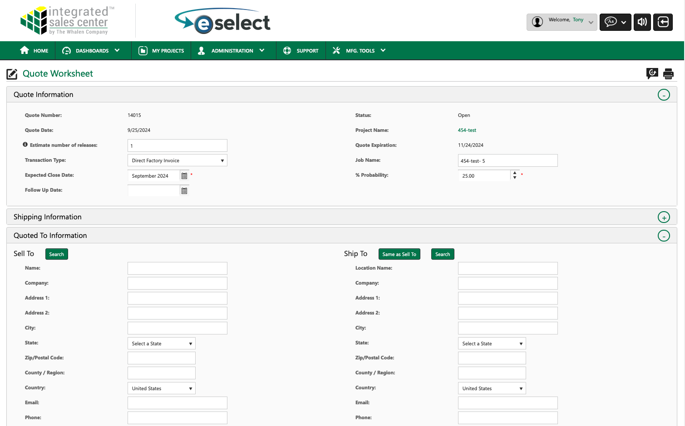
Quote Information

Slide 41
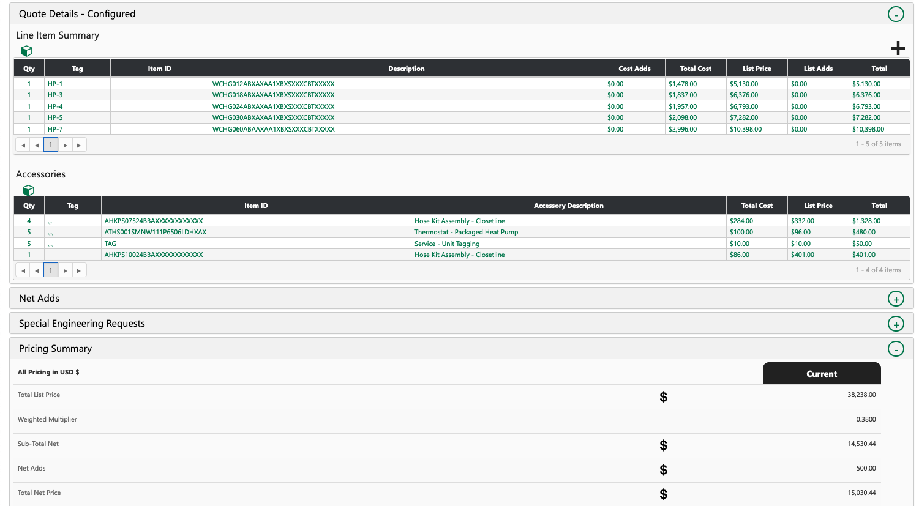
Quote Price Summary

Slide 42
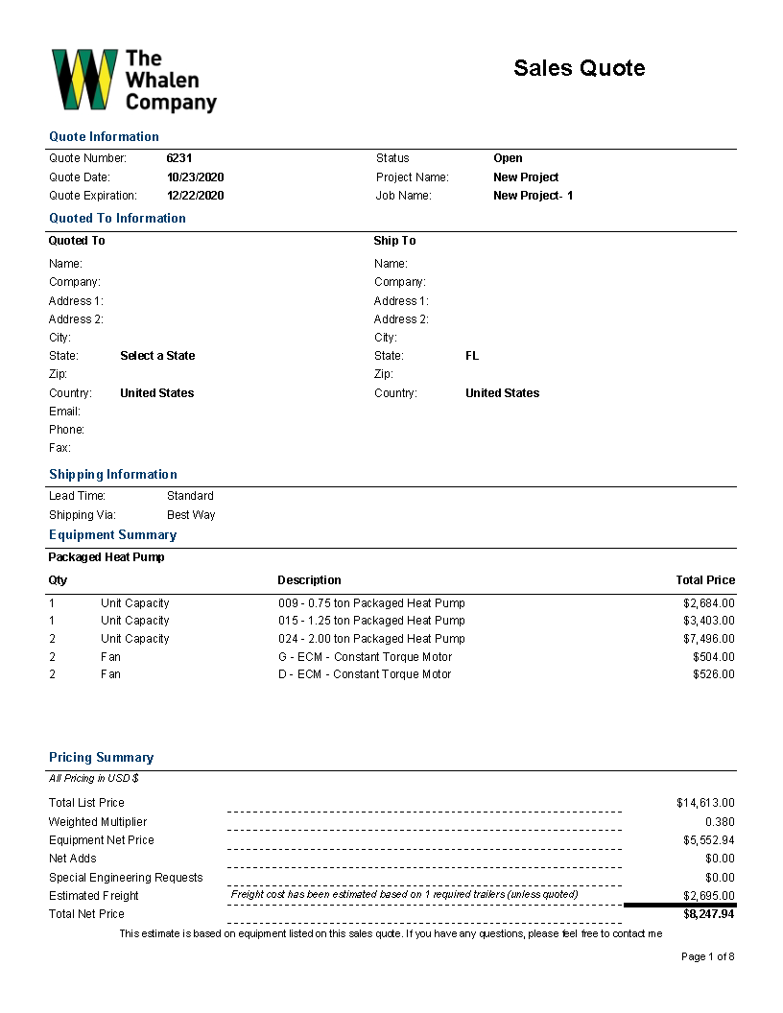
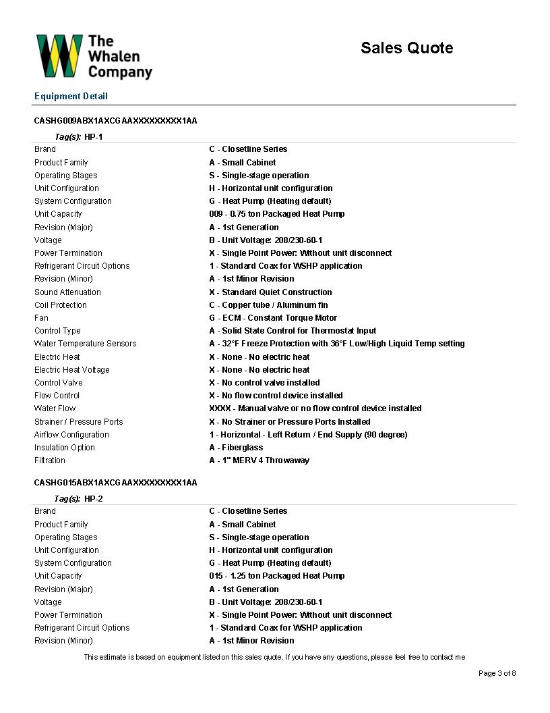
Quote Document

Slide 43
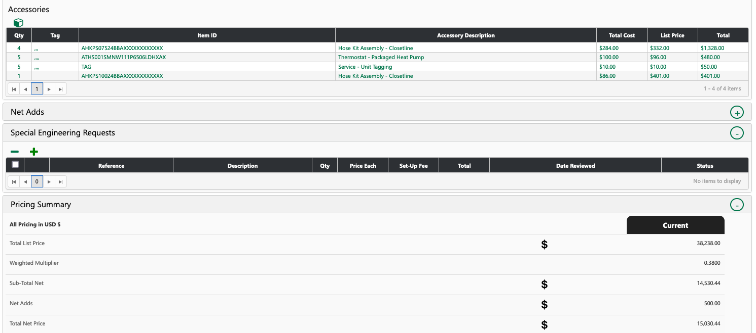
Special Engineering Request
Expand the Special Engineering Request section and click the “ + ” sign.

Slide 44
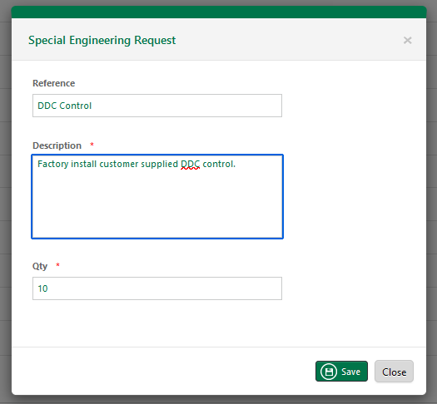
Special Engineering Request
Enter a reference that will how on the quote
Enter a short description of what is required.
Enter quantity of units to which this SER will apply.
Click save button to add to the quote
Repeat for each special required.

Slide 45
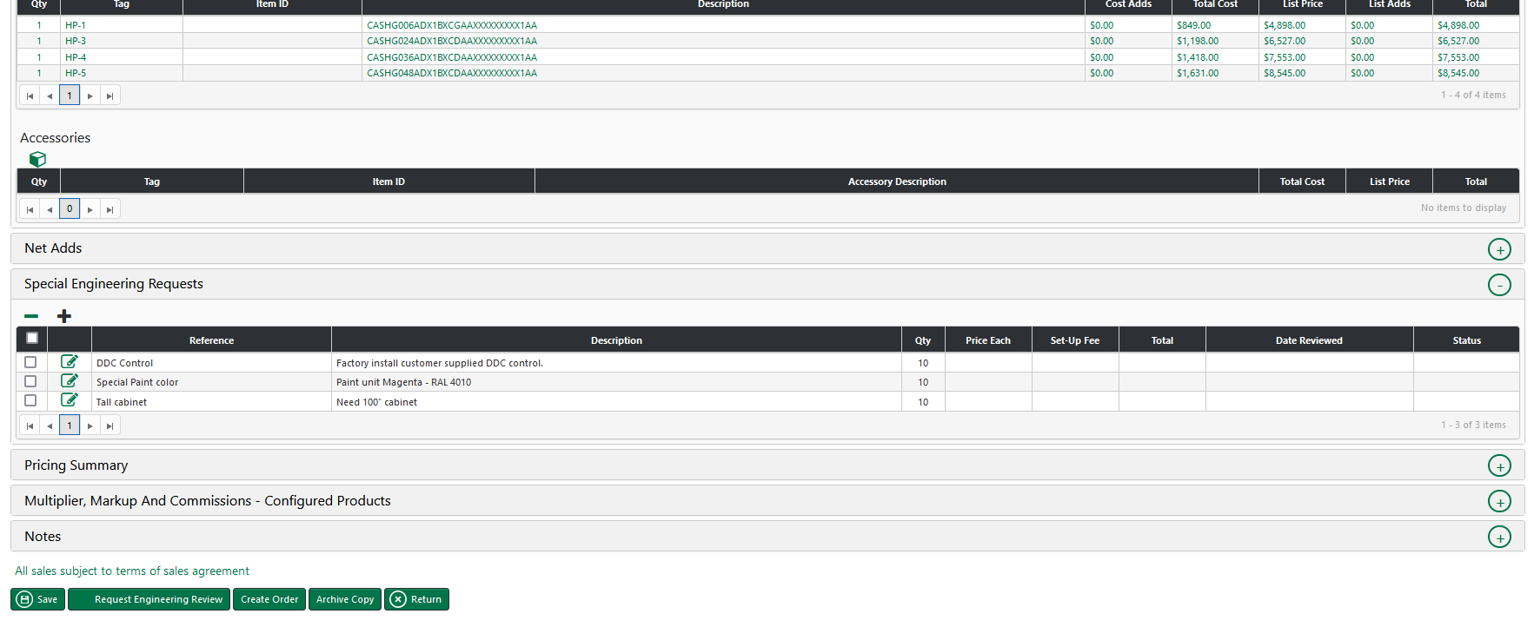
Special Engineering Request
Do not forget to click “ Request Engineering Review “ button at the bottom of the page

Slide 46
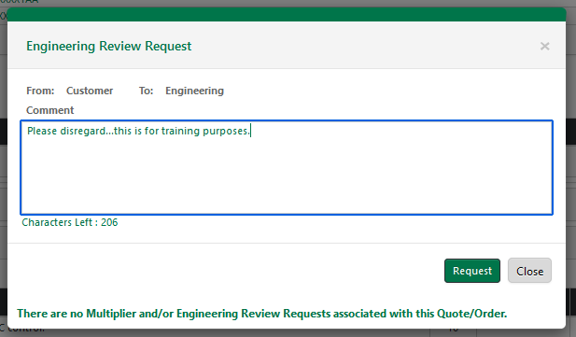
Special Engineering Request
Enter comment or note to engineering and click “ Request “ button.

Slide 47
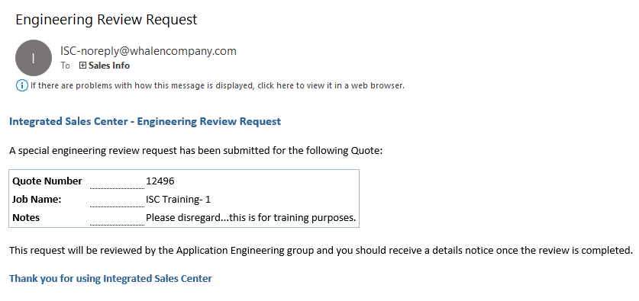
Special Engineering Request
You will receive an Email that we have received the SER.

Slide 48
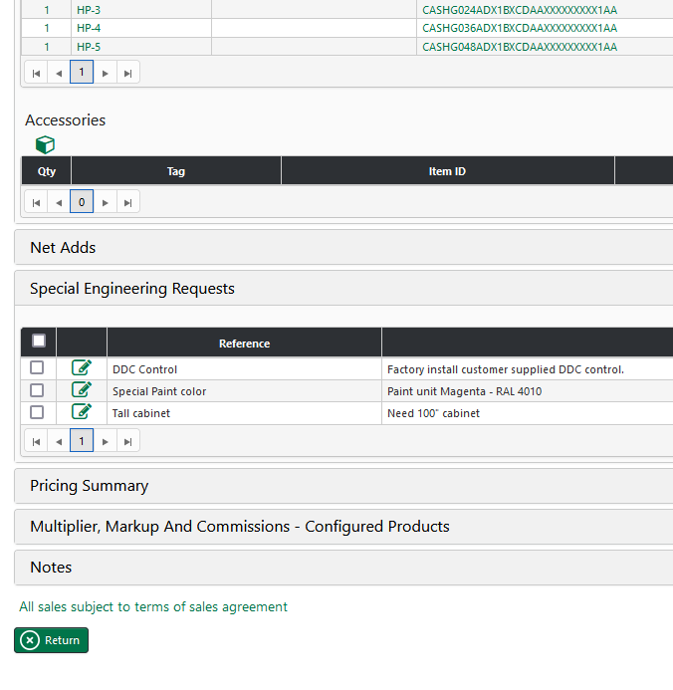
Special Engineering Request
Before Submitting SER
After Submitting SER
Notice all the button at the bottom are gone after SER is submitted.

Slide 49
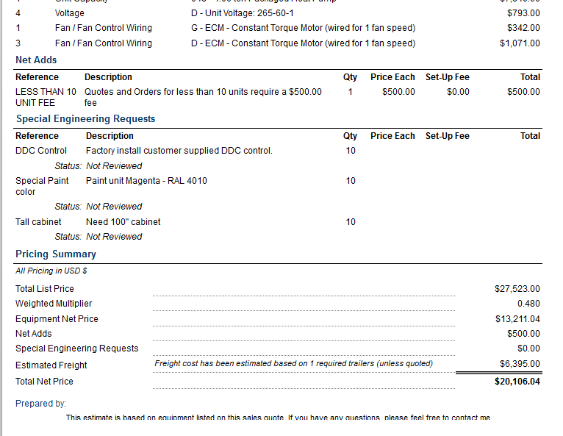
Special Engineering Request
Looking at the quote will also indicate the status of the SER.
If it is not submitted, they will not show.

Slide 50
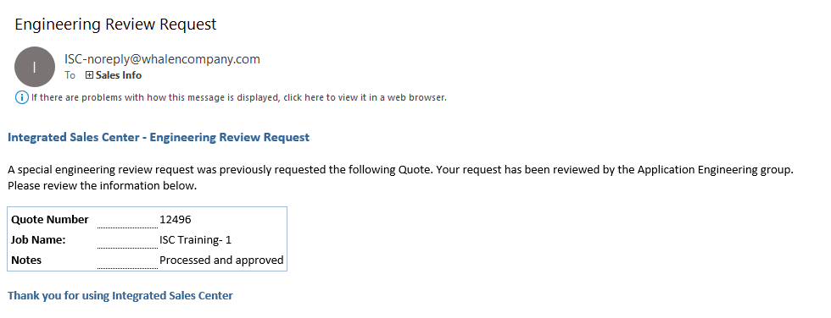
Special Engineering Request
After Engineering has reviewed, you will get a notification telling you the status or requesting additional information.

Slide 51
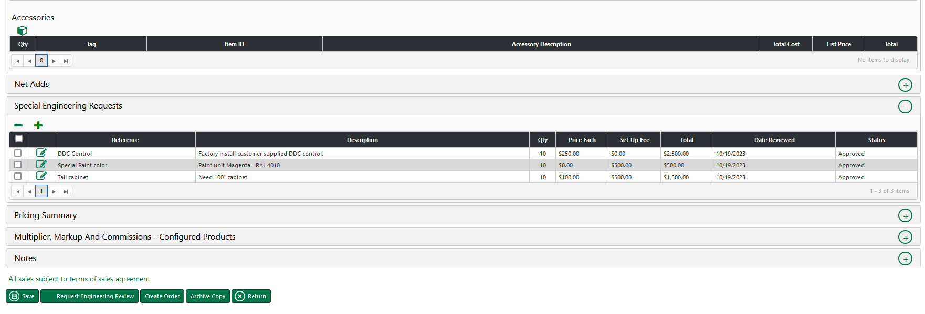
Special Engineering Request
After processing, Pricing is filled in & buttons are back

Slide 52
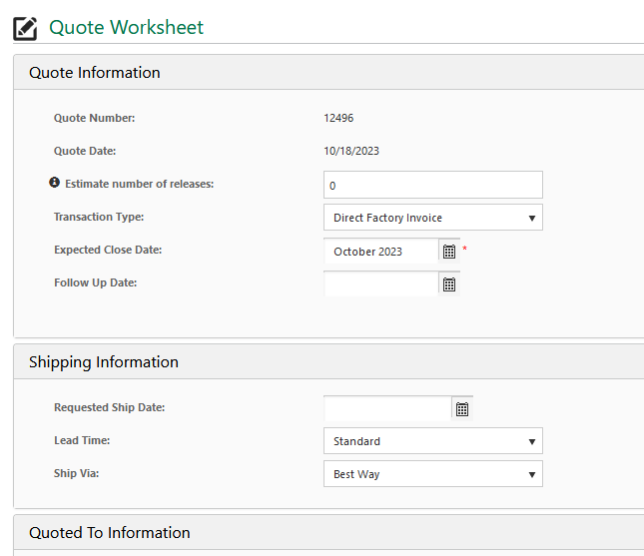
Special Multiplier Request
Set Transaction type to proper setting
Typically, Direct Factory Invoice for a commissioned sale
Buy/resell for orders less than 10 units.
Do not forget to click “ Request Engineering Review “ button at the bottom of the page

Slide 53
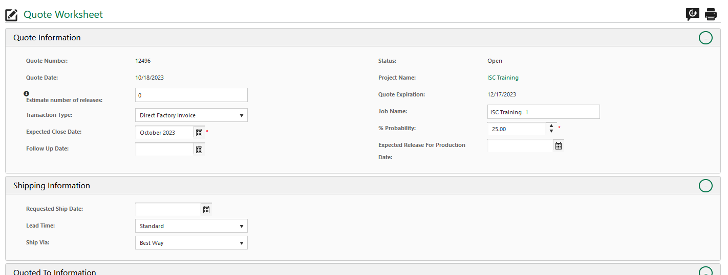
Special Multiplier Request
Expected Close Date – Date Whalen will receive a PO
Expected Release for Production – Date you will release to manufacturing
Requested Ship date – Date the project will begin shipping

Slide 54
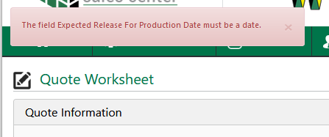
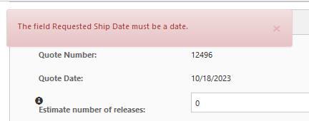
Special Multiplier Request
If the fields are blank, this will be the error you receive.

Slide 55

Special Multiplier Request
Enter desired multiplier & commission.
Click Request Special Discount.

Slide 56

Special Multiplier Request
Enter the reason for the special Multiplier Request and who is the Basis of Design.
Click “ Request “ button to submit the request to Whalen.

Slide 57

Special Multiplier Request
You will receive an Email that we have received the SMR.
Typically get a response within a day.

Slide 58

Special Multiplier Request
Similar to Special Engineer Request, all the buttons at the bottom of the page are not available until the request is processed.
After Submitting SMR
Notice all the button at the bottom are gone after SMR is submitted.

Slide 59

Creating an Order
Do not create order here
Always create your order from the final quote.

Slide 60

Creating an Order
LTL freight / special freight
Always create your order from the final quote.

Slide 61

Order Information

Slide 62

Order Price Summary

Slide 63

Attach Required Documents
Do not Forget to attach PO, Approved Submittal, & Riser Schedule

Slide 64

Order Completion
Do not Submit Order until reviewed by your RM & Inside Sales

Slide 65
Questions?

