Slide 1
Innoline® 50/50 Four Pipe System

Slide 2

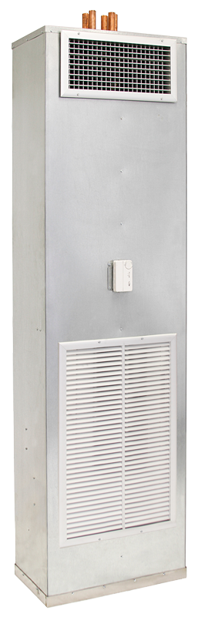
Innoline® 50/50 Riser Fan Coil
300 to 1600 CFM
Footprint
300 to 400 CFM: 24” x 14”
600 CFM: 28” x 14”
800 to 1000 CFM: 32” x 14”
1200 to 1600 CFM: 36” x 16”
4-pipe compatibility
Standard PSC motor
Optional EC motor
Naturally balanced
No soldered connections within the unit
Reduced installation and maintenance costs
Fan and pump staging for energy efficiency

Slide 3
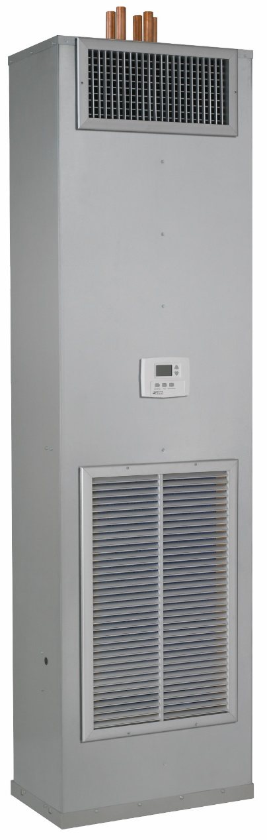
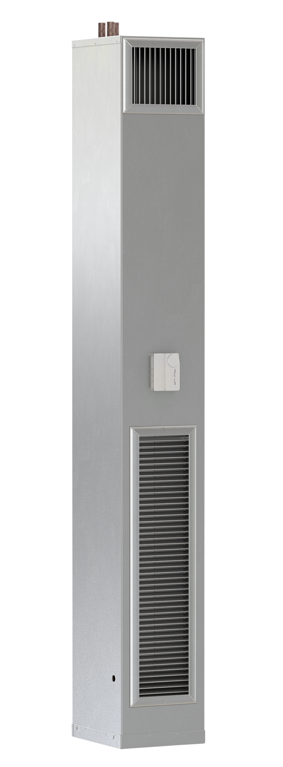
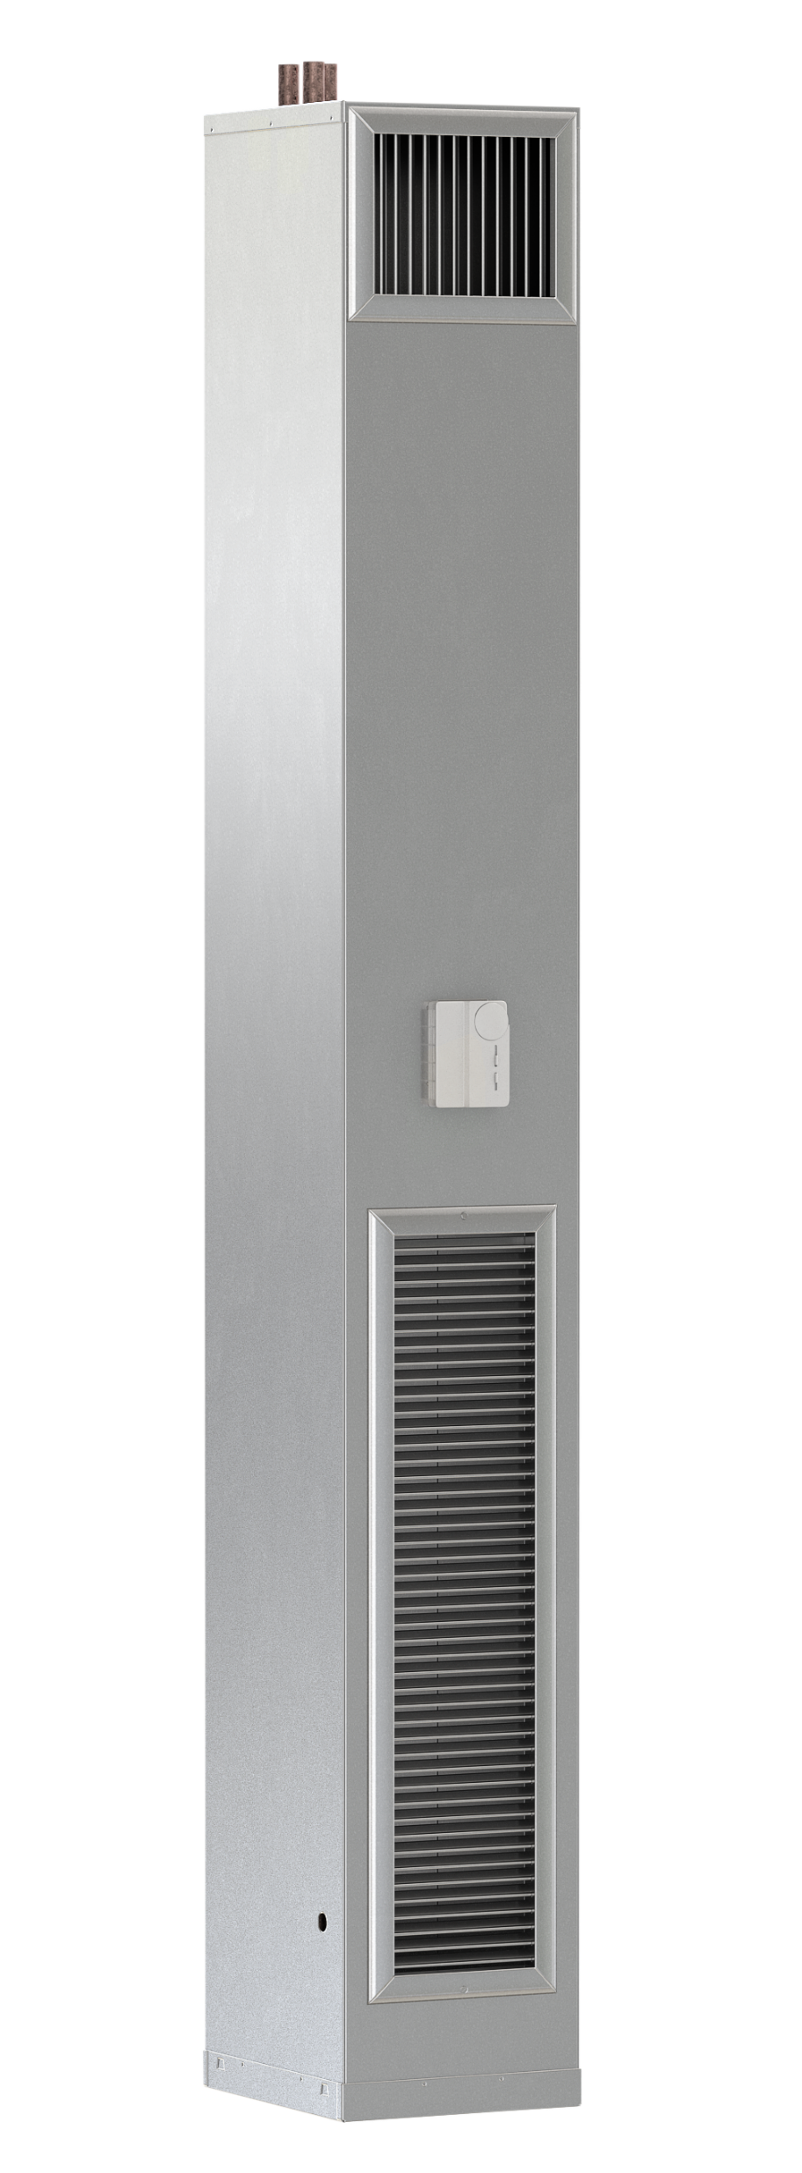
Innoline® 50/50 4-Pipe System
Energy Savings
Design Simplicity
Servicing Ease
Superior occupant comfort
Two 2-pipe 1-stage fan coils
One 4-pipe 2-stage fan coil

Slide 4
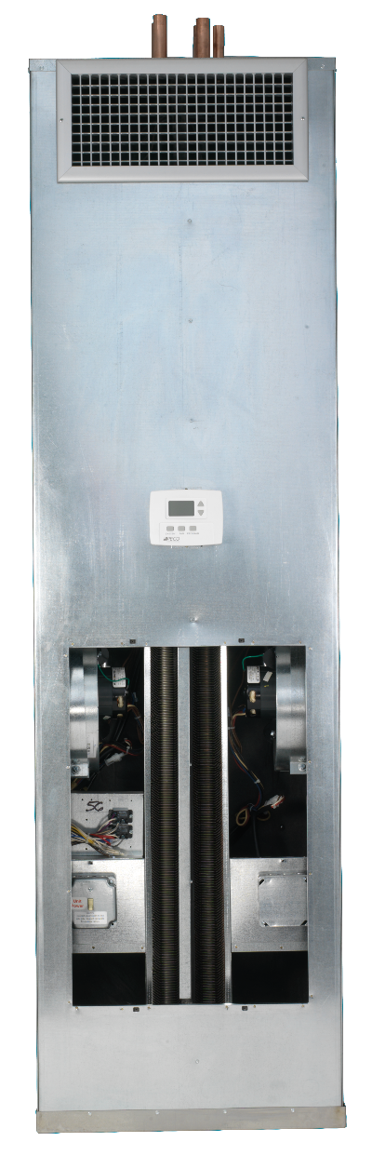
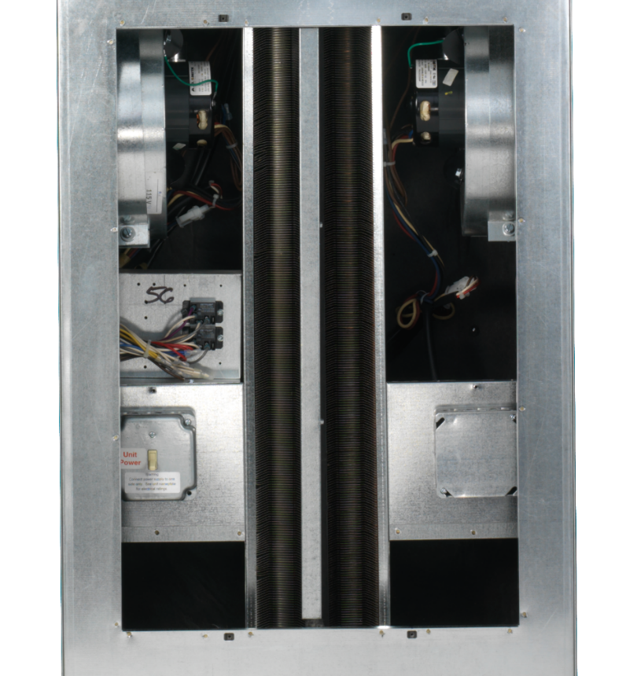
Innoline® 50/50 Riser Fan Coil

Slide 5
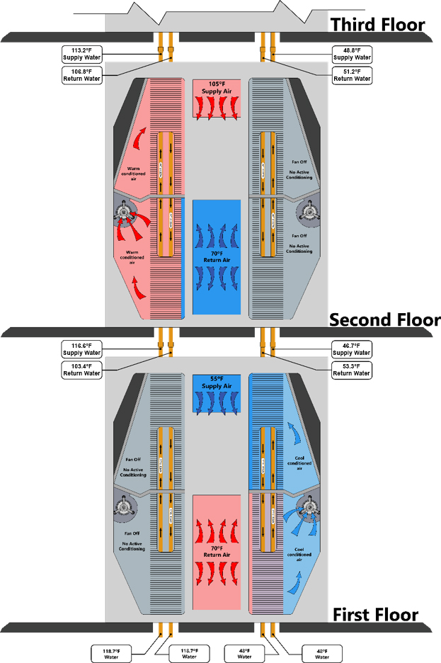
50% Cooling / 50% Heating

Slide 6
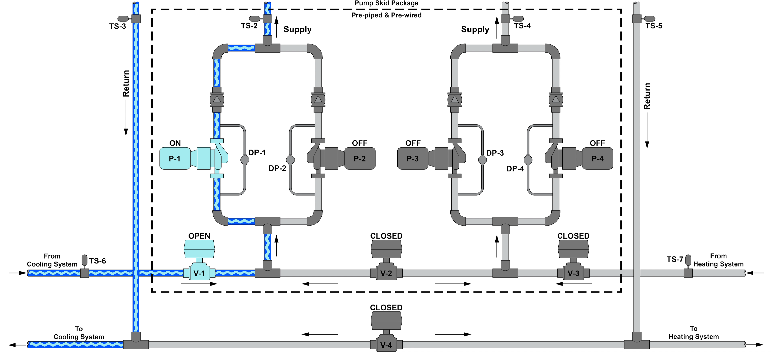
No Heating / Partial Cooling

Slide 7
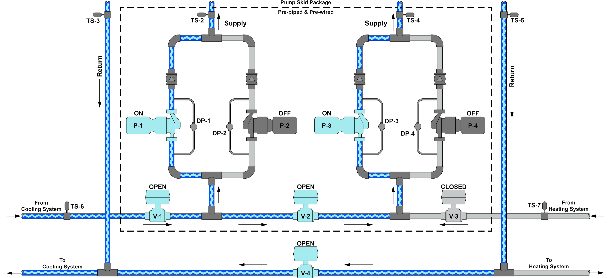
No Heating / Full Cooling

Slide 8
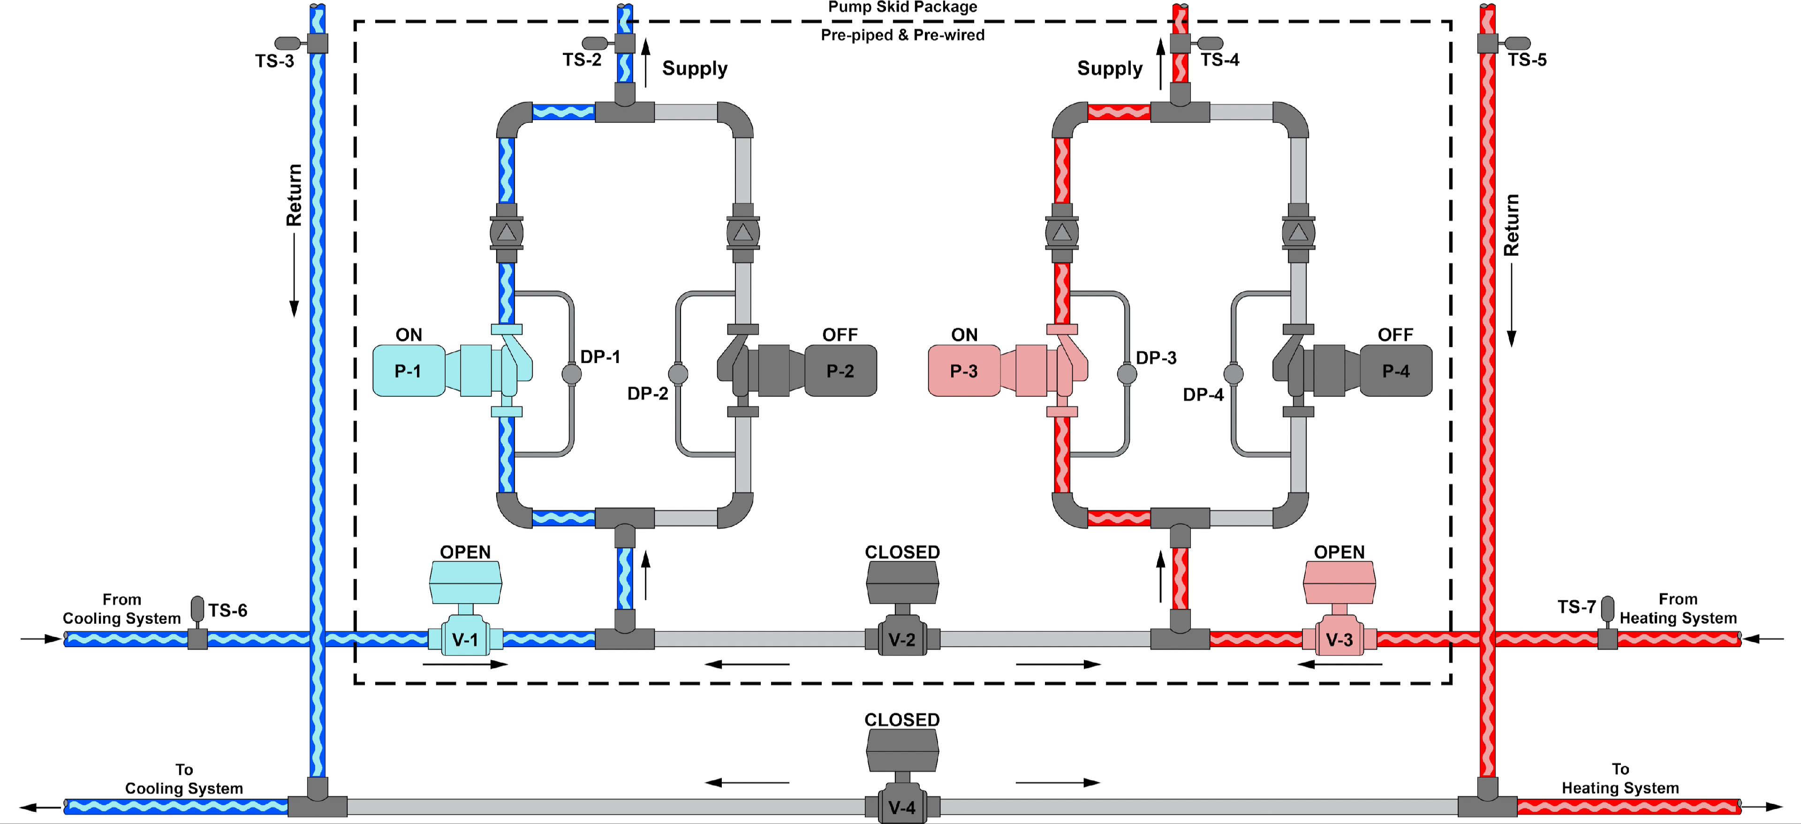
Partial Heating / Partial Cooling

Slide 9
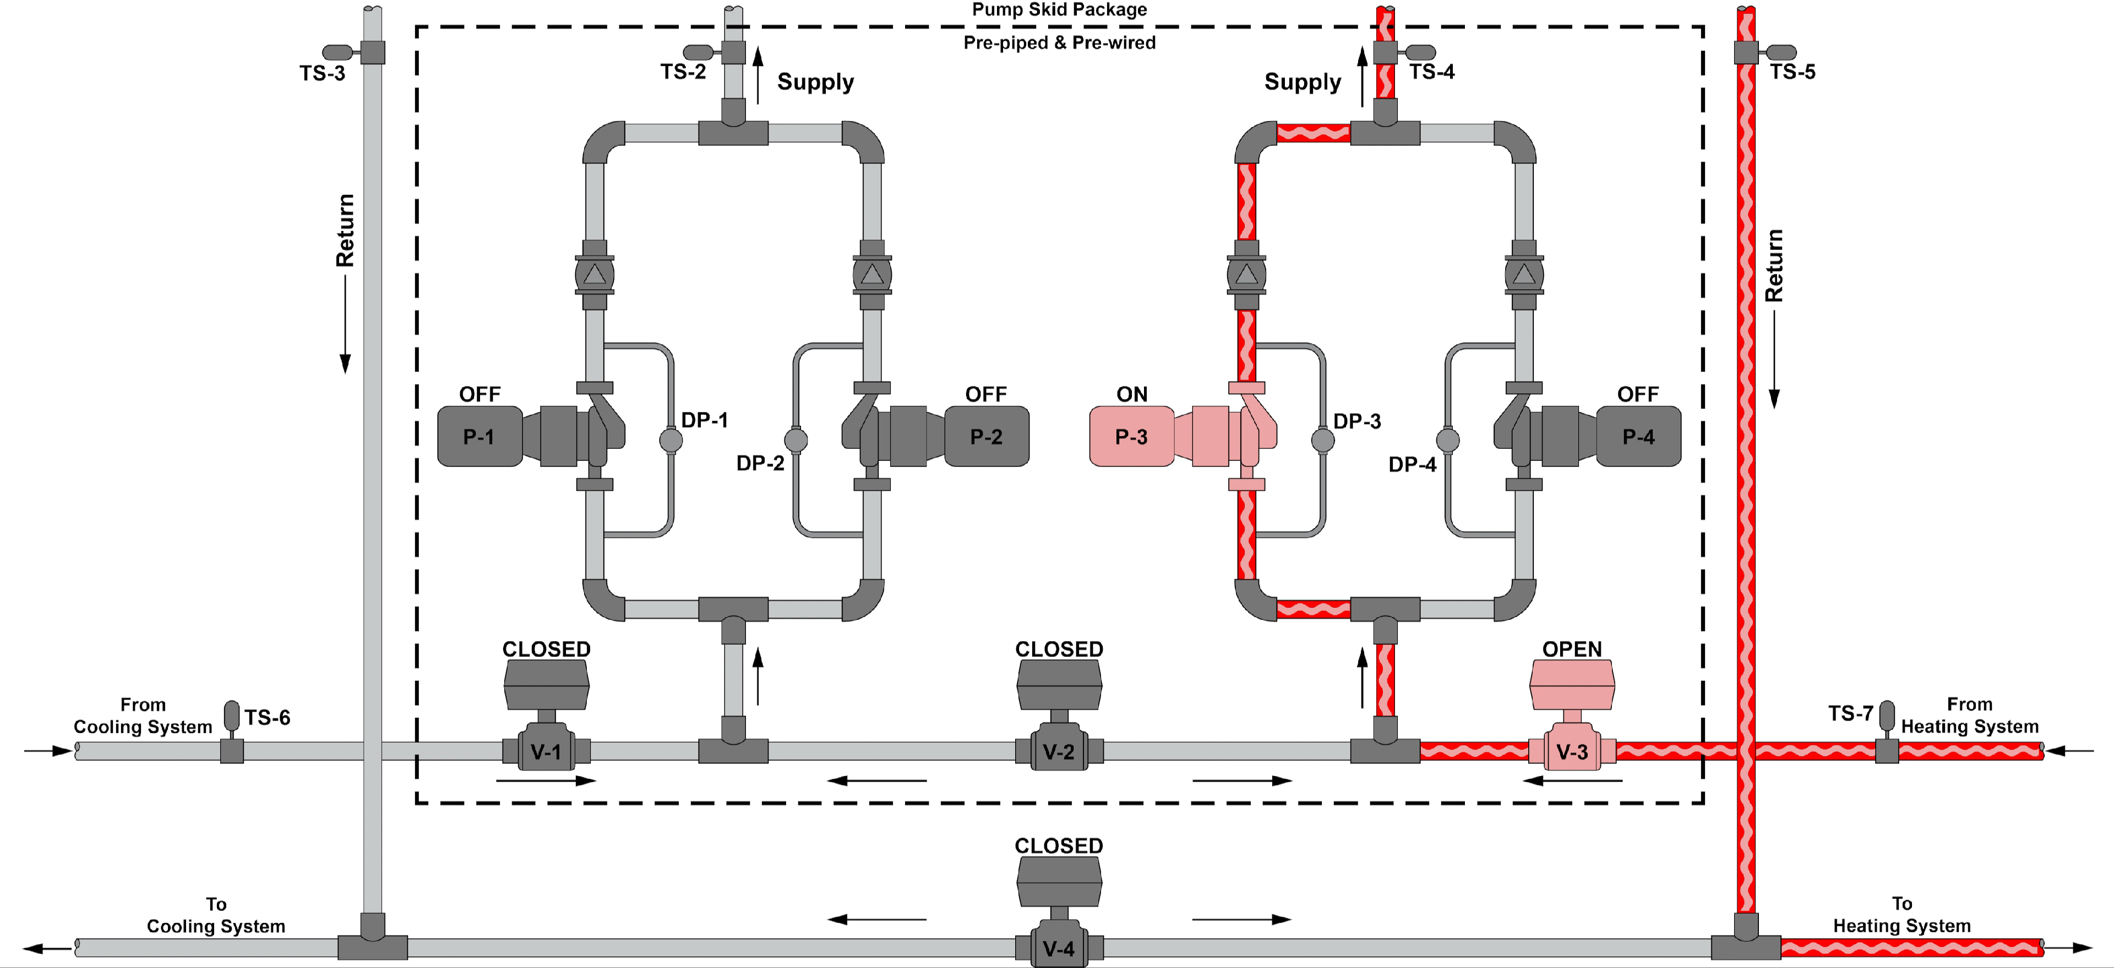
Partial Heating / No Cooling

Slide 10
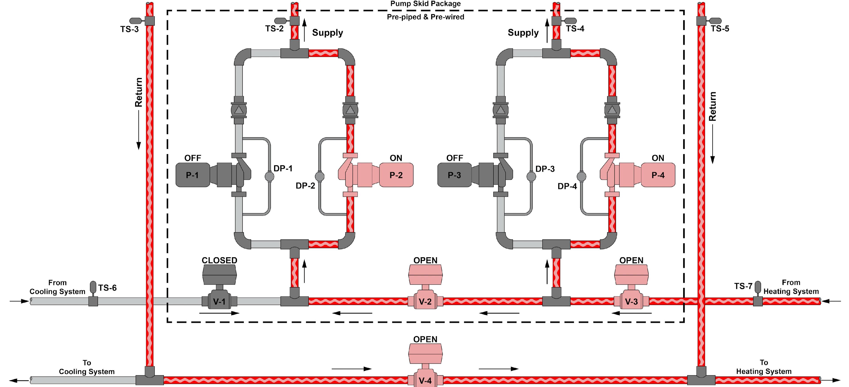
Full Heating / No Cooling

Slide 11
Innoline® 50/50 Selling Points
Innoline® 50/50 Units provide better performance at part load since each fan and coil is sized for a lower load
Innoline® 50/50 Units continually dehumidify the air by allowing the chilled water to be active 100% of the time
Innoline® 50/50 Units deliver only the load required for each season; this saves energy and provides better comfort
Up to 85% of the time, a Fan Coil Unit can operate at less than half capacity

Slide 12
Piping & Maintenance
Pipe cost savings for both material and labor
The decrease in chilled water pipe size more than offsets the increase in hot water pipe size
Smaller pipes for larger capacities also OPENS the door for cost effective two- and three-story applications
Maintenance
The only moving part on Whalen 50/50 Units is the fan motor which can be changed in less than 10 minutes

Slide 13
Design Consideration
Operates at lower hot water temperatures
Separate hot water loops of Whalen and other heating equipment
Maximum of 140° F EWT
Outdoor reset
Design should incorporate indoor/outdoor reset of hot water supply temperature

Slide 14
Questions?
Notes:
14

