Slide 1
Innoline® Riser Fan Coil Units &
Innoline® 50/50 4-Pipe System

Slide 2
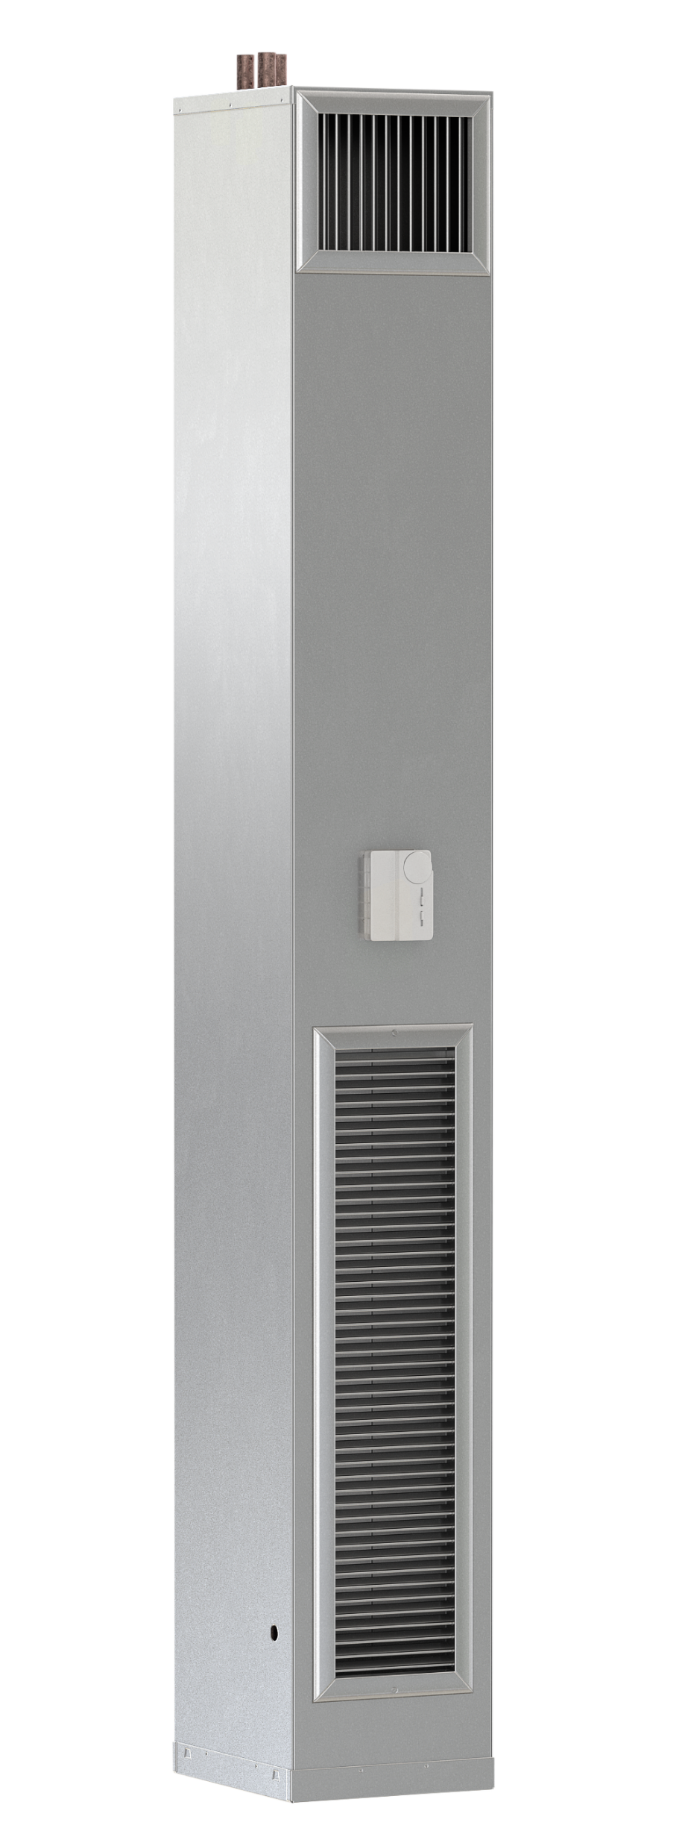
Innoline® Riser Fan Coil
What is an Innoline® Riser Fan Coil?
The product that started The Whalen Company
It’s a valveless fan coil
The risers are inside the cabinet with fins on them
One of if not the smallest footprint unit on the market

Slide 3
Innoline® Riser Fan Coil
What is an Innoline® Riser Fan Coil?
A different type of fan coil than anyone else
A tremendous opportunity for replacement for those markets with an installed base.
A tremendous opportunity for those owners that are looking for operating savings.

Slide 4

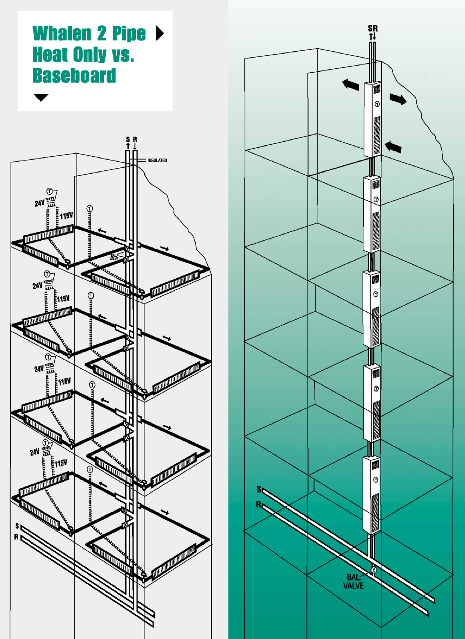
Innoline® Riser Fan Coil
Whalen Innoline® 2-Pipe Heat Only vs. Baseboard heating
Same finned tube type coil
Enclosed in a cabinet with a forced air fan
Very simple & Very reliable forced air, finned tube, radiator
All solder joints are external to the cabinet

Slide 5
Ideal Buyer
More often than not, it will be the building owner that is planning to operate the building long term.
Unit longevity, efficiency, and low maintenance are the drivers

Slide 6

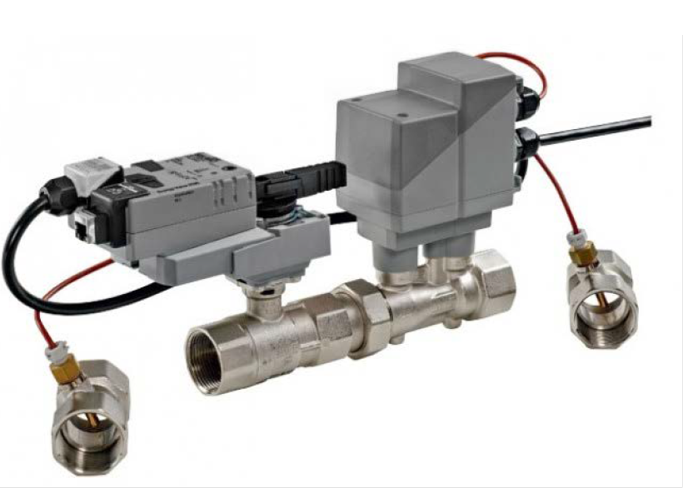
Innoline® Riser Fan Coil
200 to 800 CFM
Footprint
  200 to 300 CFM: 12” x 14”
  400 to 500 CFM: 16” x 14”
  600 to 800 CFM: 18” x 16”
Smallest footprint on the market
Lower Pumping Costs: Elimination of system resistance caused by system valves, coils, and run-out piping
Add the Innoflow™ valve to take advantage
of a Variable Flow System
Full time humidity control: Face and Bypass Dampers
Unit types
  2-Pipe Riser Fan Coil
  4-Pipe Riser Fan Coil
  Whalen Heater

Slide 7
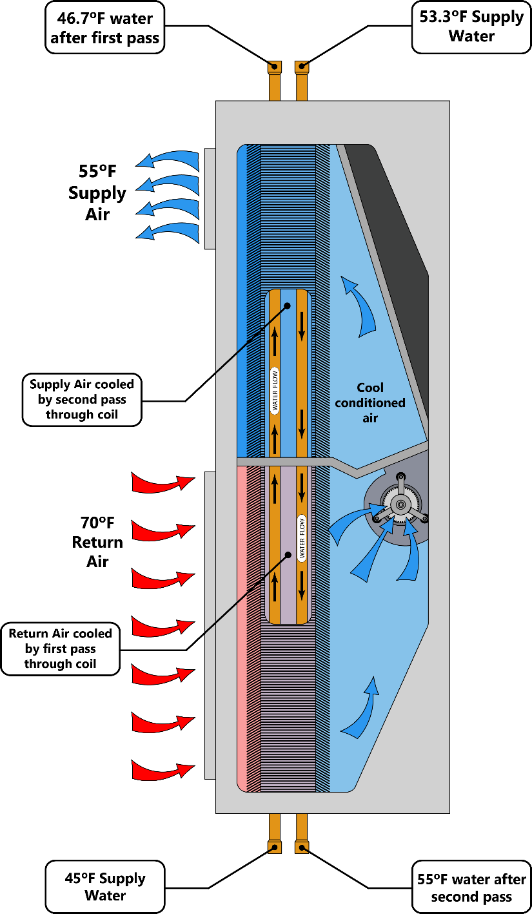
The Whalen System
It works by Thermodynamic Performance
Average water temperature
  Total riser GPM goes through each unit
  Takes advantage of a large finned surface area
Primary and secondary surface
Four air passes
Humidity control

Slide 8
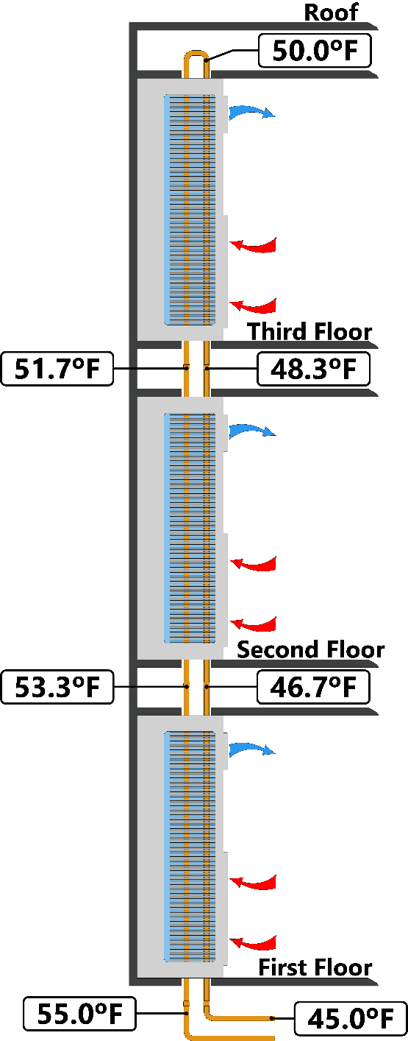
The Whalen System
(50.0 + 50.0)/2 = 50
(51.7 + 48.3)/2 = 50
Average water temp = 50ºF
(53.3 + 46.7)/2 = 50
45.0 EWT
(55.0 + 45.0)/2 = 50

Slide 9
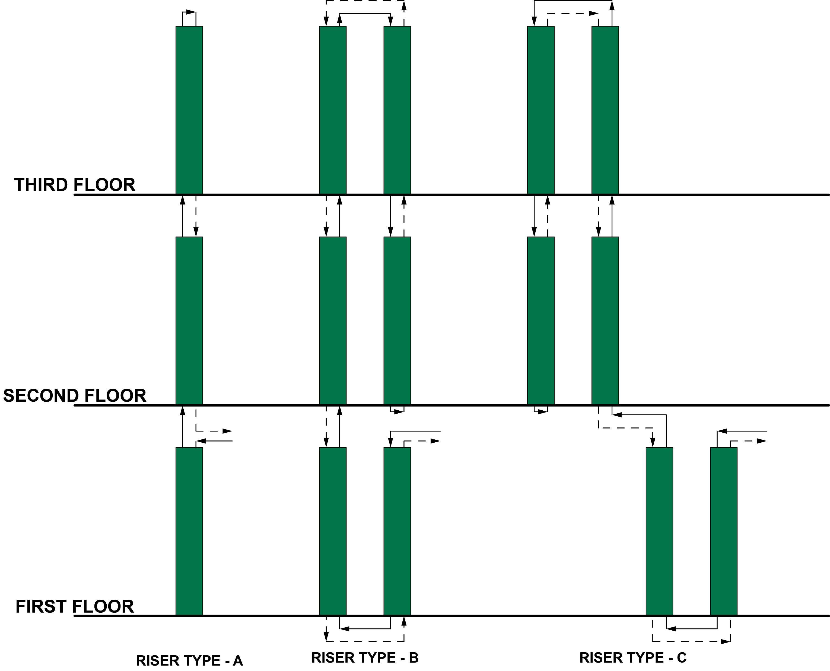
Unit Looping – Series Piping

Slide 10
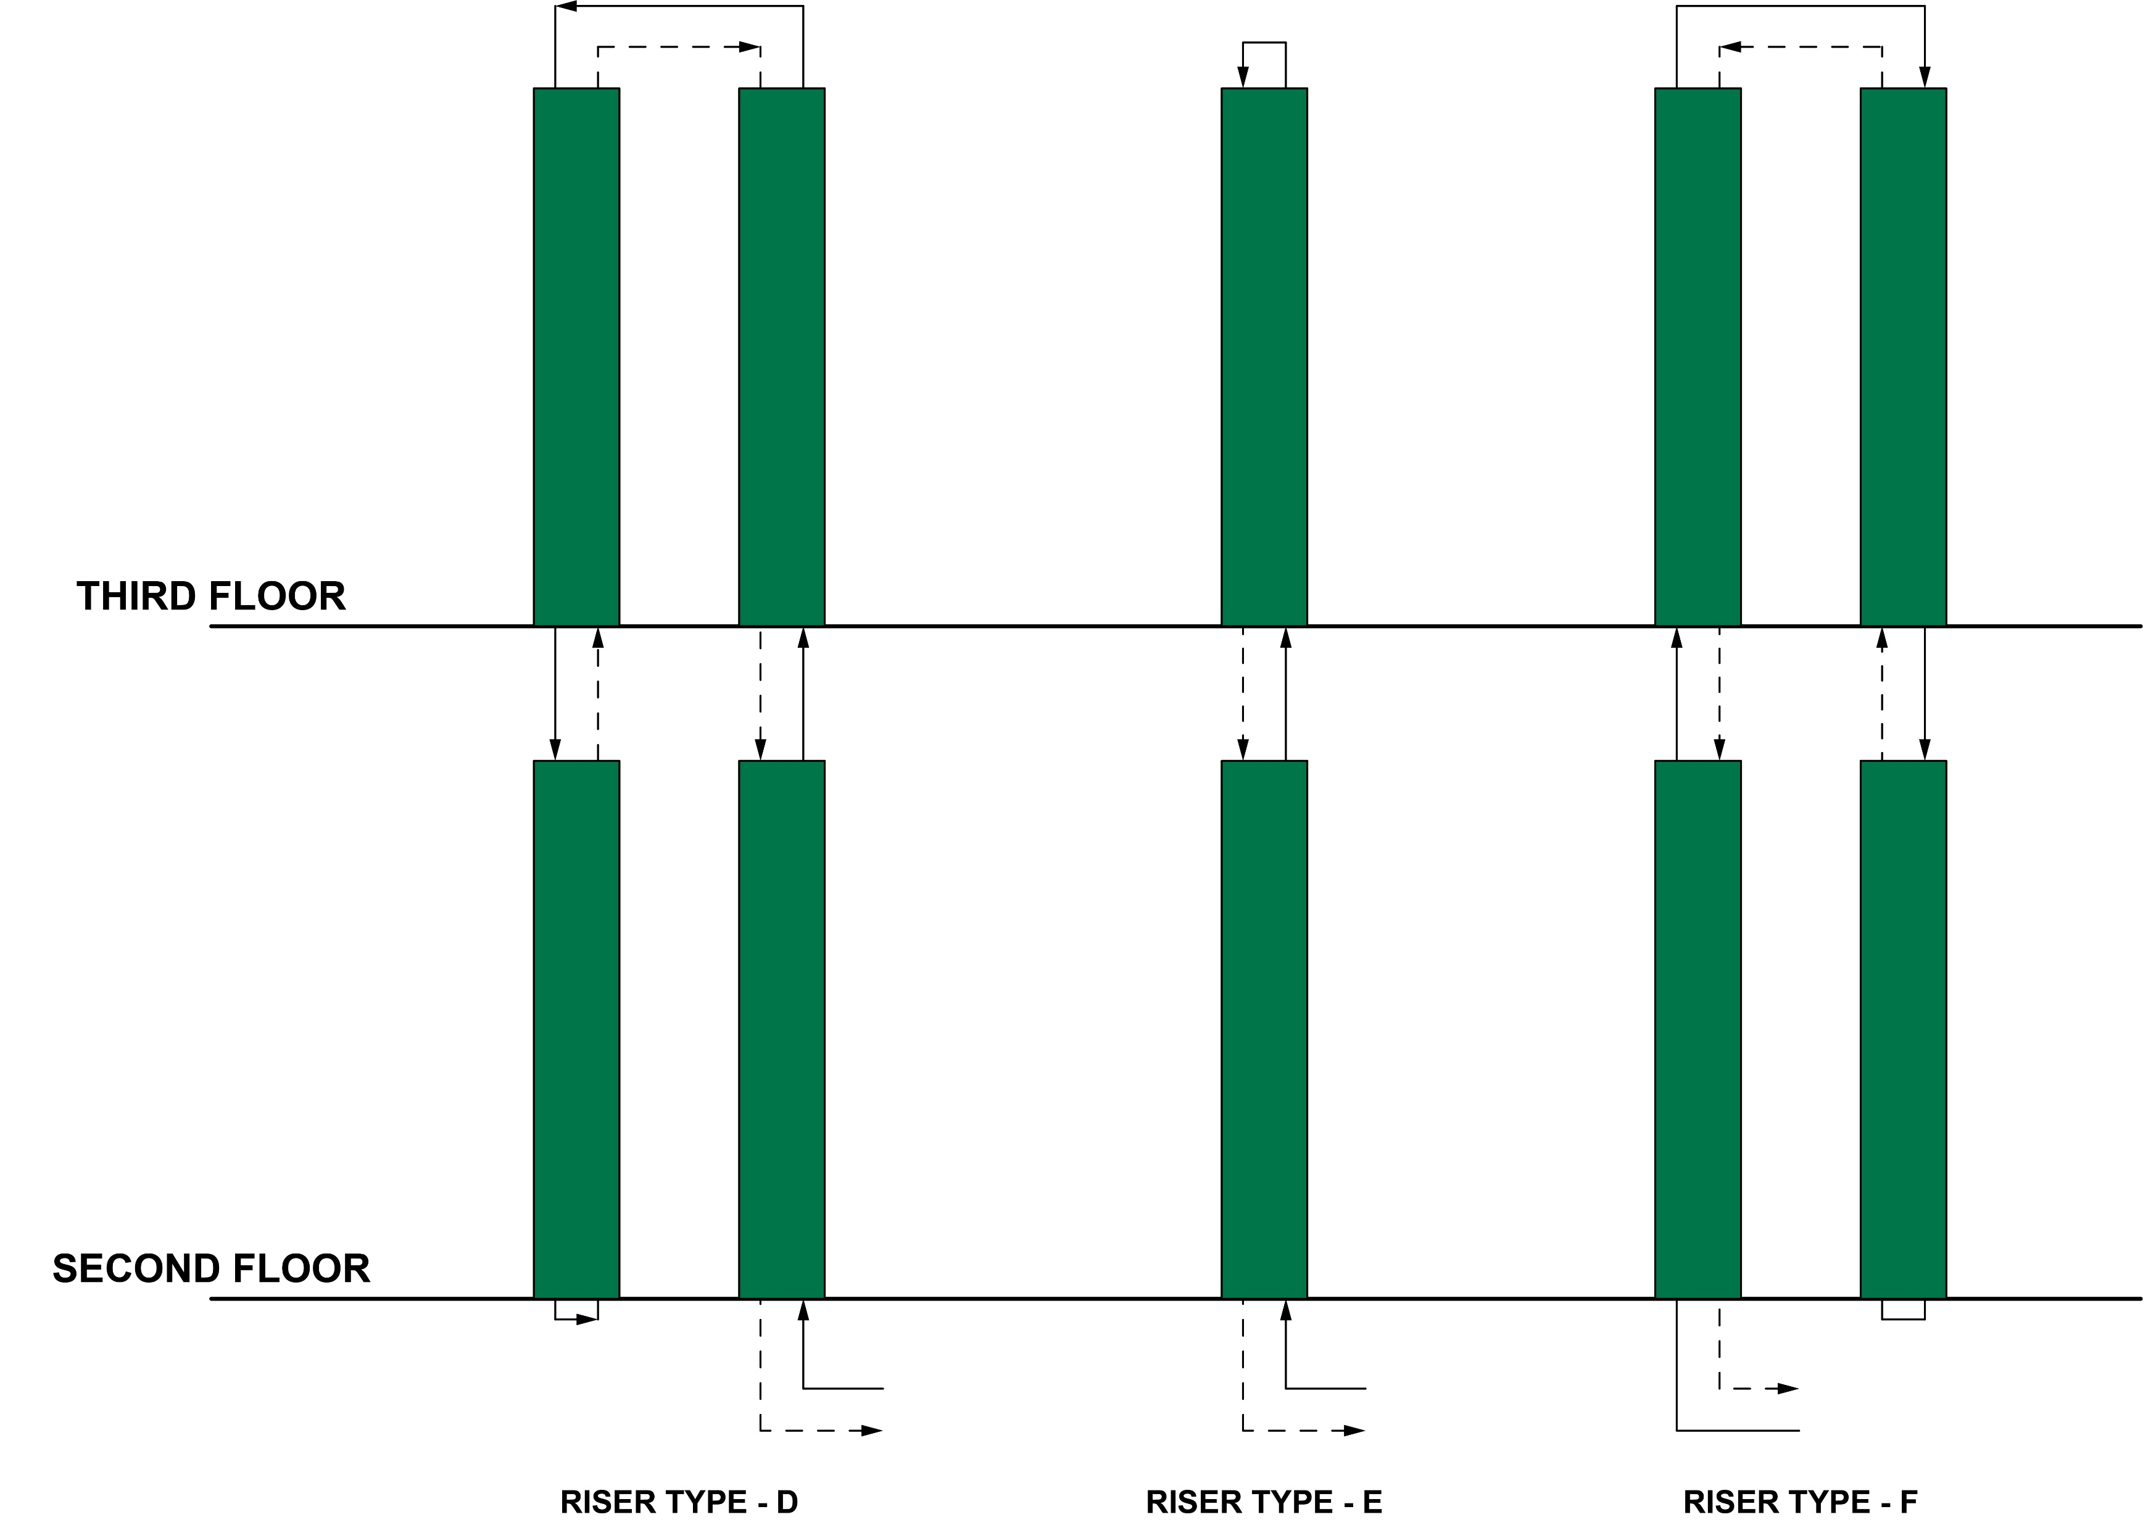
Unit Looping – Series Piping

Slide 11
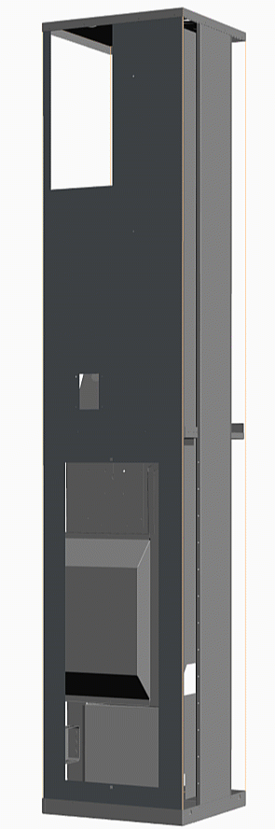
Innoline® Riser Fan Coil – Air Path

Slide 12
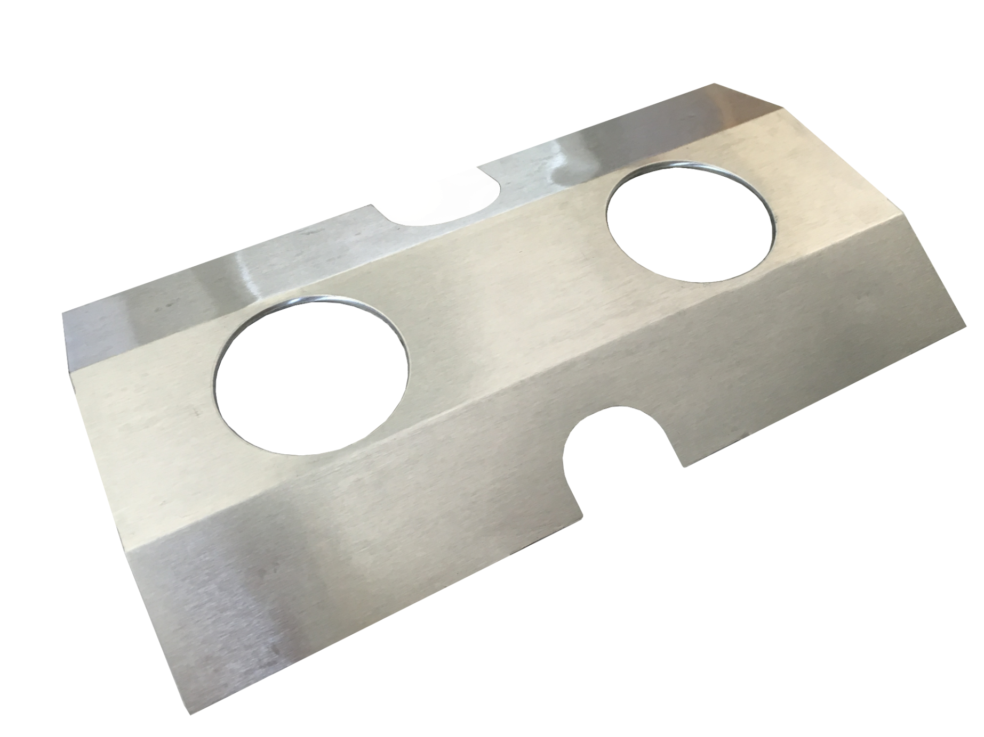
Compact Riser Grouping
Drain
Return
Supply
Drain

Slide 13
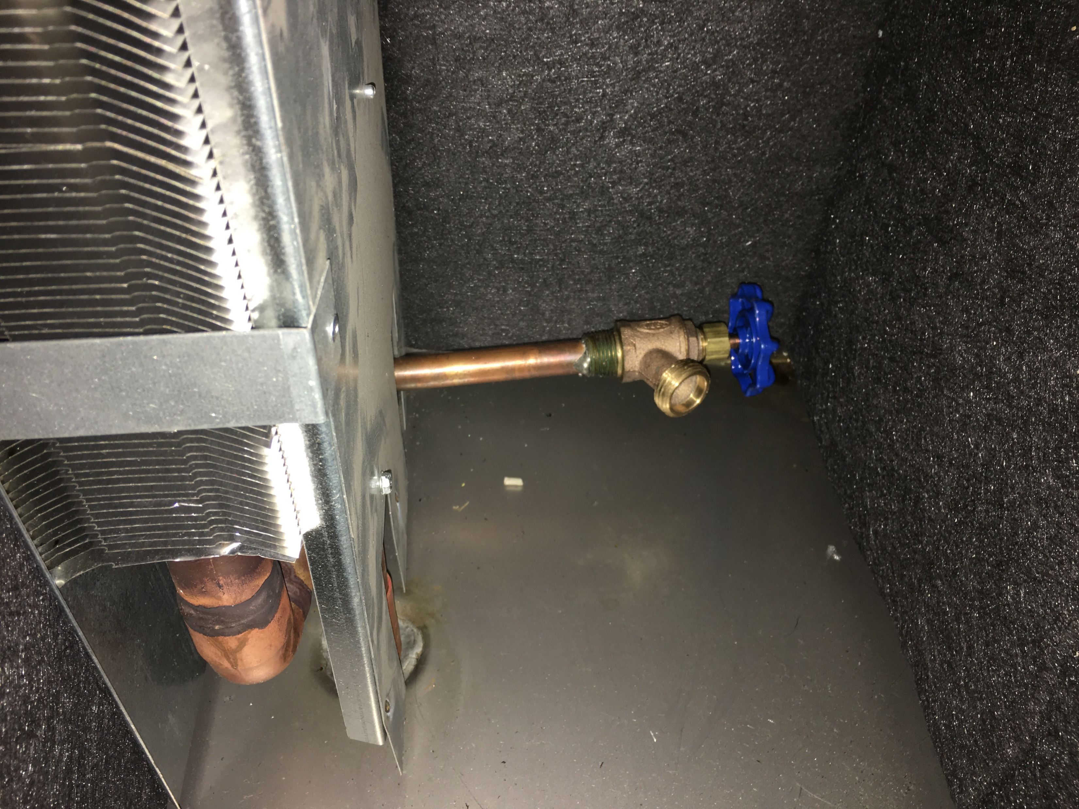
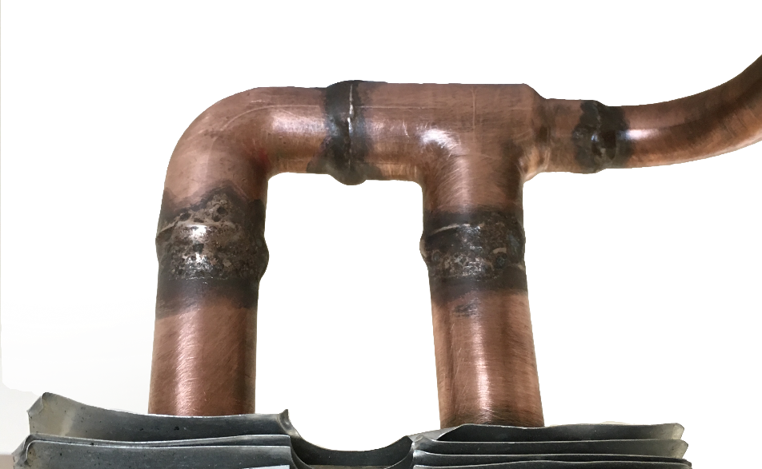
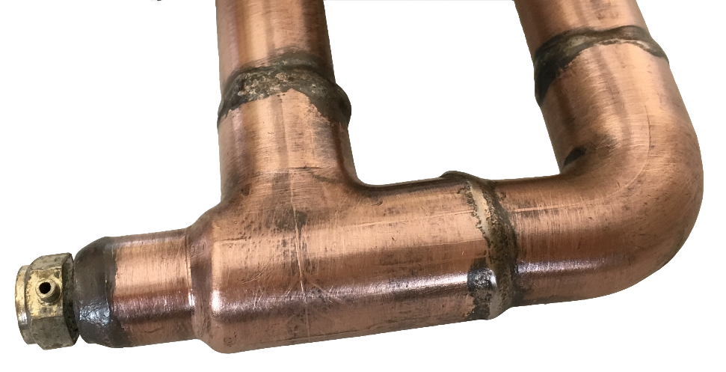
Riser Terminations
Bottom U-Bend with drain valve
Top U-Bend with manual vent
Bottom U-Bend

Slide 14
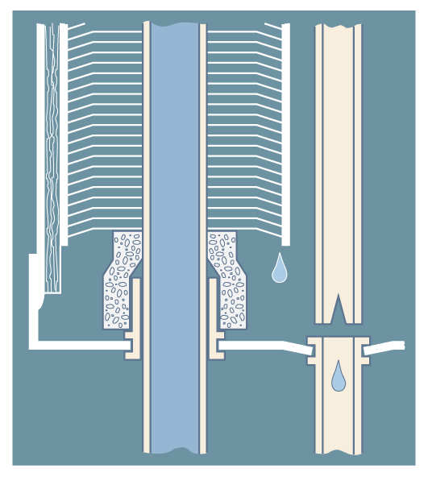
The Whalen Concept
Condensate Drain

Slide 15
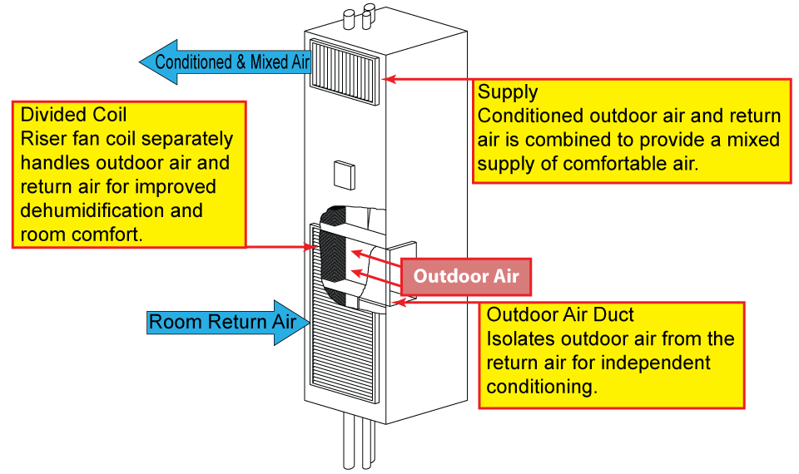
Conditioning Outdoor Air

Slide 16
Questions?
Notes:
16

