Slide 1

Refrigerant Transition

Slide 2
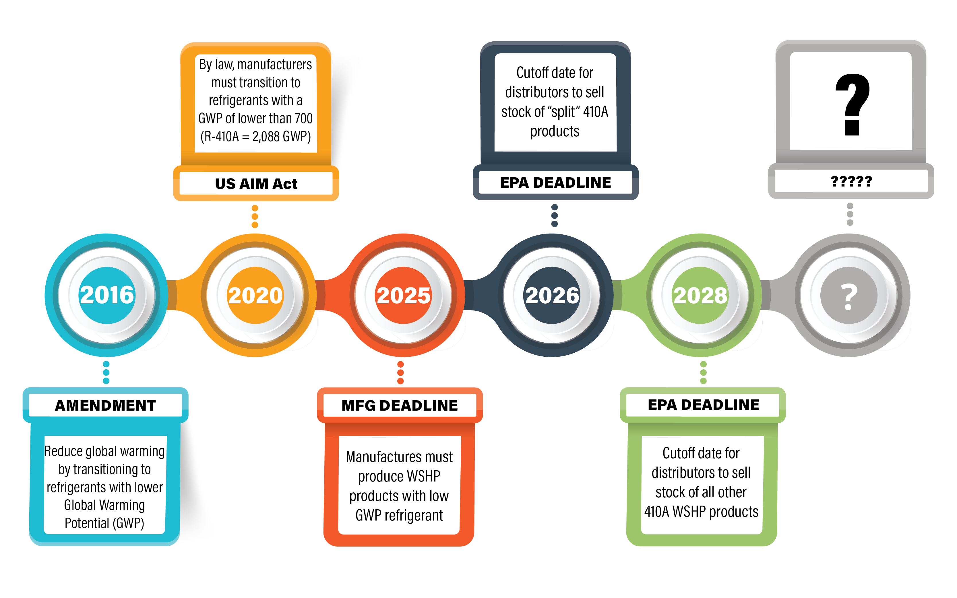
Refrigeration Transition Timeline

Slide 3
Refrigeration Transition Timeline
Next Deadline
IMPORTANT

Slide 4
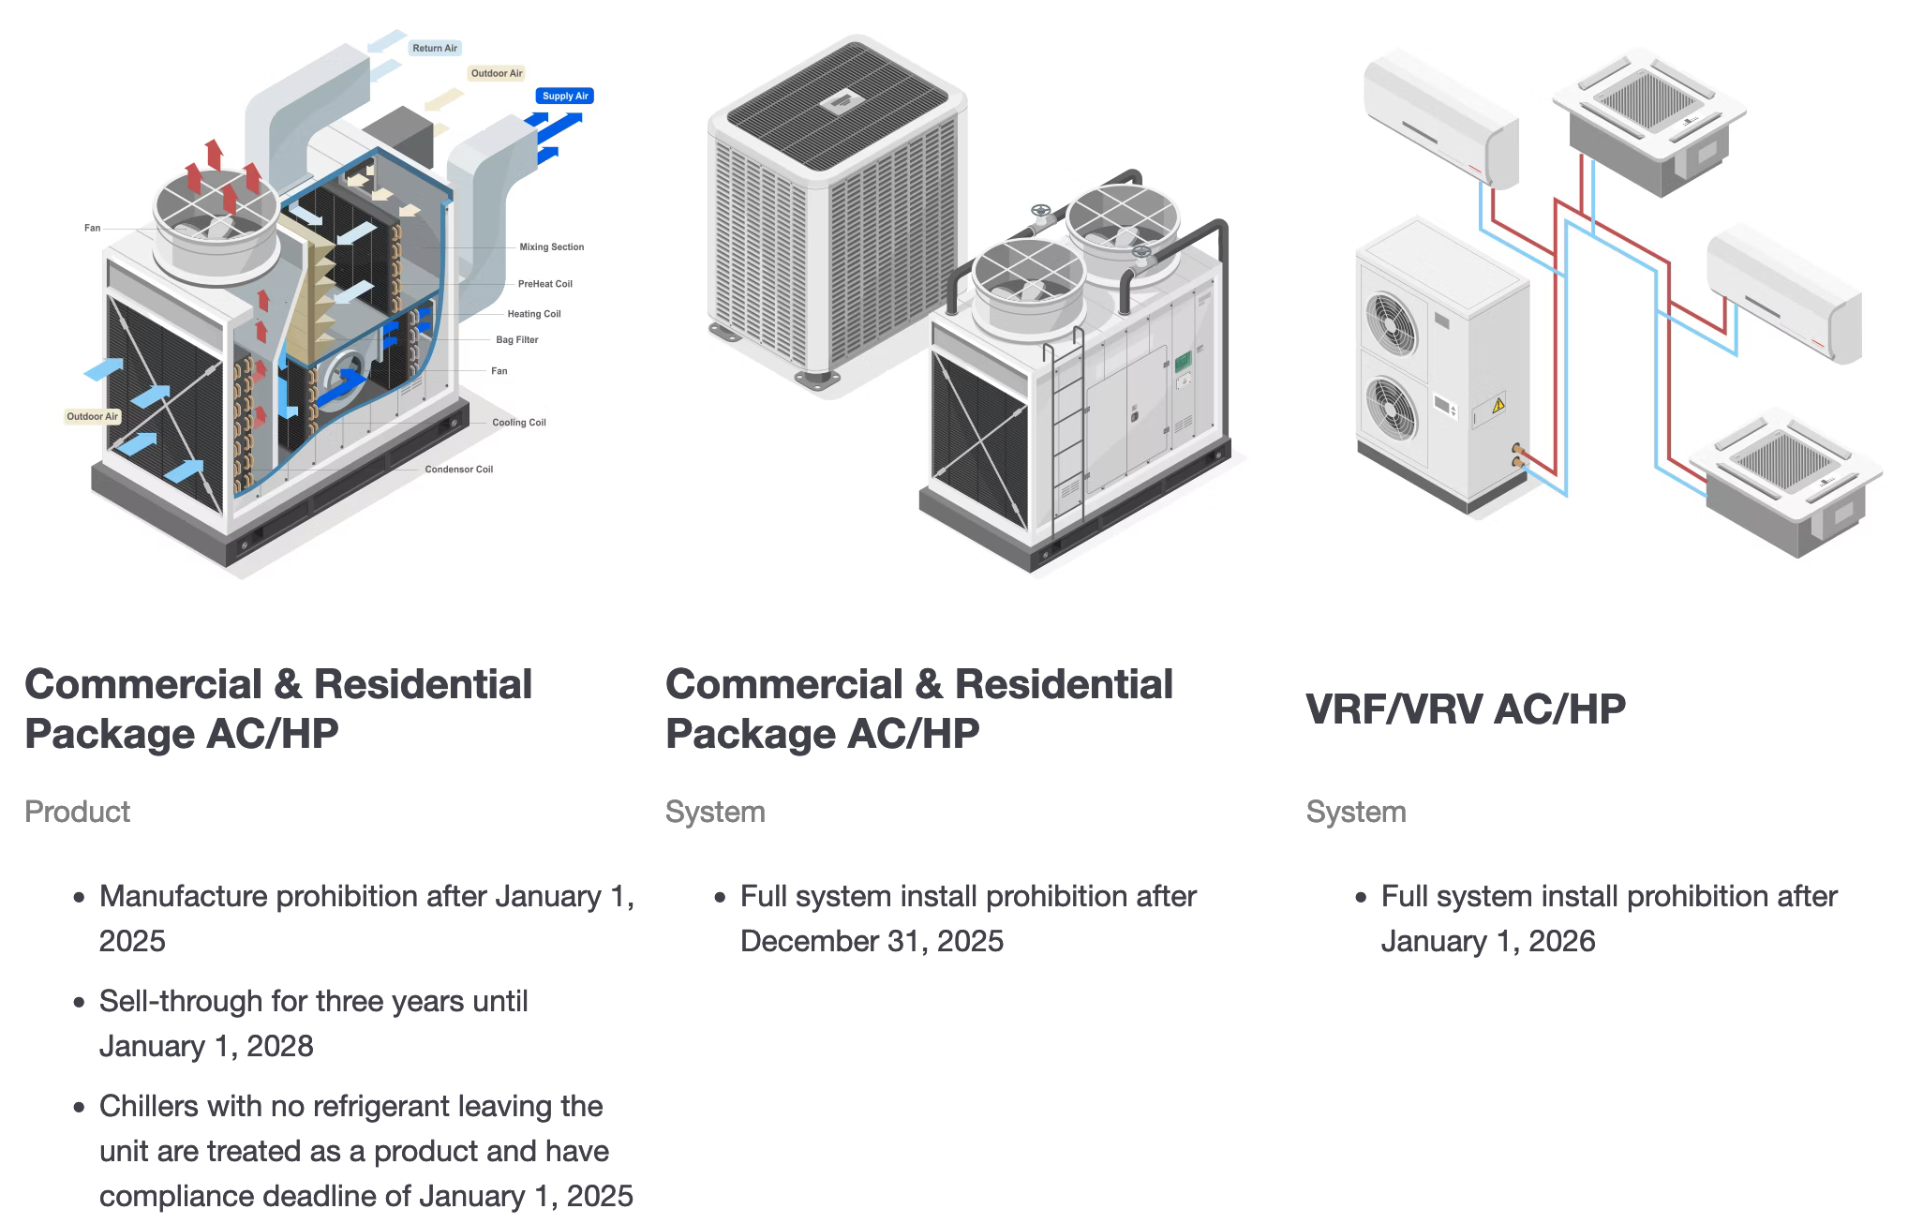
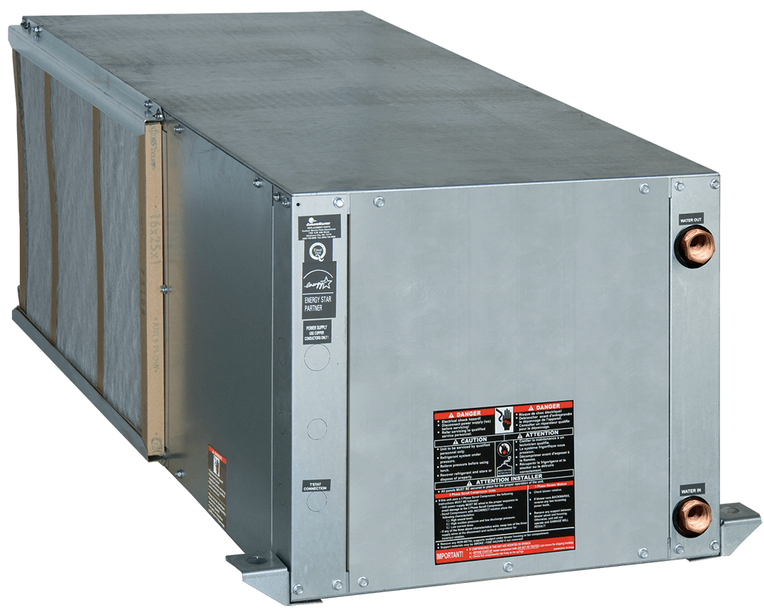
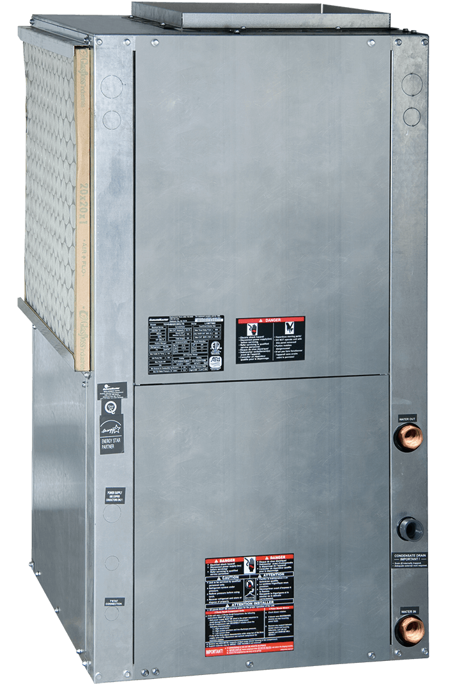
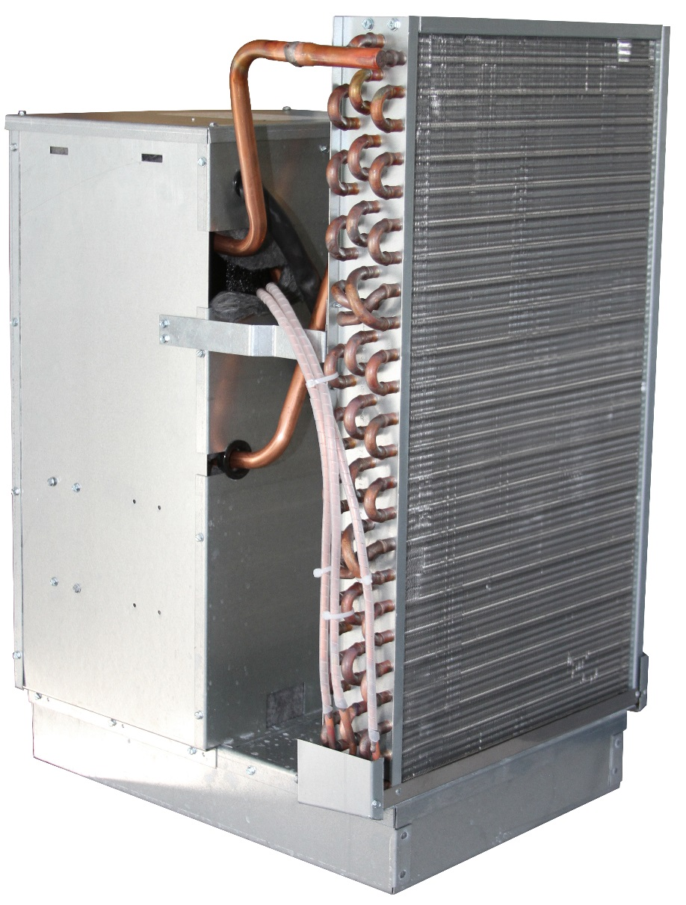
AC / Heat Pump Transition Timeline
Commercial & Residential Packaged (AC/HP)
VRF / VRV (AC/HP)
PRODUCT (sealed system)
SYSTEM
SYSTEM

Slide 5
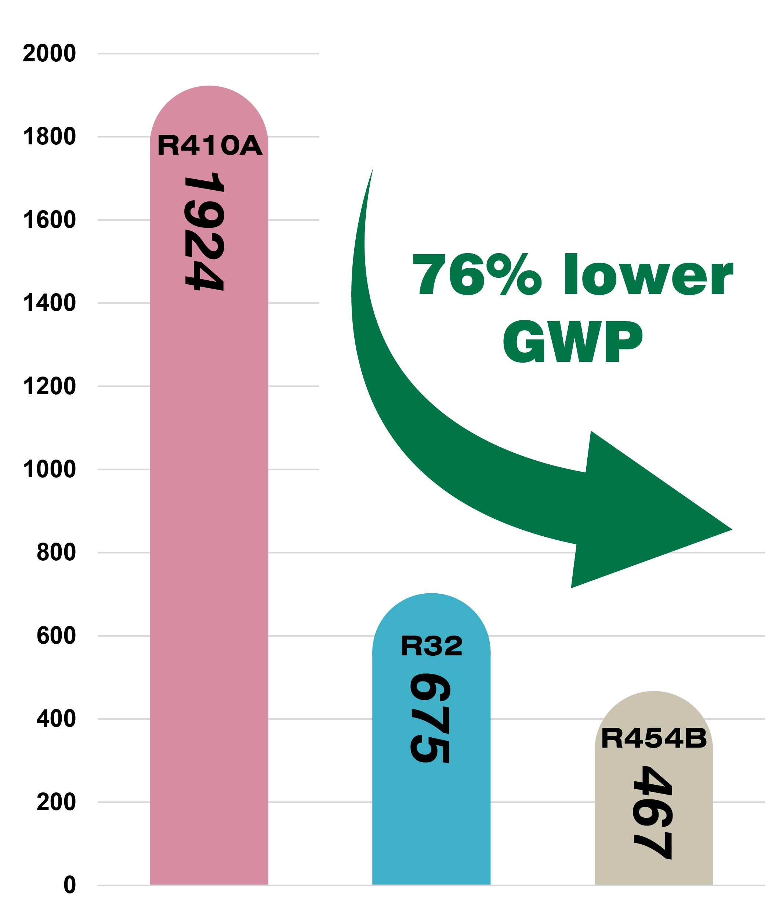
Refrigerant Global Warming Potential
Whalen is using R-454B refrigerant
Lowest widely used GWP option to replace R-410A
76% decrease vs R-410A
34% decrease vs R-32
Ozone depletion of ZERO
Similar operation and efficiency to current R-410A products

Slide 6
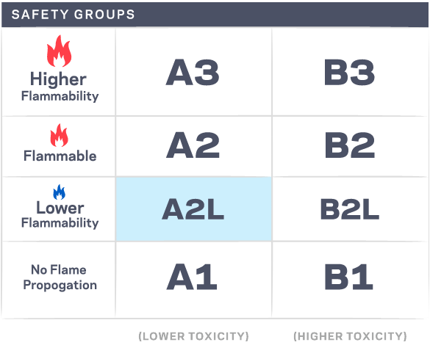
R-454B – A2L CLASS REFRIGERANT
R-454B is classified by ASHRAE as an A2L lower flammability refrigerant
UL 60335 2-40 safety standard requires products with more than 62 ounces of A2L refrigerant to contain a factory installed Refrigerant Detection
If a refrigerant leak is detected, the RDS triggers a system fault & the unit enters a mitigation mode to reduce leaked refrigerant concentration level

Slide 7
Minimum Installation Area
Minimum area where a blower-equipped unit must be installed, and mechanical/natural ventilation is not required

Slide 8
Questions?
Notes:
8

